Slide 1


Introduction to a more-than-human
theoretical framework

Slide 2
Summary
This teaching activity introduces you to a theoretical framework that presents three important concepts to understand the process of doing more-than-human design: assemblage, constituency, and pluriversal perspectives.
The framework and the concepts are clarified by comparing them to the Double Diamond framework for Human-Centered Design.
Learning outcomes
After the teaching activity, you should be able to:
Explain in your own words what the concepts assemblage, constituency, and pluriversal perspectives mean in the context of more-than-human design.
Compare more-than-human design with human-centered design by describing similarities and differences.
Discuss some of the considerations, difficulties and opportunities related to the different concepts.
If the teaching activity is used in conjunction with one or more other teaching activities on the OER, students should also be able to:
Describe the connection of the different activities that we will work on during this course/module to the concepts presented here. (REMOVE WHEN NECESSARY)

Slide 3
Content
Going from human-centered design to more-than-human design
Assemblage
Design constituency
Pluriversal perspectives, and some ways to do so:
Learning from Indigenous Ways of Knowing
Adopting Pedagogies from Environmental Science Education
Applying Artificial Intelligence
Group assignment

Slide 4
Key readings
Escobar, Arturo (2018) Designs for the Pluriverse: Radical Interdependence, Autonomy, and the Making of Worlds. Duke University Press.
Giaccardi, Elisa; Redström, Johan; and Nicenboim, Iohanna (2024). The making(s) of more-than-human design: introduction to the special issue on more-than-human design and HCI. Human–Computer Interaction, 1–16. doi:https://doi.org/10.1080/07370024.2024.2353357
Latour, Bruno (2005). Re-assembling the social – an introduction to actor-network theory. Oxford University Press, 2005.
Riley, Kathryn; and White, Peta (2019). "Attuning-with", affect, and assemblages of relations in a transdisciplinary environmental education. Australian Journal of Environmental Education, 35(3), 262–272. https://doi.org/10.1017/aee.2019.30.
Wakkary, Ron (2021). Things we could design for more-than-human-centered worlds. The MIT Press.

Slide 5
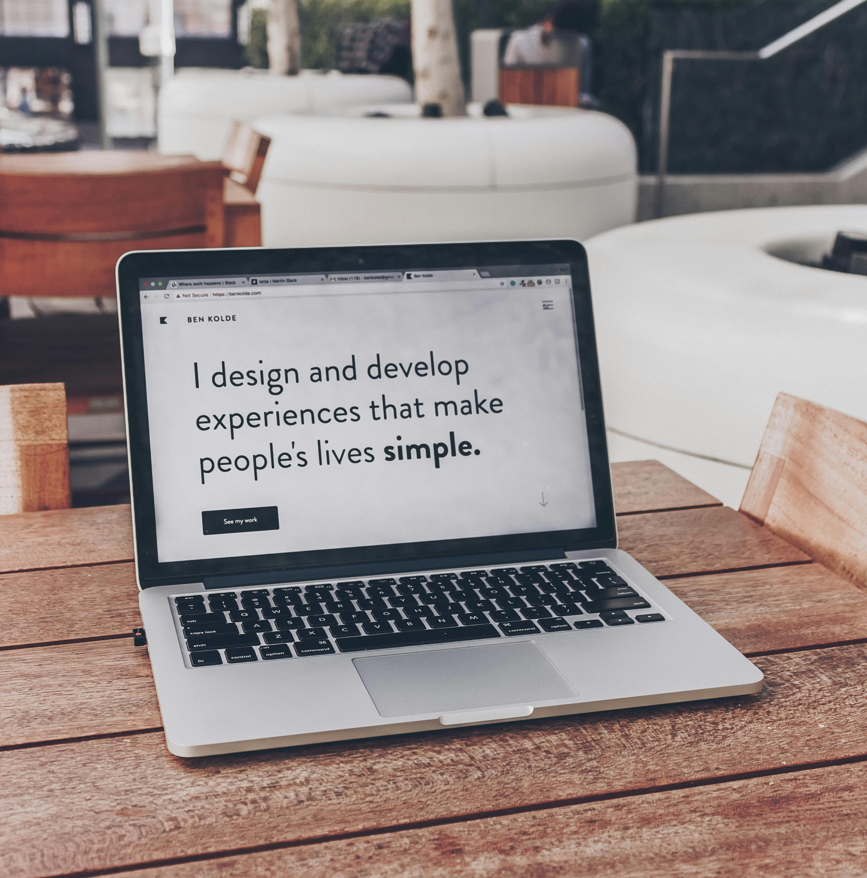
From Human-Centered Design…
Human-Centered Design is an approach to problem-solving commonly used in process, product, service and system design that develops solutions to problems by involving the human perspective in all steps of the problem-solving process. Human involvement typically takes place by observing the problem within context, brainstorming, conceptualizing, developing concepts and implementing the solution.
Photo by: Ben Kolde https://unsplash.com/photos/white-and-black-laptop-bs2Ba7t69mM

Slide 6
Human-Centered Design Process
Often, the Double Diamond model is used to visualize the Human-Centered Design process (Design Council, 2005).
Humans are actively involved in the different steps of the model.
FINDING THE RIGHT PROBLEM
FINDING THE RIGHT SOLUTION
ALTERNATIVES
Divergence
Convergence
Divergence
Convergence
TIME

Slide 7
…to More-than-Human Design
How can we consider and involve more-than-humans in a similar process?

Slide 8
Connecting More-than-Human Design to Human-Centered Design
ASSEMBLAGE
CONSTITUENCY
FINDING THE RIGHT PROBLEM
FINDING THE RIGHT SOLUTION
ALTERNATIVES
Divergence
Convergence
Divergence
Convergence
TIME

Slide 9
Assemblage
To find "the right problem" (locating and working with what is worth investigating), it is necessary to have a deep understanding of the context.
This can be done by studying different assemblages.
An assemblage is a technical term for a network, where humans and more-than-humans (fellow beings and things), and even concepts or ideas are connected (Latour, 2005).
Each node in this network is called an actor/actant.
Each actant can be part of many different networks, and there are networks of networks.
There is an indefinite number of assemblages.

Slide 10
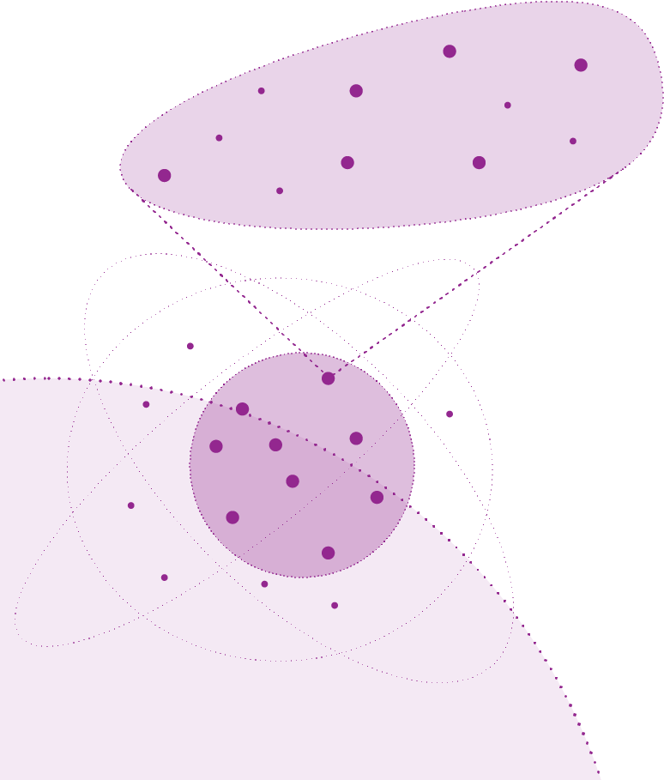
transport
sales
grounding
packaging
wheat
Assemblage example:
Birthday Cake
A birthday cake consists of several components — such as flour, sugar, and eggs — as well as the devices and labor used to make it — such as an oven, man-power, and a wooden spoon. These actors can be broken down further.
The flour in a birthday cake was grown as wheat and then ground into a fine powder, packaged, sold, and so on. This can be considered another assemblage.
The birthday cake can also be an actant in another assemblage, such as the assemblage of a birthday party (Cresswell et al., 2010).
Flour assemblage
chocolate
flour
sugar
eggs
Birthday Cake assemblage
spoon
man-power
oven
candles
oven
Birthday Party assemblage

Slide 11
Questions about the assemblage
To gain a better understanding of the assemblage, designers may ask themselves:
What is the structure of the assemblage?
What are all the elements of a specific assemblage that make up the social and environmental ties between human and more-than-human actors?
How is the assemblage held together and by which types of connection?
How does action take place in the assemblage?
What are the key actions that mobilize the assemblage? And who and what can be held accountable for an action?
Which action influences or is influenced by which humans or more-than-humans act in the assemblage, in what ways?

Slide 12
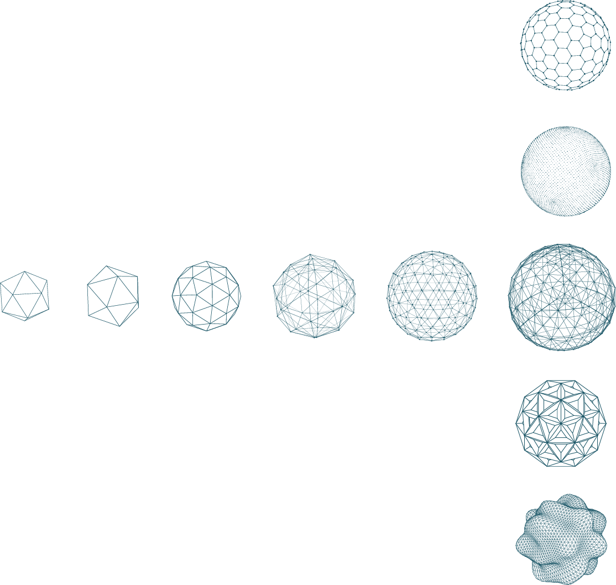
Panorama
Your view on an assemblage is always limited to a panorama (Latour, 2005).
Different points of view result in different panoramas. It is not possible to gather all points of view.
By sharing your panorama with others, and through collaboration, you can refine your panorama until it feels like a coherent 'whole'.

Slide 13
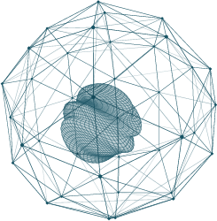
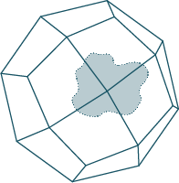
The new design as part of the panorama
The designer, who is about to design a new technology, will design an element that will eventually become part of the assemblage, which in turn will change the picture of the panorama.
When creating the initial panorama, the design is not present yet; there is only a vague notion of the new design.
Through design iterations, both the design and the panorama will become clearer and more refined.

Slide 14
Questions about the panorama and design
To gain a better understanding of the relationship between panorama and design, designers may ask themselves:
Where in the panorama could the new design be placed and what influence might it have on the assemblage (possibly leading to alternative panoramas)?
How might the new design reassemble the types of connection inside an assemblage or between assemblages?

Slide 15
Example design brief:
Tomato Harvesting Technology
The task is to develop a tomato harvesting technology for an urban farming initiative.
The farm has an abundance of tomatoes, and they do not want to let them go to waste.
However, the number of volunteers to help pick the tomatoes is not large enough.
The municipality is willing to support the farming initiative by financing the design of a cheap technology that can be of help.

Slide 16
Understanding the assemblage
Example design brief: Tomato Harvesting Technology
To understand the assemblage, the designer can start with one element and investigate its connections. For practical reasons, it may be helpful to start investigating assemblages from the starting point of (some of) key actors mentioned in the design brief, such as the tomato, the farmer, the volunteers, or even the municipality.
For example, we could start with the tomato:
The tomato has a connection with the farmer who decides to sow tomato seeds, how many, where, and when.
The tomato has a connection with the soil that feeds it.
The tomato has a connection with the sun, which provides the tomato plant with the energy to grow.
The tomato has a connection with insects, such as predatory wasps, ladybugs, and lacewings, which help tomato pollen spread.
The tomato has a connection to the harvesting crates, in which the tomatoes are placed once they have been picked.
The tomato has a connection with the scissors with which they are pruned.
It is impossible to understand all connections, but we aim to uncover as many relevant connections as possible.
Starting from the tomato does not mean that it should remain the center of the assemblage. As everything is connected, the designer may discover another element in connection to the tomato or one of its connections that makes more sense as a central element and go from there to further draw the connections.
There are no clear boundaries to an assemblage. Still, what the designer considers as the assemblage should make sense to them as a coherent whole—that is, a panorama—after investigating the network.

Slide 17
Painting and refining the panorama
Example design brief: Tomato Harvesting Technology
The designer's understanding of the assemblage around the tomatoes is a panorama.
The designer may share this panorama with the head farmer of the urban farming community.
This may lead to a refined panorama. For example, the designer may have forgotten the link between the tomatoes and the predatory wasps, but by sharing the panorama with the head farmer, they might notice this missing connection, and the designer may add it to the panorama to make it a more holistic picture.
Although the designer aims to create an initial panorama to start the design work, its precise definition remains open until the design process is finished.
In the example of the tomato harvesting technology, the new design may eventually find a place in the heart of the panorama because it is directly linked to the tomatoes that will be harvested by it, to the head farmer, who may adapt the planning to it, but also to the soil that may get compacted by it.

Slide 18
Constituency
According to Wakkary, designers bring together humans and more-than-humans in a design process. He calls for a political structure – a constituency – for who/what participates in the making of a new design.
A constituency is a convening of both humans and more-than-humans to discuss their involvement in the design process.
The designer should make a conscious choice about which actors in the assemblage they pay attention to and give a voice to. They must exercise with caution to avoid including only convenient stakeholders; it is important to broaden engagement and actively consider perspectives beyond those traditionally included in human-centered approaches.
You can see the constituency as a group of co-designers, bringing together key human and more-than-human actors to discuss what can and should be made.
Members of the constituency can be initiated by a smaller subset of the panorama that are deemed particularly concerned and relevant, including the designers themselves.
The constituency, like any form of assemblage, is never fixed. According to Tomico, the designer is responsible for constantly `maintaining, caring for, and refining the gathering that is the constituency'.
Over time, additional elements may be incorporated into the panorama, potentially resulting in a reassembly of the constituency.
This is an iterative process in which both the panorama and the constituency become increasingly clear and more concrete.

Slide 19
Questions about the constituency
The following questions are pertinent for designers to consider when convening a constituency:
Who/what do I consider members of the constituency?
Whose voice(s) do I give priority to?
How do different fellow beings benefit from taking part in a constituency around a design?
How do I make participants in the constituency speak? In other words: how do I listen?
What modes of communication may I use to give voice, to listen, and to “do-it-with-others”?
How aware am I, as a designer, of my own position in an assemblage and constituency, my own intentionality,
and my limited view?
What role and obligations do I have when designing with participants in a constituency?
In what ways should participants in a design constituency be involved in creating a new design?
How should the design be maintained? By whom and by what?

Slide 20
Example design brief: Tomato Harvesting Technology
Constituency for the tomato harvesting tech
the designer may decide to invite the head farmer, the community farmers, the volunteers, the tomatoes, the predatory wasps, ladybugs, and lacewings, and the soil in the design constituency.
However, the designer may decide to give priority to the voices of the head farmer, the community farmers, and the soil.

Slide 21
Understanding assemblages and constituencies seems very hard...
There are no definitive answers, you cannot understand the assemblage completely or paint the perfect panorama or invite the best constituency.
The only thing you can do is to investigate broadly and deeply.
Escobar’s (2018) idea of the pluriverse can contribute to this discussion.
The pluriverse is a world consisting of many worlds, each with its own ontological (the study of what exists/is) and epistemic (the study of how we know what we know) grounding.

Slide 22
Pluriversal perspectives
By inviting multiple perspectives and ways of seeing, designers can deepen the panorama and constituency.
In that way, they enrich the ‘broth’ that they use for ‘cooking’ when creating a new ‘dish’ - a new design. The following quote from Lent (2017) exemplifies this distinction:
“The Marquis of Qi said, ‘Only Chü is in harmony with me!’ Yen Tsu replied, ‘All that Chü does is agree with you – wherein is the harmony?’. ‘Is there a difference between harmony and agreement?’ asked the Marquis. Yen Tsu replied, ‘There is. Harmony is like making broth. One uses water, fire, vinegar, sauce, salt, and plum to cook his fish and meat, and burns firewood and stalks as fuel for the cooking process. The cook blends these ingredients harmoniously to achieve the appropriate flavour. Where it is too bland, he adds flavouring, and where it is too concentrated, he dilutes it with water. When you partake of this broth, you feel most content. The relationship between ruler and minister is the same’ . . . ‘Now Chü is not acting accordingly. Whatever you say is right, Chü also says is right; whatever you say is wrong, Chü also says is wrong. If you add water to flavour water, who can eat it?’“ (Lent, 2017, p. 186)

Slide 23
Inviting pluriversal perspectives
Three possible ways to invite pluriversal perspectives:
Learning from Indigenous Ways of Knowing
Attuning with Nature
Applying Artificial Intelligence

Slide 24
Pluriversal Perspective I.
Learning from Indigenous ways of knowing
One way for designers to pay attention to worldviews that are radically different from the Western worldview, is by inviting Indigenous and traditional worldviews.
Since many Indigenous worldviews already take more-than-human perspectives into account, they can help to define the assemblage and the constituency.
However, this approach also comes with pitfalls and responsibilities:
Indigenous peoples have sometimes been mistreated and misled by researchers in the distant and recent past.
An important concept is relational accountability, which is about creating and maintaining respectful and mutually beneficial relationships between the designers and the Indigenous communities that are part of the constituency.
This means that there should be reciprocity in the relation: those who contribute to a design project should benefit from the results of the design.
Many Indigenous ways of seeing species and entities involve spiritual conceptions of what they are, which can be highly problematic in the context of Western academia.

Slide 25
Pluriversal Perspective I.
Questions when learning from
Indigenous ways of knowing
How can I, as a designer, relate respectfully to Indigenous knowledge and to those who share this knowledge with me?
How can I apply this knowledge in respectful ways?
How do all participants benefit from taking part in a constituency around the design?
In what ways can more-than-human design improve our relations with nature?
When and in what cases should I pay attention to cultural and spiritual conceptions of the more-than-human?
What kinds of tensions in worldviews might the design operate from or across?
What knowledge do I rely on and consider valid?

Slide 26
Pluriversal Perspective II.
Attuning with nature
Another way to investigate the assemblage and give more-than-humans a voice is by sensitising the humans involved in the design process (both the human designer and the human co-designers) to the more-than-humans that are part of the constituency.
This can be done through embodied ways of attuning with nature.
More specifically, one way to do this is through some of the pedagogical methods that have been developed in the field of (early childhood) environmental science education.
Slow pedagogies: allow people to pause or dwell in spaces for more than a short moment .
Wild pedagogies complement slow pedagogies and assume that an important part of education can include activities meant to provide fertile ground for purposeful experience without seeking to control the results or those involved.

Slide 27
Example design brief: Tomato Harvesting Technology
Slow and wild pedagogies for the design brief
Human co-designers might consider relating to the tomatoes by engaging in the hands-on practice of growing, caring for, and harvesting the tomatoes.
Slow pedagogy could involve participatory design workshops that invite citizens to urban gardening events to feel the soil, touch the leaves, and taste the fruits.
Wild pedagogy could involve an invitation to visit the farm and wander around.

Slide 28
Pluriversal Perspective II.
Embodiment
Humans always interact with nature through embodiment, including technologies.
The designer needs to consider which embodiments are going to be used and how this may affect relationships with nature.
For example, we might look at nature through magnifier glasses and establish a scientific relationship with nature before we touch it and establish an emotional relationship with what we touch.
By attuning with nature through slow and wild pedagogies, we notice much more than, e.g., the grass that needs mowing in our gardens or the hedges that need to be cut. We notice the hedgehogs, the insects, and the bird nests in the hedge.

Slide 29
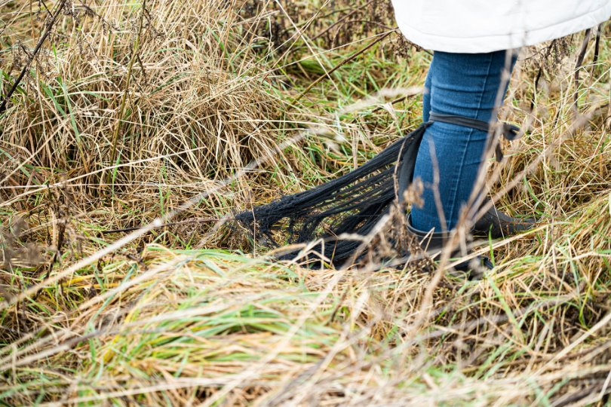
Pluriversal Perspective II.
Questions to ask about embodiment
What different sensual modalities can be activated beyond vision? And through which embodiments?
How might new designs, as a new form of an embodiment, shape how humans attune with the environment?
Photo by Lucas Loorbach: walking around an area with hair-like equipment to experience an animal's perspective

Slide 30
Pluriversal Perspective III.
Applying AI
Within HCI, the use of Artificial Intelligence (AI) is gaining popularity.
AI may also be a useful tool in more-than-human design.
For example, when AI learns from big data associated with more-than-humans, data mining might enable humans to fathom large complex patterns and thus understand things more holistically.
When ecosystem data are mapped to the functionalities of urban (infra)structures, these structures can be harmonized with the workings of ecosystems and thus contribute to making humans live more sustainably.
AI methods might also offer the potential to create simulations of life forms in ecosystems and test how different agendas might affect the constituencies.

Slide 31
Pluriversal Perspective III.
Risks with applying AI
AI is a projection of the human programmer and their worldviews.
The use of AI in more-than-human design can be problematic if AI programmers lack an awareness of ethical concerns and an understanding of the different contexts and constituencies within which the AI that they have conceived is operating.
There is a tendency among designers to anthropomorphize or zoomorphise AI as an entity that is separate from the human. Designers may therefore perceive AI as something that is like a magic wand, an oracle, or a wildcard. Consequently, there is a danger of understanding AI as something that is akin to nature – a separate species.
Most AI methods used in the field of Internet of Things (IoT) mainly target urban environments. However, they may also target natural environments. Being naive about the consequences of implementing AI in urban or natural environments, while not quite understanding what the machine-learning algorithms are about, can cause more harm than good.

Slide 32
Pluriversal Perspective III.
Questions to ask when applying AI
Related to these risks, the designer might ask the following questions:
Who designed the AI? Where is the data coming from that shapes the AI? Which worldviews may therefore be incorporated in the AI?
What would be the appropriate degree of agency to give to the AI?
What are the consequences of implementing AI in natural environments?

Slide 33
What about the second diamond?
With More-than-Human Design in its infancy, there are no specific methods yet.
Most More-than-Human Design is currently of a more speculative nature.
Methods from Human-Centered Design may be used in combination with a More-than-Human Design perspective to give form to a new technology. The design, the panorama in which the design is situated, as well as the constituency that revolves around the design will become clearer and more concrete as you go through iterative design cycles.
FINDING THE RIGHT PROBLEM
FINDING THE RIGHT SOLUTION
ALTERNATIVES
Divergence
Convergence
Divergence
Convergence
TIME

Slide 34

GROUP WORK Consider the following design brief:
A housing company has built a new student complex close to the university. There are 250 rooms, half of them with balconies, and there is a common garden. As the complex is the first of its kind in this area, the housing company is concerned that it will get messy because the students do not feel connected to each other and the area. The housing company would like you to design something to help the new students feel more connected and responsible for their rooms, the building, the garden, and each other.
Image from Microsoft Powerpoint

Slide 35
GROUP WORK
Take this design brief and place it in the context of your institution (where is it? You can come up with your own idea).
Discuss the different assemblages, panoramas and constituencies for this design brief.
Create a short plan/presentation for how you would go about working further on this project.
Be specific on the more-than-humans you would consider and involve in the design and how.
Work in groups for 60 minutes, after which you will be asked to present your plan for 5 minutes.

Slide 36
References
Cresswell, Kathrin. M.; Worth, Allison; Sheik, Aziz. (2010). Actor-Network Theory and its role in understanding the implementation of information technology developments in healthcare. BMC medical informatics and decision making, 10(1), 1–11.
British Design Council. (2005). The Double Diamond. https://www.designcouncil.org.uk/our-resources/the-double-diamond/
Escobar, Arturo. (2018) Designs for the Pluriverse: Radical Interdependence, Autonomy, and the Making of Worlds. Duke University Press.
Giaccardi, Elisa; Redström, Johan; and Nicenboim, Iohanna (2024). The making(s) of more-than-human design: introduction to the special issue on more-than-human design and HCI. Human–Computer Interaction, 1–16. https://doi.org/10.1080/07370024.2024.2353357
Latour, Bruno. (2005). Re-assembling the social – an introduction to actor-network theory. Oxford University Press.
Lent, Jeremy. 2017. The Patterning Instinct: A Cultural History of Hu. Promotheus Books.Riley, Kathryn, and Peta White. “‘Attuning-with’, affect, and assemblages of relations in a transdisciplinary environmental education.” Australian Journal of Environmental Education 35(3) (2019): 262–272. https://doi.org/10.1017/aee.2019.30
Riley, Kathryn; and White, Peta. (2019). "Attuning-with", affect, and assemblages of relations in a transdisciplinary environmental education. Australian Journal of Environmental Education, 35(3), 262–272. https://doi.org/10.1017/aee.2019.30.
Wakkary, Ron. (2021). Things we could design for more-than-human-centered worlds. The MIT Press.
Wilson, Shawn. (2008). Research is ceremony – indigenous research methods. Fernwood publishing.

Slide 37
This teaching activity was developed as part of the MOVA project co-funded by the European Union. https://mova.uni.mau.se/
Disclaimer: Funded by the European Union. Views and opinions expressed are however those of the author(s) only and do not necessarily reflect those of the European Union or the European Education and Culture Executive Agency (EACEA). Neither the European Union nor EACEA can be held responsible for them.

