Slide 1


Redesigning from a
more-than-human-centred perspective

Slide 2
Summary
In this teaching activity, students will make a tangible ecosystem web (from popsicle sticks and yarn). This contextual ecosystem web supports understanding the specific ecosystem involved around the design at the start of a project and promotes consideration of the more-than-human world. In a later stage, it allows students to assess how their design impacts this ecosystem and helps them to define concrete design requirements to improve more-than-human inclusivity. They will document positive and negative impacts elicited by design on more-than-human actors, noting the design elements causing these impacts and their intensity. This will spark a collaborative brainstorm on redesign suggestions to mitigate negative impacts.
Learning outcomes
After this activity you should be able to:
Identify the impact of a design in an ecosystem.
Construct a dynamic web of the ecosystem affected by the design, identifying relationships and opportunities for redesign from a more-than-human perspective.
Reflect on and discuss the insights gained from the activity and propose ways to apply this method in future projects.
Reflect on their role and responsibilities as designers within the more-than-human world.

Slide 3
Outline/Content
Introduction and defining actors
Introduction and defining actors
Embodied web and redesigning
Reflection
Embodied web & redesigning

Slide 4
Key readings
De Roo, B., & Ganzevles, G. A. (2023). The umwelt-sketch as more-than-human design methodology. Designing Interactive Systems Conference. https://doi.org/10.1145/3563703.3596628

Slide 5
More-than-human-centred design
expands the scope beyond human users to consider the interactions and well-being of all entities involved, including animals, plants, ecosystems, and technological systems

Slide 6
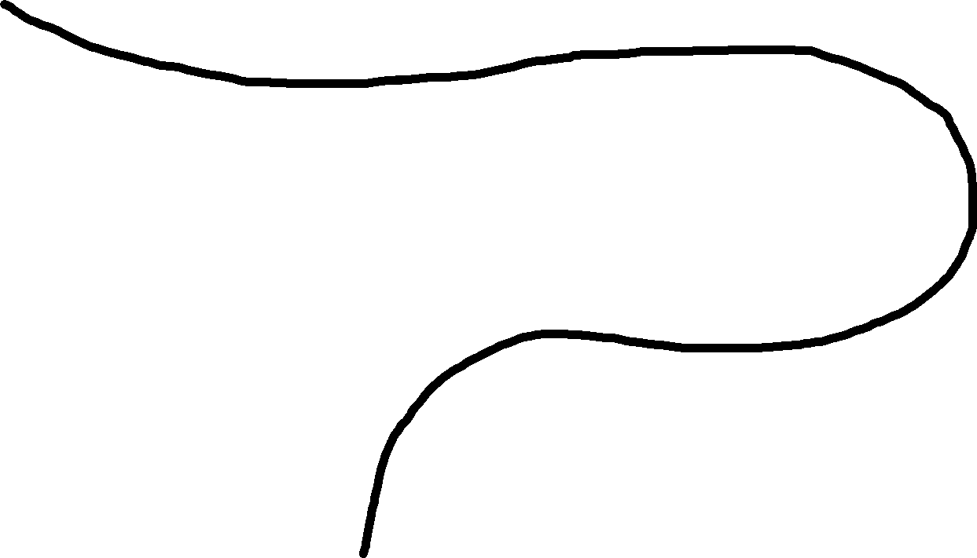
2
3
1
Look individually for actors in the ecosystem.
Make sure you represent both abiotic (e.g., sun) and biotic factors. The latter should consist of different trophic structure layers: primary producers (plants), consumers (e.g., animals, bacteria), detrivores (e.g., worms), and decomposers (fungi)
Create a list of all actors in the ecosystem that are impacted during all lifecycle phases.
Go to an ecosystem that represents the product's lifecycle phase (production/use/after use)
5
4
Part 1
Today
Consider making some actors ambassadors if there are too many
Divide the actors over the popsicle sticks

Slide 7
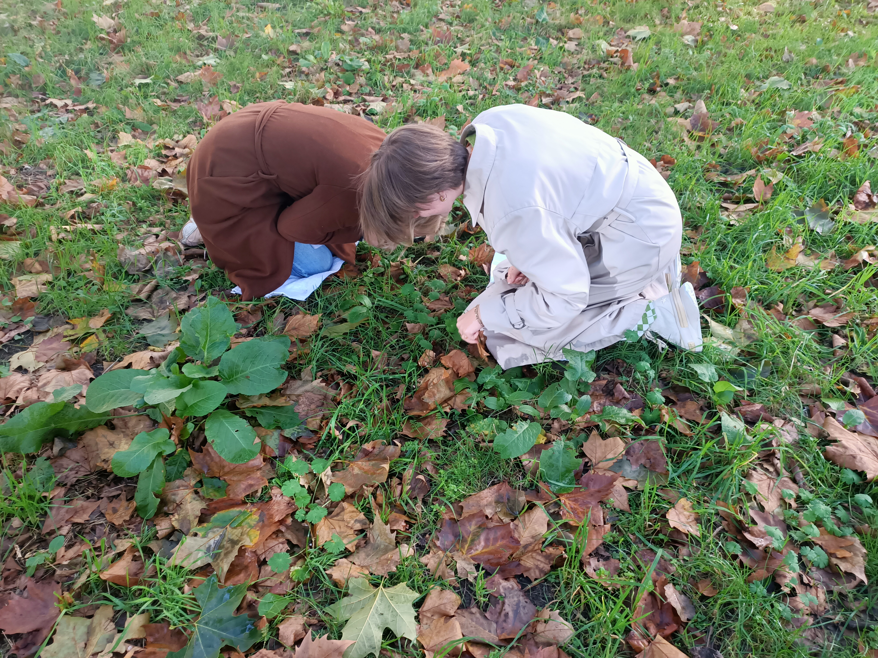
Exploring the context
Defining actors on-site

Slide 8
7
8
6
Make relations between actors with yarn strings and discuss relations
Think about habitat, nutrients, fertilization and food etc.
Consider case impact during the entire product lifespan through intuitive impact expression
Prepare materials
(write actor names on masking tape and put on the popsicle sticks)
10
9
Part 2
Today
Attach the worksheets on the right location in the web
Define impact through worksheets
11

Slide 9
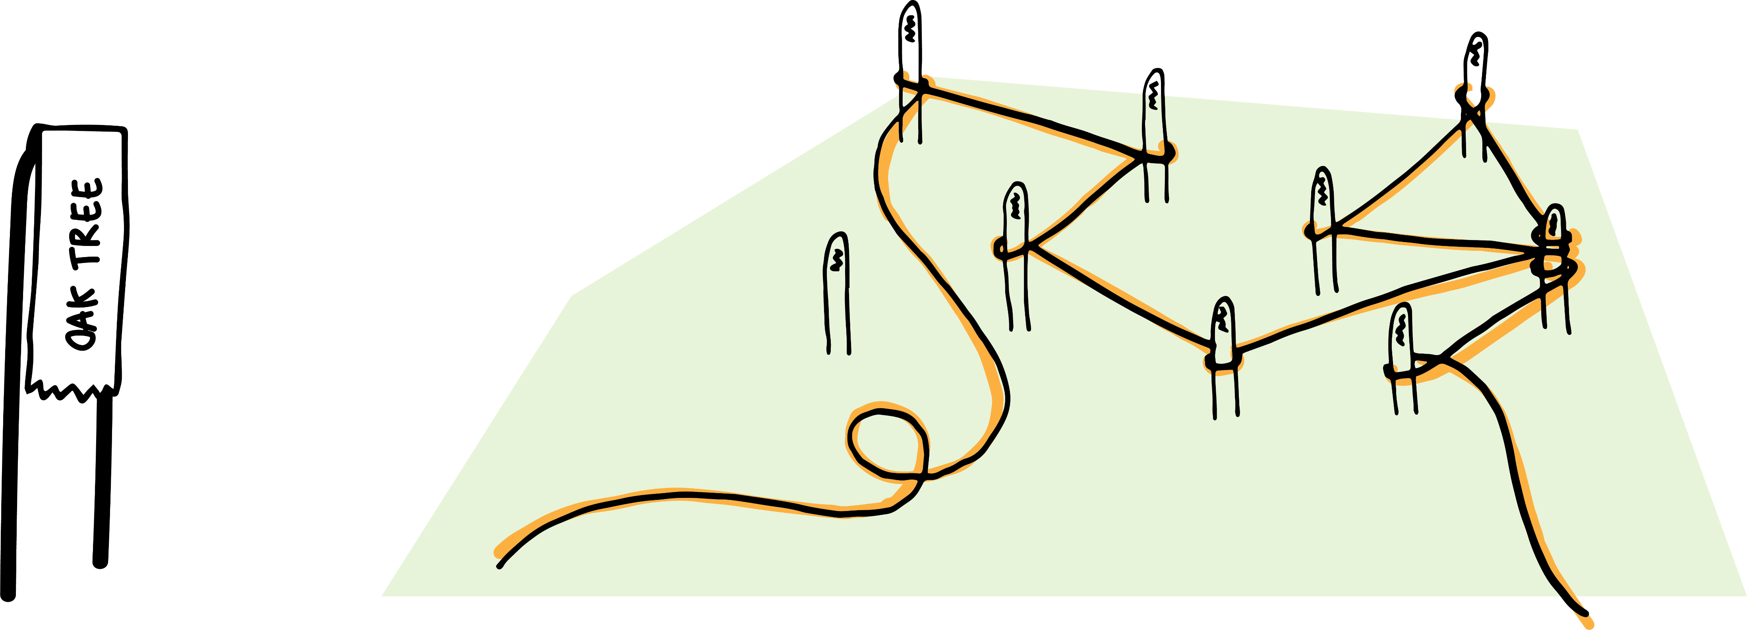
Making
the web
Defining actors
relationships

Slide 10
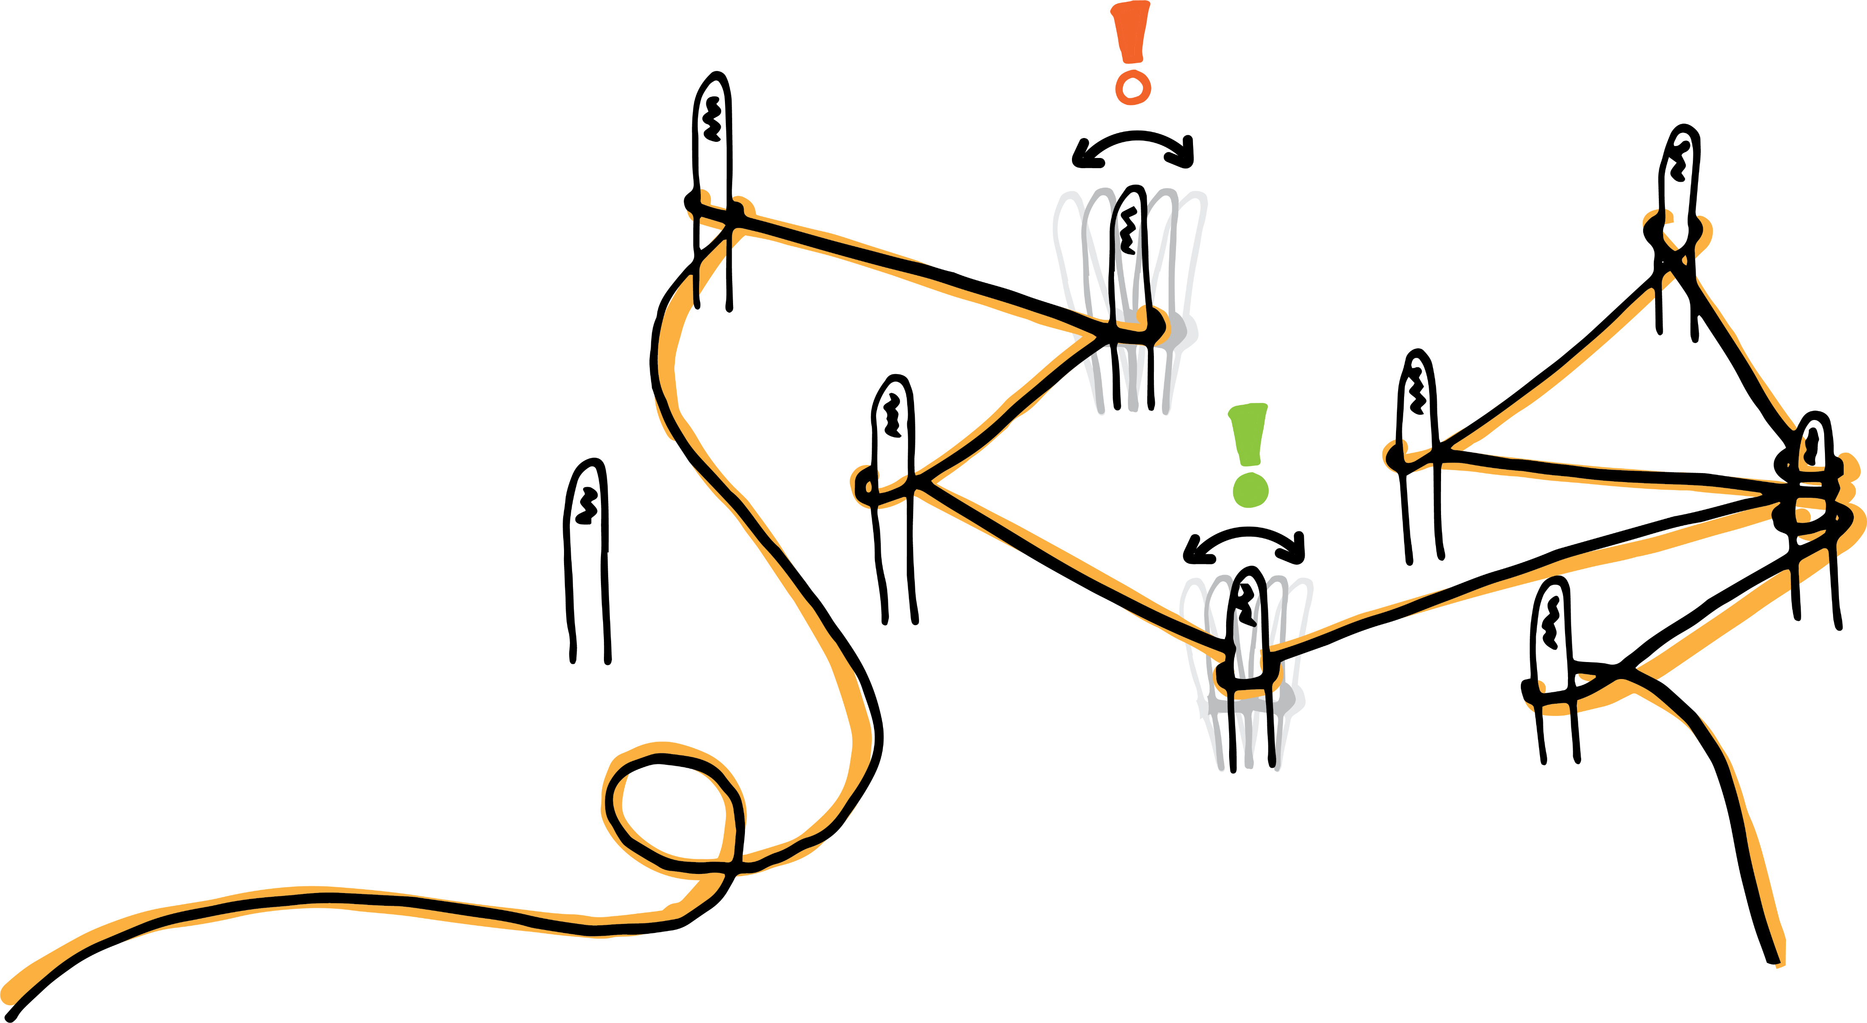
Who is affected most?
Making
the web
Distributing impact caused by the design

Slide 11
13
14
12
Ideate for redesign suggestions for each impact-worksheet
Use the worksheets as a to-do list to inform the next steps in your design process, further investigating and implementing the redesign suggestions.
Consider which actors are the most negatively impacted. Make a prioritization.
15
Part 3
Today
clean up the activity by gathering all materials used. Make sure no materials are left behind in the ecosystem.

Slide 12
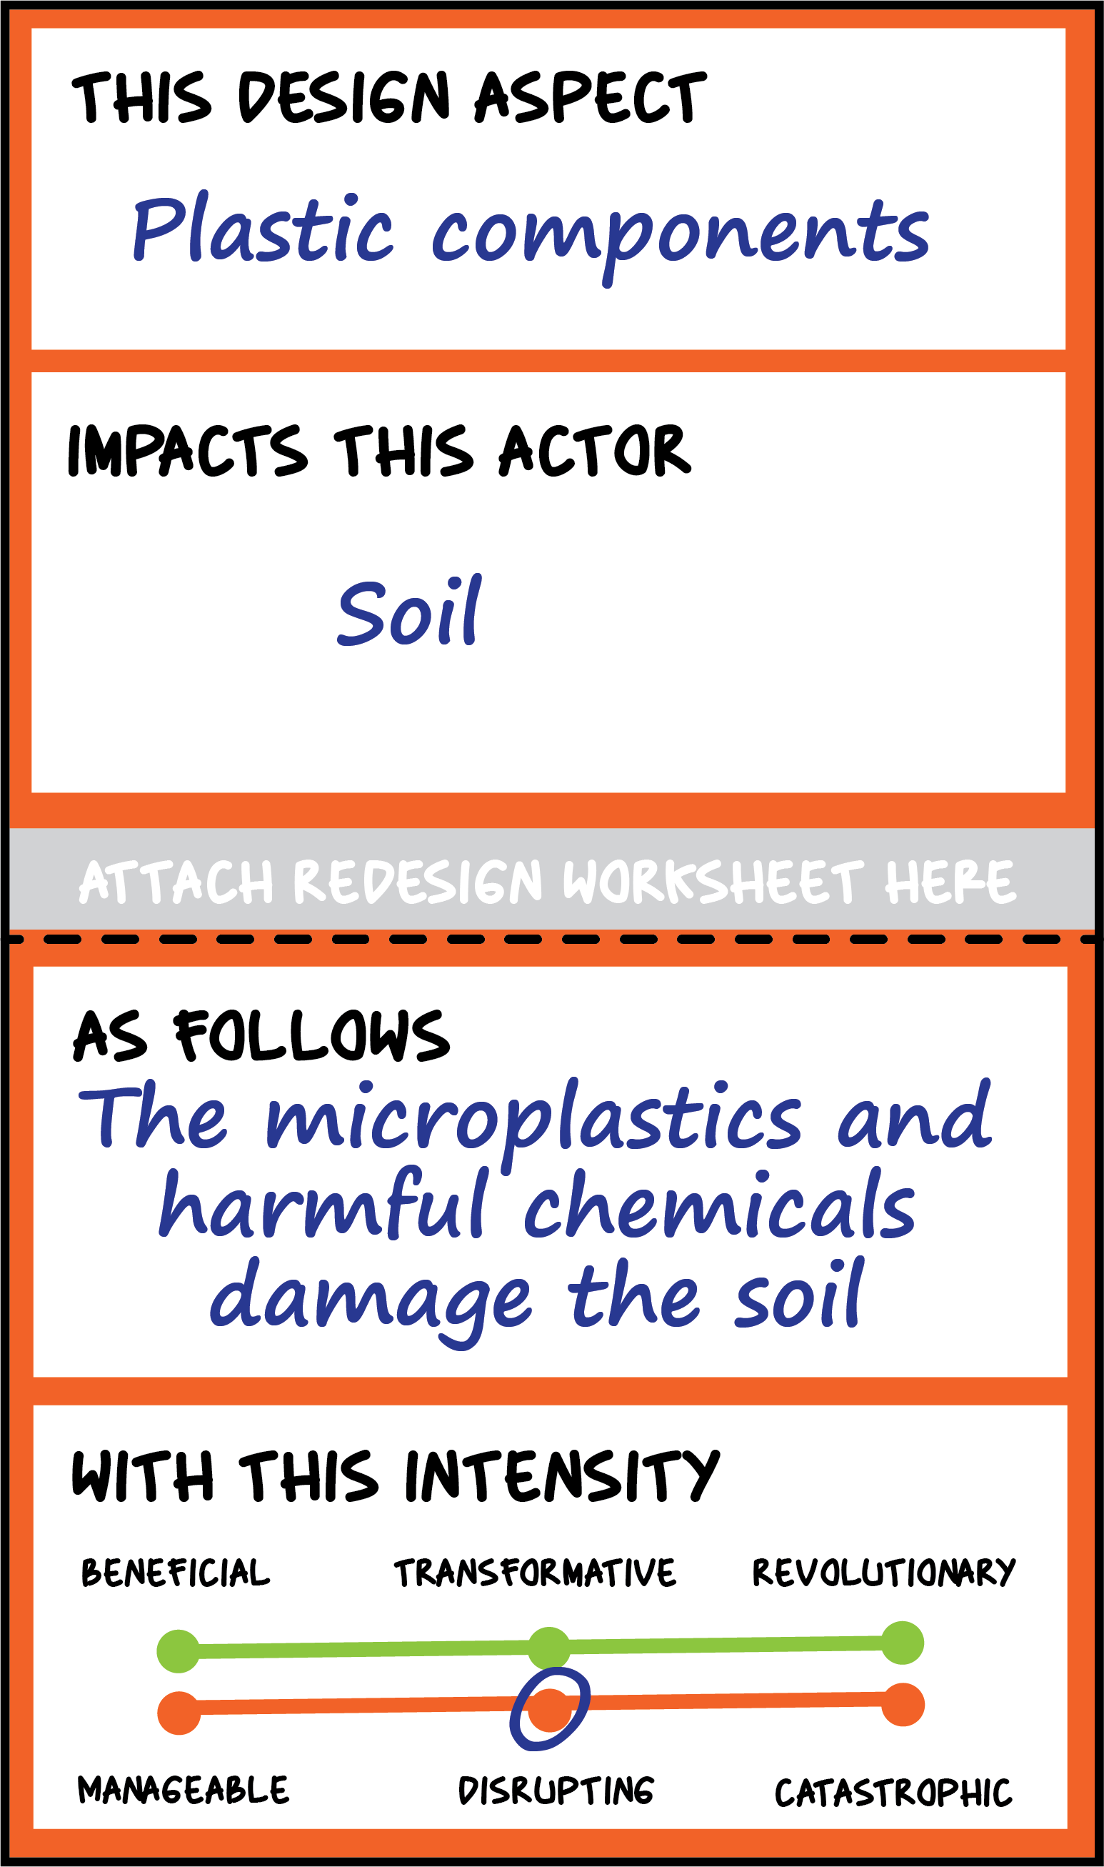
Making
the web
Distributing impact caused by the design

Slide 13
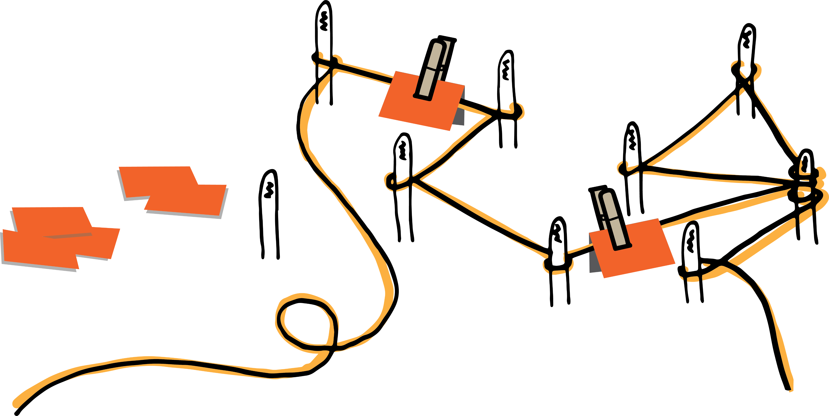
Who should get priority?
Making
the web
Distributing impact caused by the design

Slide 14
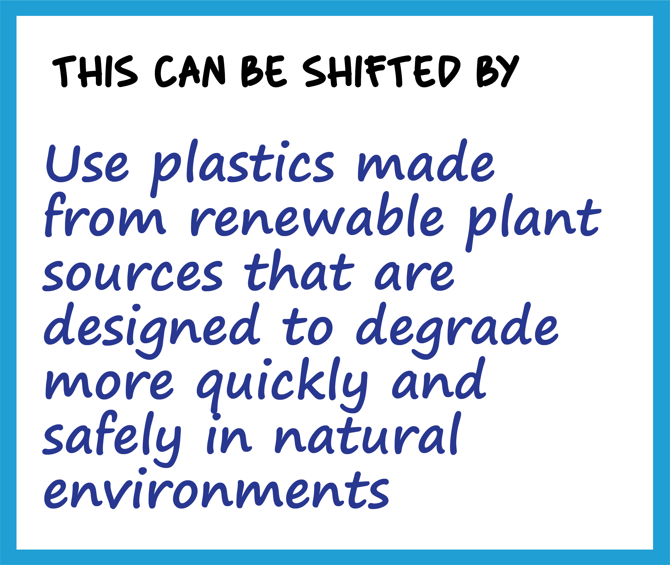
Making
the web
Ideating redesign solutions

Slide 15
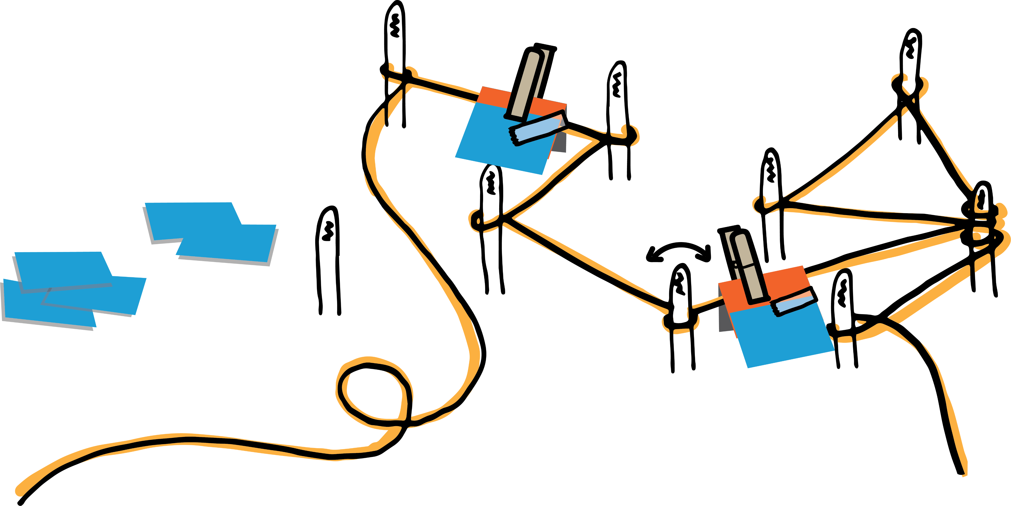
Making
the web
Ideating redesign solutions

Slide 16
Let's reflect!
Share the insights of the activity with the other groups and discuss differences in the mappings/actors included.

Slide 17
This teaching activity was developed as part of the MOVA project co-funded by the European Union. https://mova.uni.mau.se/
Disclaimer: Funded by the European Union. Views and opinions expressed are however those of the author(s) only and do not necessarily reflect those of the European Union or the European Education and Culture Executive Agency (EACEA). Neither the European Union nor EACEA can be held responsible for them.

