Slide 1


Provocations and more-than-human perspectives in design

Slide 2
Summary
This teaching activity introduces students to what provocations are in relation to more-than-human perspectives in design. We distinguish between provotypes, as the materialisation of provocations in design artefacts, and provotyping as a process to trigger and pose tensions and dilemmas of current everyday practices. We illustrate how provocations can be materialised and experimented with and why designerly provocations complements current design methods to cultivate design explorations that accommodate alternative approaches for embracing more-than-human perspective.
Learning outcomes
After the teaching activity students should be able to:
Describe provotyping and provotypes in more-than-human perspectives in design.
Construct provotypes in more-than-human perspectives in design.
Evaluate and reflect on provotypes and provotyping in more-than-human perspectives in design.

Slide 3
Outline/Content
What are provocations in design
Why provocations and more-than-human perspectives
How to provotype
When to provotype
Group work

Slide 4
Key readings
Jensen, R. H., Nilsson, E. M., Hansen, AM., Yoo, D. & Eriksson, E. (2025). Provocations and More-Than-Human Perspectives in Human-Computer Interaction. Interacting with Computers, 2025. iwaf020, https://doi.org/10.1093/iwc/iwaf020
Jensen, R. H., Encinas, E., & Raptis, D. (2022). Spicing It Up: From Ubiquitous Devices to Tangible Things Through Provocation. In TEI 2022 - Proceedings of the 16th International Conference on Tangible, Embedded, and Embodied Interaction: TEI '22 (pp. 1-15). Article 33 Association for Computing Machinery (ACM). https://dl.acm.org/doi/10.1145/3490149.3502257

Slide 5
What are provocations, provotypes and provotyping?

Slide 6
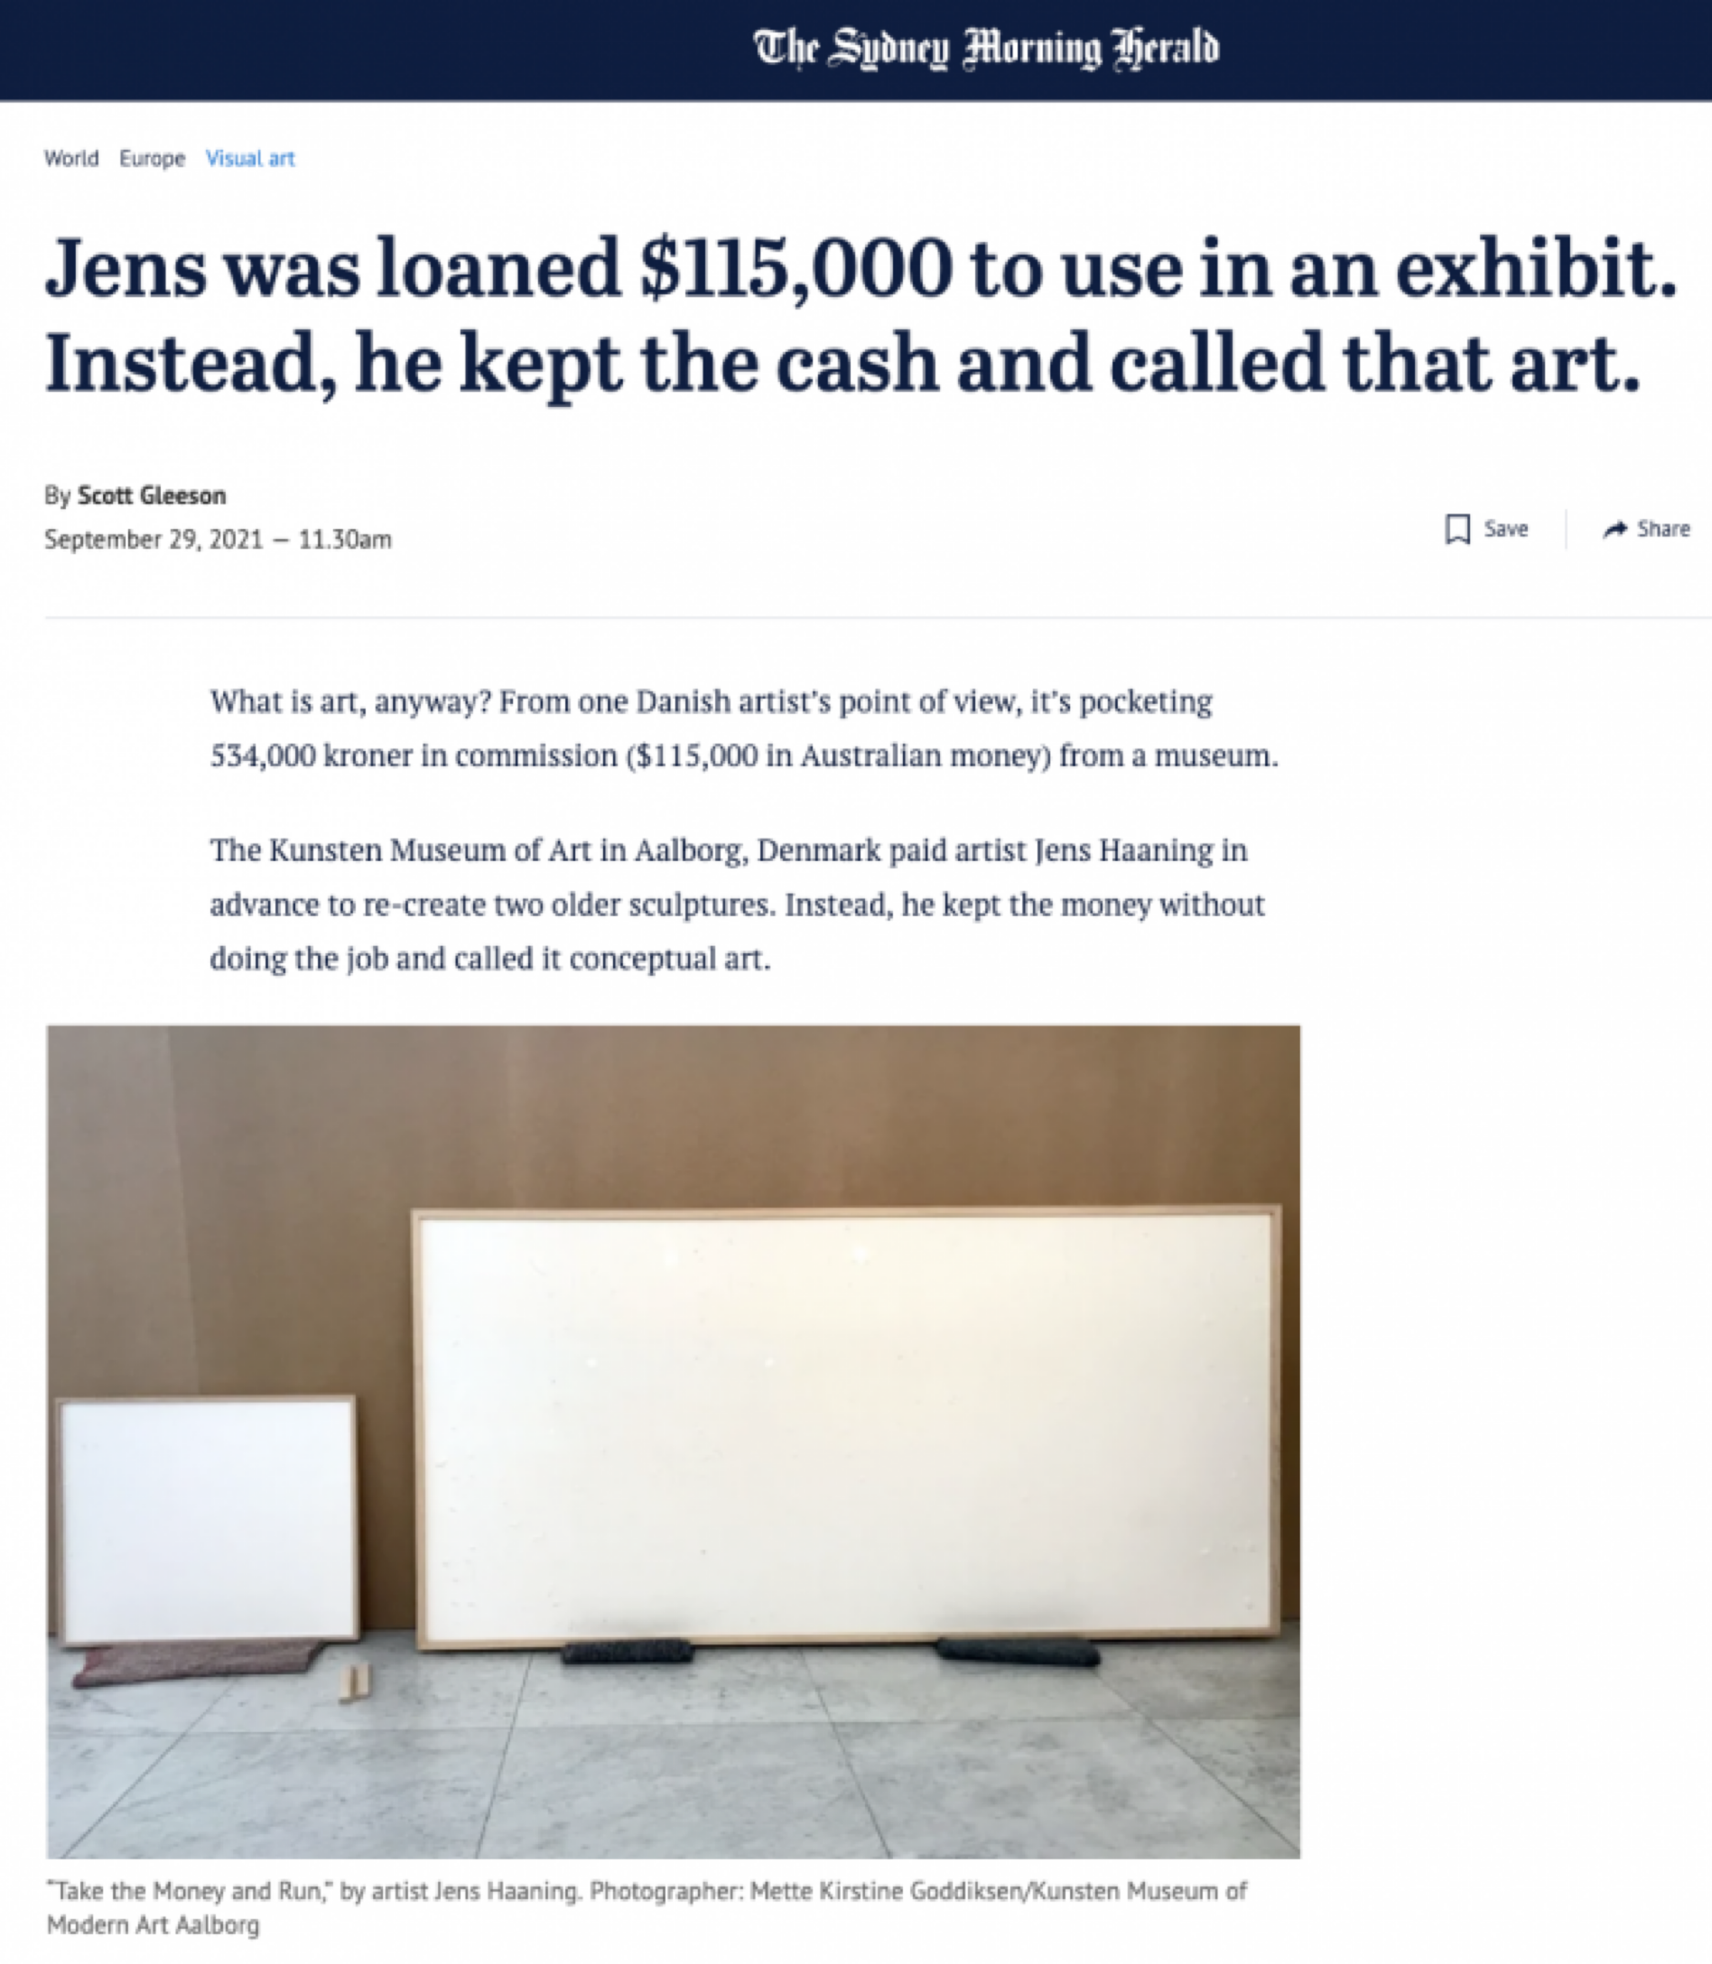
Provocations as critical encounters
... provocation has for centuries proven a powerful means for artists and activists to challenge what we take for granted …
Critical Design and Critical Theory: The Challenge of Designing for Provocation (Bardzell et al., 2012)
https://www.smh.com.au/world/europe/jens-was-loaned-115-000-to-use-in-an-exhibit-instead-he-kept-the-cash-and-called-that-art-20210929-p58vlh.html

Slide 7
Provocations in design
“… to promote critical engagement and reactions from participants, including around subject matters that are hard to articulate or envision…”
Provocative design for unprovocative designers: Strategies for triggering personal dilemmas. (Ozkaramanli & Desmet, 2016)

Slide 8
Why Provocations in design
…. help explore complex topics (e.g., sustainability, more-than-human perspectives)
challenge and disrupt existing social and cultural norms by articulating topics seen as taboo
promote debate around design ideas within a design team
help generate new ideas
Playing with Provocations (Vines, 2016).

Slide 9
Provotypes (designerly artefacts)
…. a provotype (from "provocation" and "prototype") is a tangible or intangible design artefact aimed at provoking discussions and reflections among different users and stakeholders in a design project
… unlike prototypes that focus on solving problems, provotypes explore potential (more-than-human) futures, challenge expectations, mediate concepts and ideas, and intervene in people’s everyday life
Provocation Through Narratives: New Speculative Design Tools for Human-Non-Human Collaborations (Casnati et al., 2024).

Slide 10
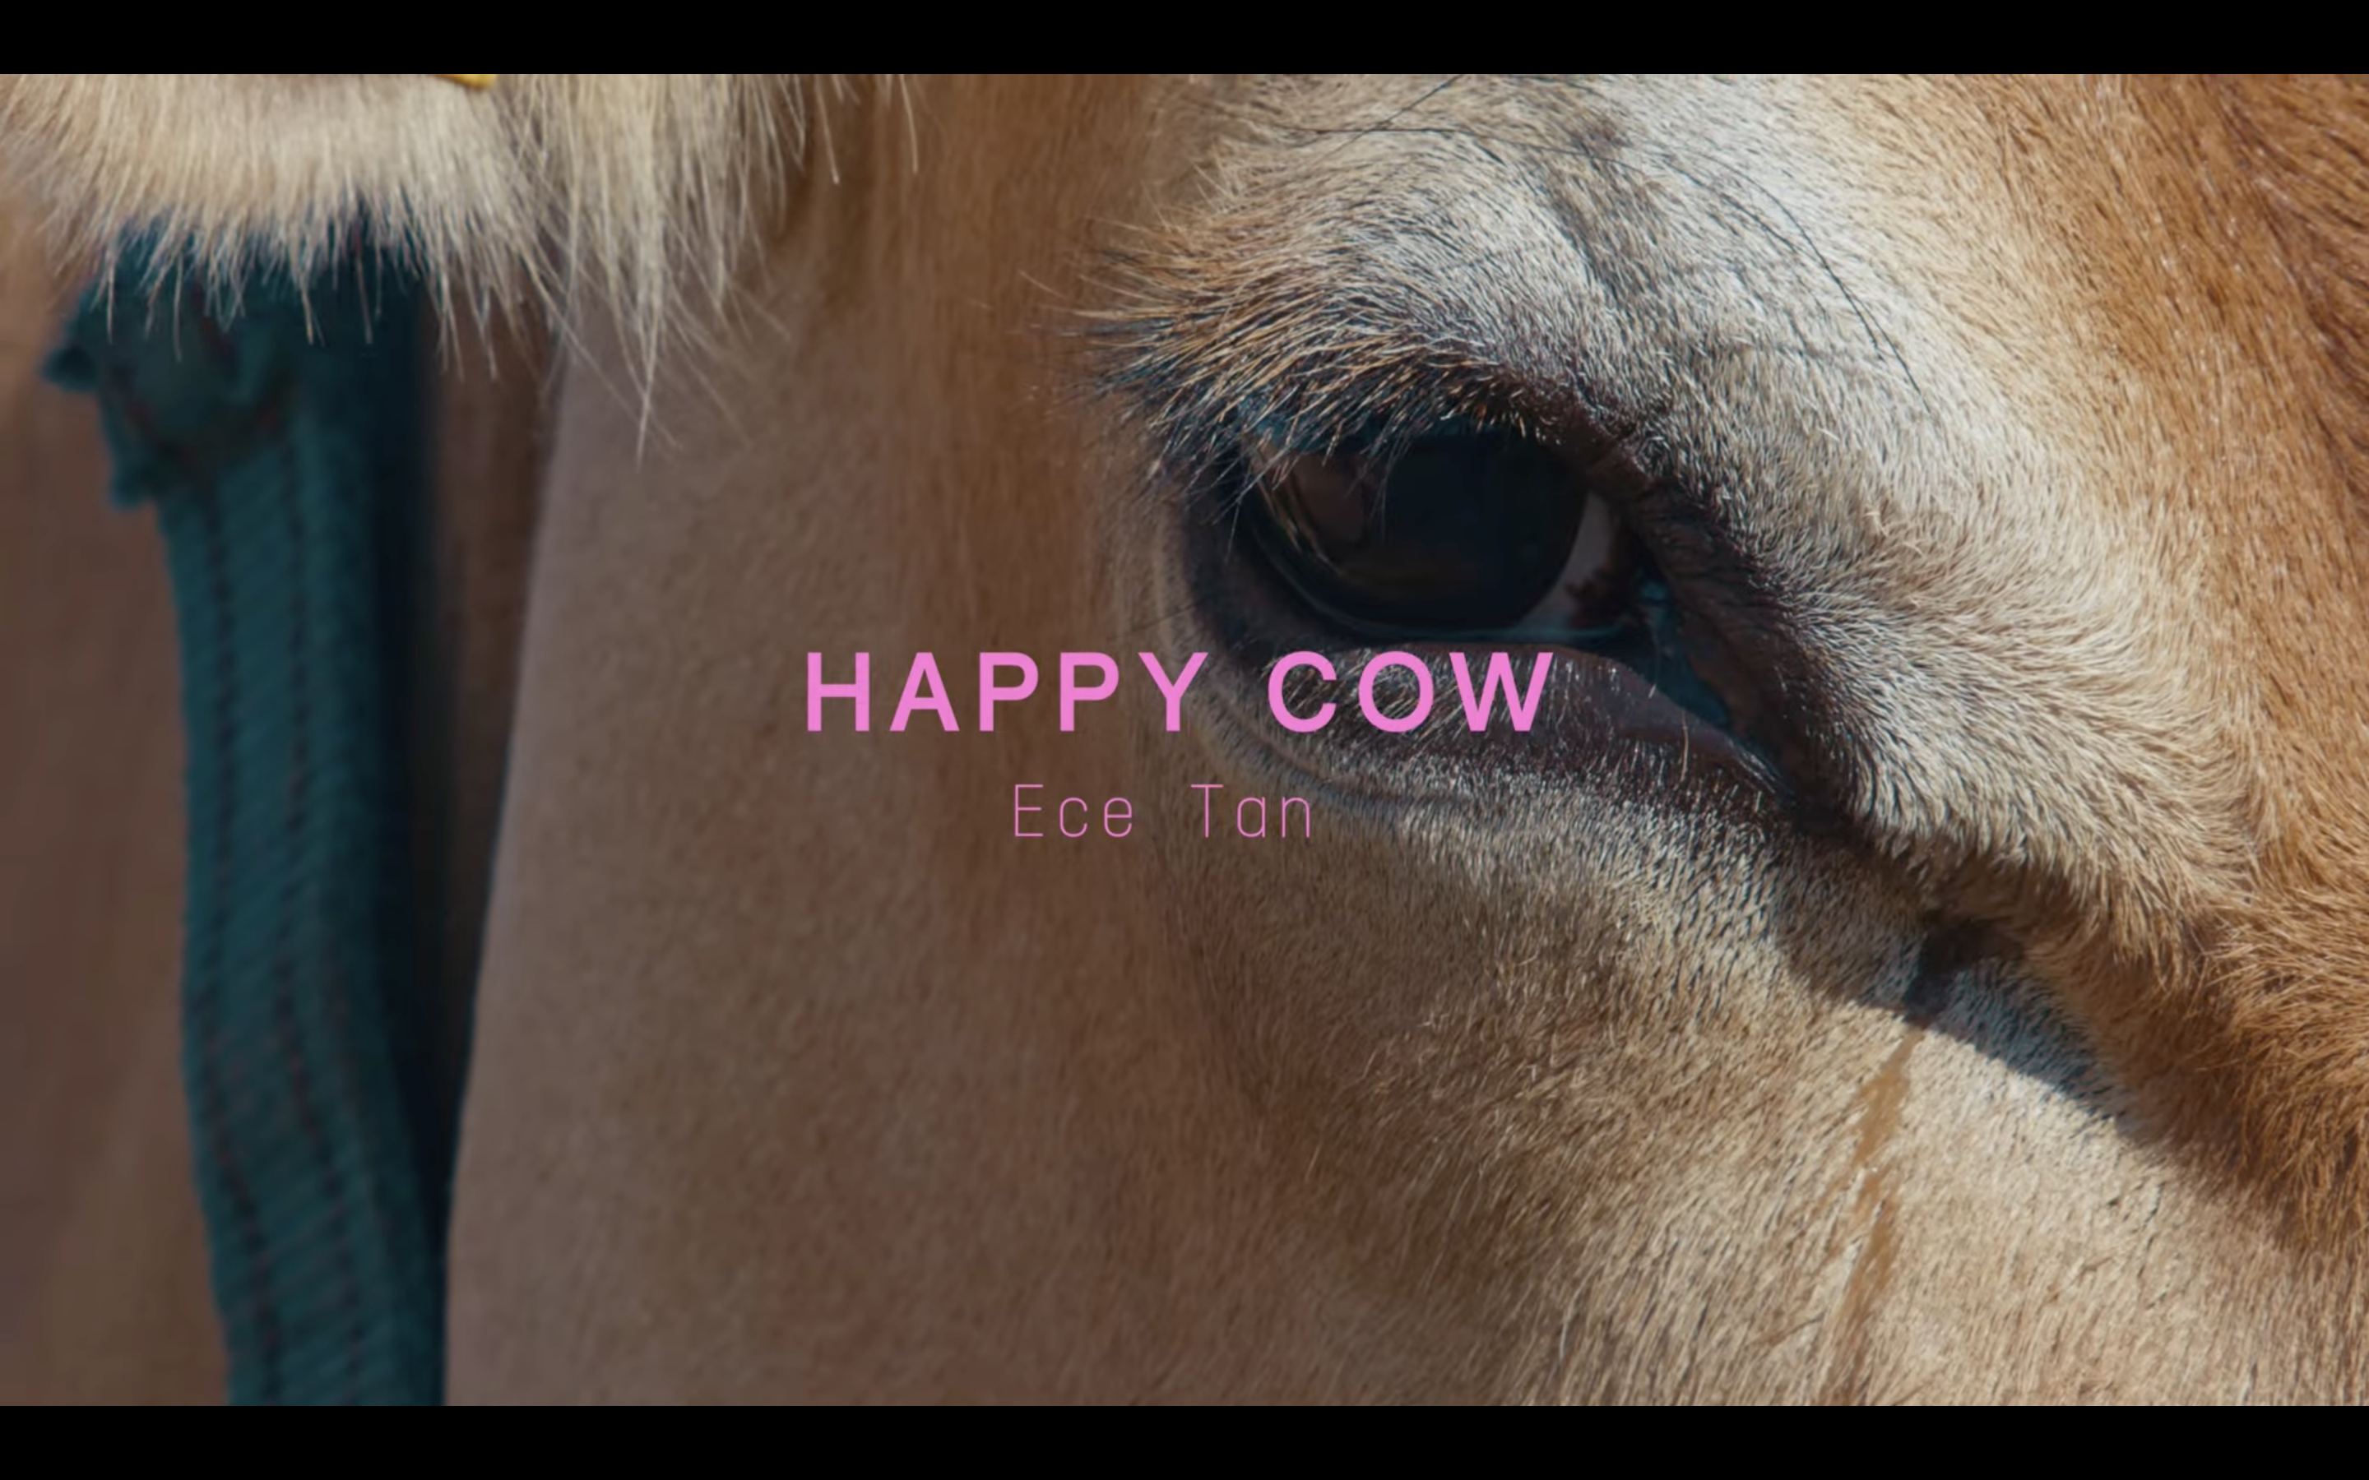
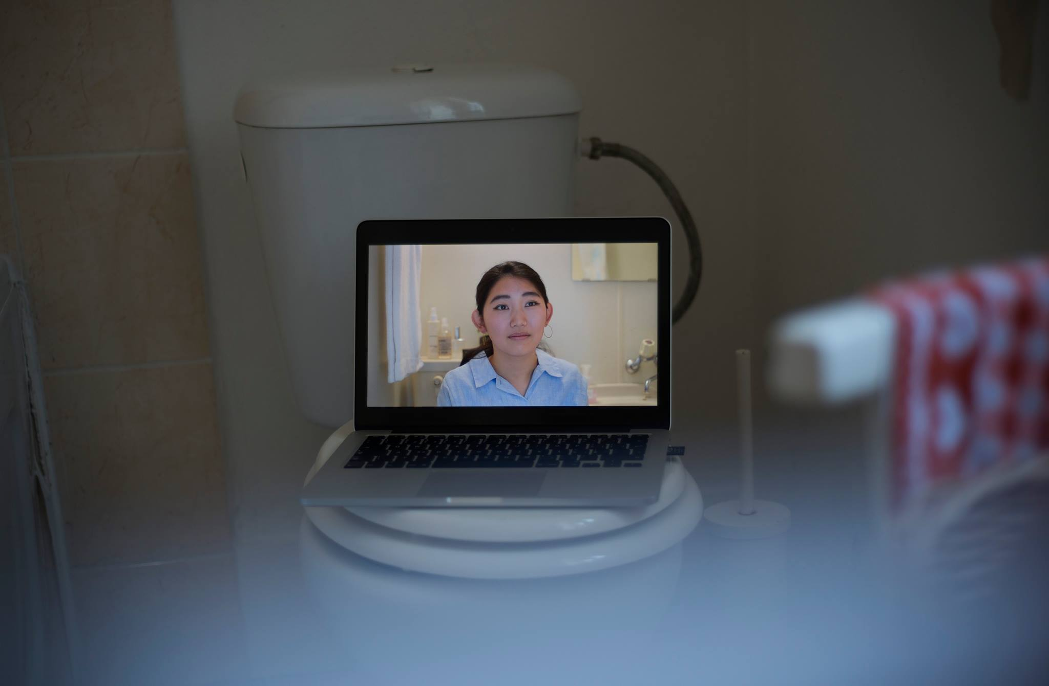
Provotypes and more-than-human perspectives
The Happy Cow Project
`the toys are meant to serve as "critical and provocative tools" to remind desensitised consumers of the range of emotions that animals can feel.’
U - your smart toilet assistant
“What if we would stretch the idea of a Siri in the bathroom? A voice assistant connected to the toilet? How would it sound and feel? What would it do? Which kind of relation would you have with it? Which problems might arise?”
https://www.youtube.com/watch?v=OUQse8InSqg
https://mljuul.com/U
https://vimeo.com/258780690

Slide 11
How to provotype?

Slide 12
Provocative design dimensions
Conceptual is about an idea/belief/concept to be challenged or critiqued through design
Functional deals with how far from the expected norm the design is intended to function and operate
Aesthetics is about how cultural and social meanings inscribed in the design can spark debate and reflection (e.g., more-than-human perspectives)
Aesthetic, Functional and Conceptual Provocation in Research Through Design (Raptis et al., 2017)

Slide 13
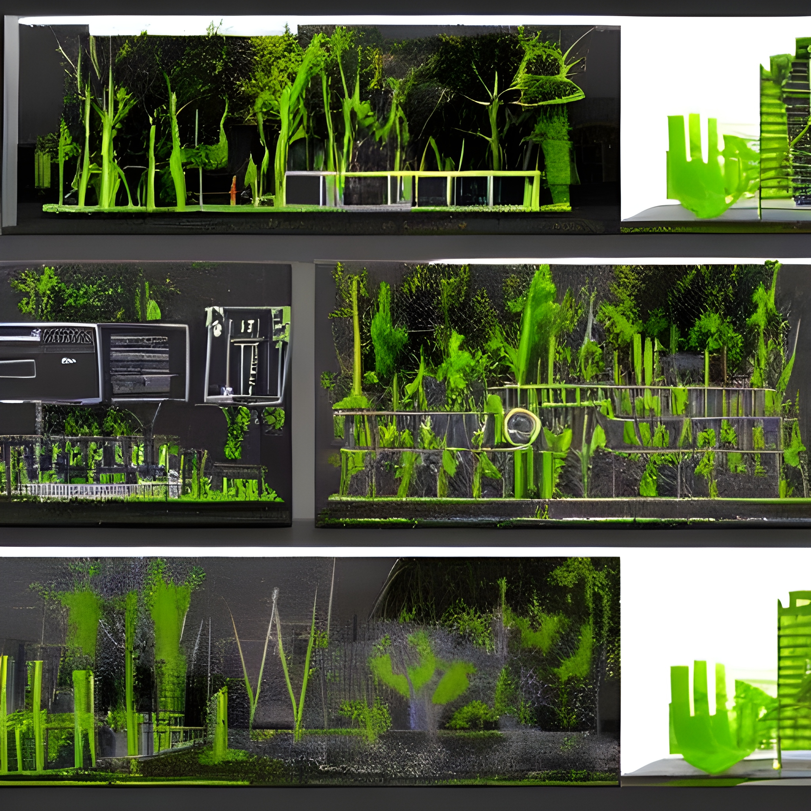
Prototyping (future desires)
… prototyping is primarily directed towards the construction of the future
Various prototypes enable and encourage prospective users to get concrete experience with a prospective computer system/interactive design.
AI generated by https://deepai.org/

Slide 14
Provotyping (troubling mundane everyday life)

Slide 15
Provotyping (troubling mundane everyday life)
… to expose tension and problems in current practice by getting participants to experience new ways of doing it in alternative ways…
Towards a Provotyping Approach in Systems Development (Mogensen, 1992)

Slide 16
Provotyping (troubling mundane everyday life)
… to expose tension and problems in current practice by getting participants to experience new ways of doing it in alternative ways…
Towards a Provotyping Approach in Systems Development (Mogensen, 1992)
… design to challenge the status quo to expose assumptions and trigger reflective discussions on the design space…
Design in the Absence of Practice: Breaching Experiments. (Crabtree, 2004)

Slide 17
Provotyping (troubling mundane everyday life)
… to expose tension and problems in current practice by getting participants to experience new ways of doing it in alternative ways…
Towards a Provotyping Approach in Systems Development (Mogensen, 1992)
… design to challenge the status quo to expose assumptions and trigger reflective discussions on the design space…
Design in the Absence of Practice: Breaching Experiments. (Crabtree, 2004)
… by asking what can be done to make trouble we trigger the well-known and make it visible and account-able…
Studies of the Routine Grounds of Everyday Activities Social Problem. (Garfinkel , 1964)

Slide 18
… provotyping can be viewed as the staging of socially-shared practices, through which the problematic is made visible by design and the experience is rendered account-able…
Provotyping Accountability: Exploring Smartphone Use in the Home through Design. (Jensen et al. , 2023)
Notes:
How can we use design to breach more-than-human perspectives in mundane everyday life

Slide 19
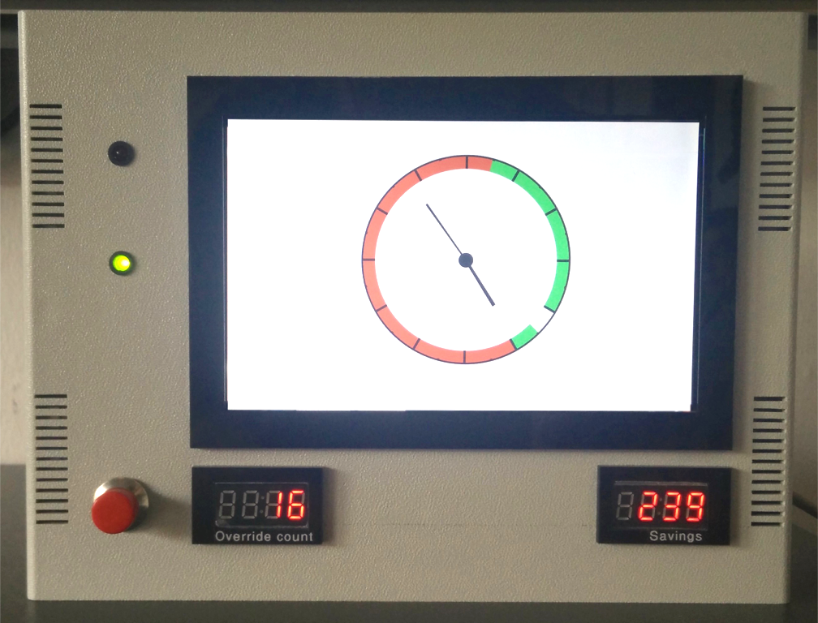
Provotyping and more-than-human perspectives
The BOX Project
“How can a design engage households to use renewable energy? Not by making this effortless, but more disruptive by provocations. We choose to intervene in laundry practices, because it is a practice rich of household routines and social norms."
The Gossiper Fridge
“The Gossiper Fridge tells stories about the animals involved in creating the produce currently in the fridge to cultivate a deeper connection with the natural world and raise awareness about the interconnectedness of human consumption and animal lives
Example Scenario
Human Opens Fridge:
Trigger: The fridge door is opened.
Story: "Did you know that the almonds in your fridge were pollinated by bees? Bees are crucial for the production of many crops, but their populations are declining due to habitat loss and pesticides. By choosing organic almonds, you're supporting bee-friendly farming practices."
Interactive Element: A short animation shows bees pollinating almond trees, followed by a quiz question: "How many crops rely on bee pollination?"
https://pure.au.dk/ws/portalfiles/portal/369030200/TEI22_FINAL_GOOD.mp4

Slide 20
When to provotype
Prototyping
Exploring and materialising user needs
Solution-oriented
Evaluating usability, features & affordances
Convenient and functional benefits
Provotyping
Triggering practices
Problem-oriented
Staging dilemmas & tensions
Slight-strangeness and de-familiarness

Slide 21
Group Work

Slide 22
1: Describe
Choose a more-than-human topic you would like to raise questions and promote debate about.
Describe to your group why the chosen topic is relevant.
2: Design
Consider how to design a provotype reflecting on the three provocative design dimensions (conceptual, functional, and aesthetic to help raise awareness of your more-than-human topic.
Feel free to draw a picture of this design and discuss the design with your group
3: Reflect
Reflect on the situations where this design can trigger more-than-human concerns in mundane everyday.
Feel free to draw a picture of different situations and discuss possible intended and unintended consequences of your design with your group

Slide 23
References
Jensen, R. H., Nilsson, E. M., Hansen, AM., Yoo, D. & Eriksson, E. (2025). Provocations and More-Than-Human Perspectives in Human-Computer Interaction. Interacting with Computers, 2025. iwaf020, https://doi.org/10.1093/iwc/iwaf020
Casnati, F., Ianniello, A., Romani, A. (2024). Provocation Through Narratives: New Speculative Design Tools for Human-Non-Human Collaborations. In: Zanella, F., et al. Multidisciplinary Aspects of Design. Design! OPEN 2022. Springer Series in Design and Innovation , vol 37. Springer, Cham. https://doi.org/10.1007/978-3-031-49811-4_71
Jensen, R. H., Encinas, E., & Raptis, D. (2022). Spicing It Up: From Ubiquitous Devices to Tangible Things Through Provocation. In TEI 2022 - Proceedings of the 16th International Conference on Tangible, Embedded, and Embodied Interaction: TEI '22 (pp. 1-15). Article 33 Association for Computing Machinery (ACM). https://doi.org/10.1145/3490149.3502257
Bardzell, S., Bardzell, J., Forlizzi, J., Zimmerman, J., & Antanitis, J. (2012). Critical design and critical theory: the challenge of designing for provocation. In Proceedings of the Designing Interactive Systems Conference (DIS ‘12), ACM https://doi.org/10.1145/2317956.2318001
Raptis, D., Jensen, R. H., Kjeldskov, J., & Skov, M. (2017). Aesthetic, Functional and Conceptual Provocation in Research Through Design. In DIS '17, Proceedings of the 2017 Conference on Designing Interactive Systems (pp. 29-41). Association for Computing Machinery (ACM). https://doi.org/10.1145/3064663.3064739
Ozkaramanli, D., & Desmet, P. (2016). Provocative design for unprovocative designers: Strategies for triggering personal dilemmas. In 2016 Design Research Society 50 Anniversary Conference (pp. 2001-2016). The Design Research Society. https://pure.tudelft.nl/ws/portalfiles/portal/5019548/165_Ozkaramanli.pdf
Jensen, R. H., Encinas, E., Strengers, Y., Dannesboe, C., Kruuse, E., Skovby, J., Bach, M., Tietze, P., & Christensen, S. (2023). Provotyping Accountability: Exploring Smartphone Use in the Home through Design. In Proceedings of the 2023 ACM Designing Interactive Systems Conference (DIS '23) (pp. 1595–1609). Association for Computing Machinery (ACM). https://doi.org/10.1145/3563657.3596024
‌

Slide 24
This teaching activity was developed as part of the MOVA project co-funded by the European Union. https://mova.uni.mau.se/
Disclaimer: Funded by the European Union. Views and opinions expressed are however those of the author(s) only and do not necessarily reflect those of the European Union or the European Education and Culture Executive Agency (EACEA). Neither the European Union nor EACEA can be held responsible for them.

