Slide 1


Noticing and mapping
more-than-human entanglements

Slide 2
Summary
In this teaching activity, students will gain an increased awareness of the more-than-human actors surrounding us in everyday life. They will begin with an individual “art of noticing” exercise to observe and notice your surroundings. Thereafter, they will form groups and develop entanglement maps that capture their joint experiences. Lastly, all groups will present the findings by placing the maps on the “Wall of Engtanglements” and reflect on how these new insights gained might influence the design process.
Learning outcomes
Notice and describe entanglements with the more-than-human world.
Map and visualise more-than-human entanglements.
Reflect on how insights gained about more-than-human entanglements will influence the design process.

Slide 3
Outline/Content
Noticing more-than-human entanglements
Mapping more-than-human entanglements
Exhibiting more-than-human entanglements

Slide 4
Key readings
Haraway, Donna (2016). Staying with the trouble: Making kin in the chthulucene. Duke University Press.
Metcalfe, Daniel (2024). Stepping out of the classroom and into the worlds of other species. In Poikolainen Rosén, Anton; Salovaara, Antti; Botero, Andrea; Juul Søndergaard, Marie Louise (Eds.) More-Than-Human-Design in Practice. Routledge.
Tsing, Anna L. (2015). The Mushroom at the End of the World: On the Possibility of Life in Capitalist Ruins. Princeton University Press.

Slide 5
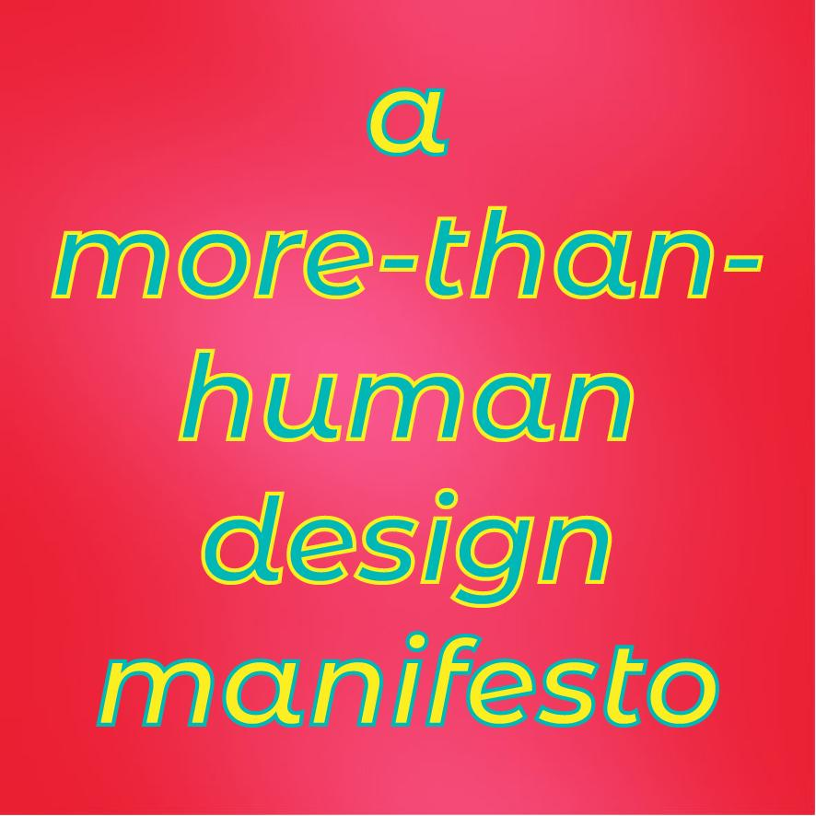
“More-than-human design aims to widen the scope of action through the creative development of methods for noticing, knowing and making the more-than-human world.”
“What can we see, hear, smell, feel and taste? What might be beyond our senses?”
A more-than-human-design lexicon (Poikolainen et al., 2025, p. xxviii)

Slide 6
“More-than-human design aims to widen the scope of action through the creative development of methods for noticing, knowing and making the more-than-human world.”
“What can we see, hear, smell, feel and taste? What might be beyond our senses?”
A more-than-human-design lexicon (Poikolainen et al., 2025, p. xxviii)
Exercise:

Slide 7

Art of noticing
About paying close attention to the world around us, especially the interactions between humans and the nonhuman world (Tsing, 2015).
By “noticing” Tsing encourages us to observe the small, often overlooked details of our environment and the complex relationships within it.

Slide 8
Individual exercise: Entanglement mapping
Select one of the exercises (see worksheet 1):
    Drinking water
    Observing a tree/plant/flower
    Drinking a coffee
    Observing the air
    Tasting a fruit/nut
    The exercises are developed by Berre Su Demir, Koç University, and Clara Maria Antunes Venâncio, Faculty of Fine Arts, University of Porto and Institute of Social Sciences, University of Lisbon.

Slide 9
Individual exercise: Entanglement mapping
Run the exercise for 20 min (see instructions on worksheet 1)
Take notes, sketch your findings/experiences
Meet back in the classroom for group work

Slide 10
Group exercise: Create an Entanglement map
    Create groups based on the exercise that you selected:
    Drinking water
    Observing a tree/plant/flower
    Drinking a coffee
    Observing the air
    Tasting a fruit/nut
Use worksheet 2 and follow the instructions (6 pages/group)
Step 1 (15 min):
List all actors identified and others associations, connections, reflections etc.

Slide 11
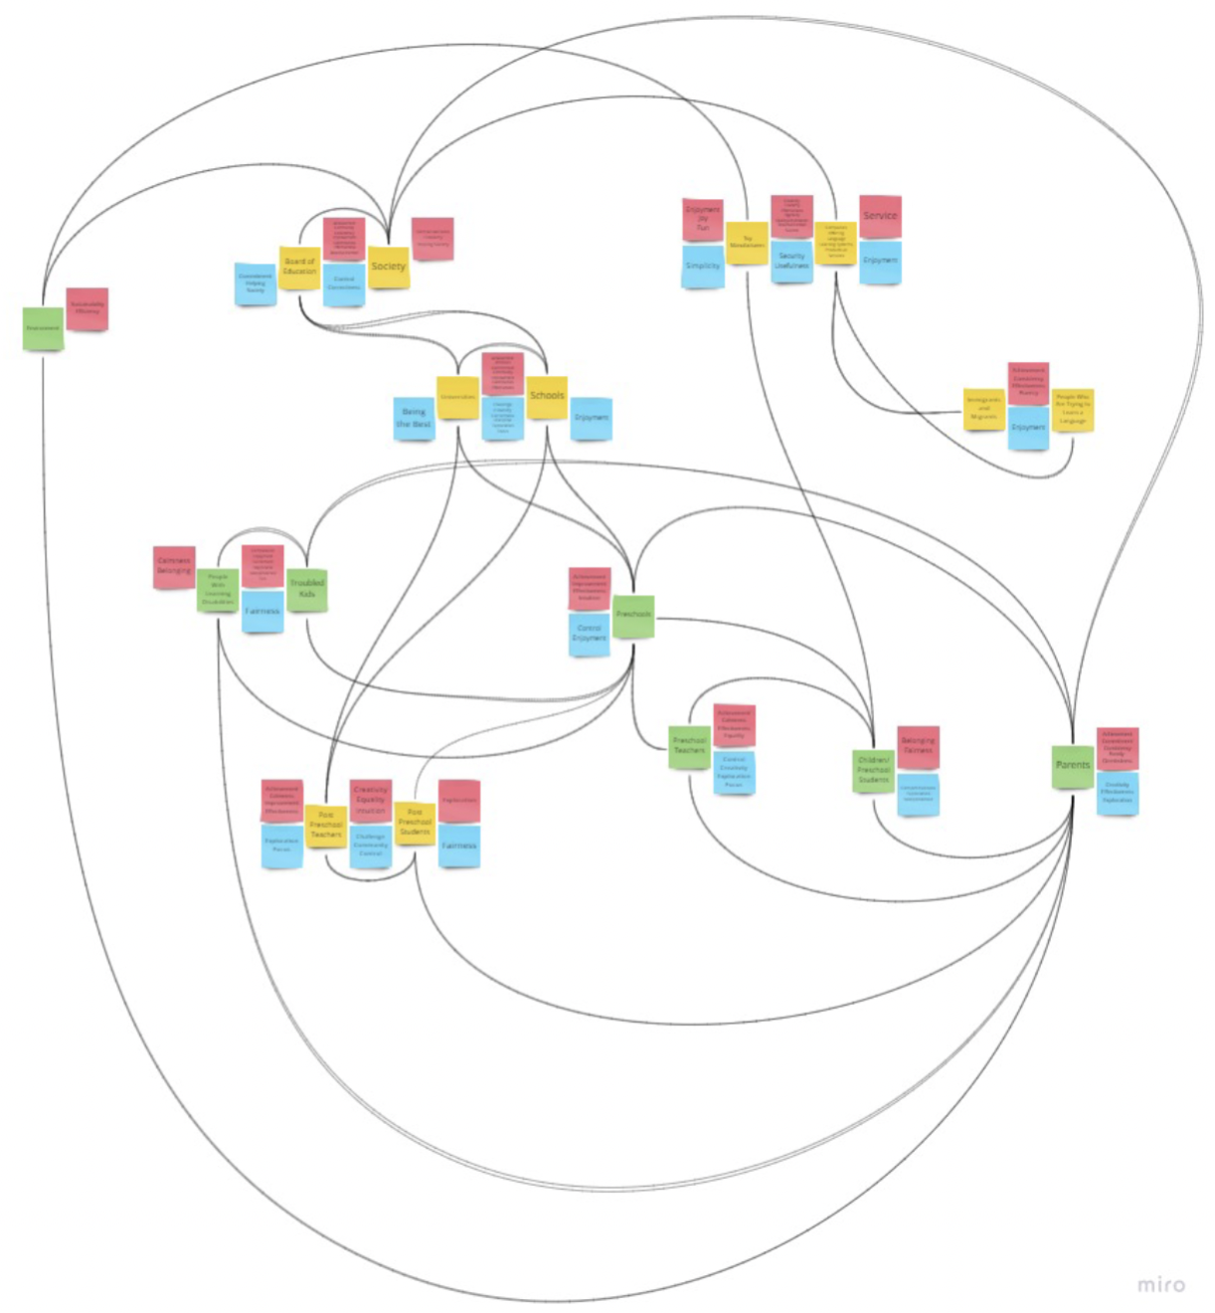
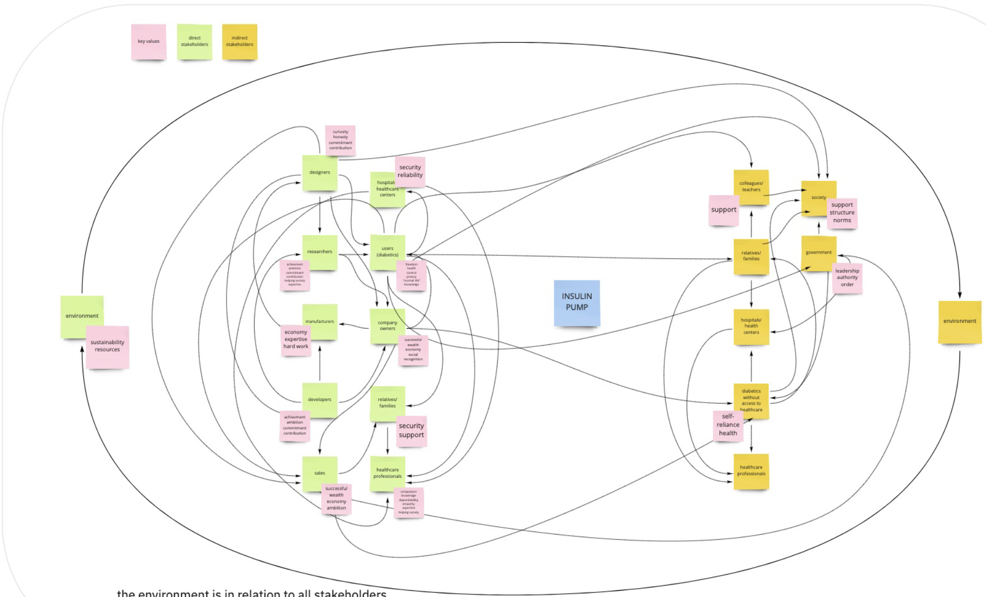
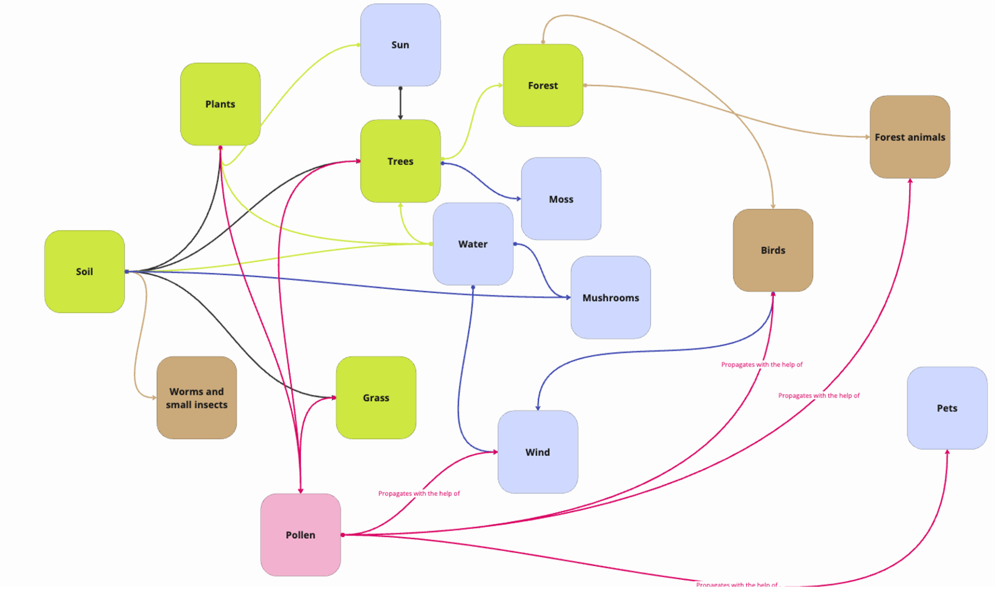

Slide 12
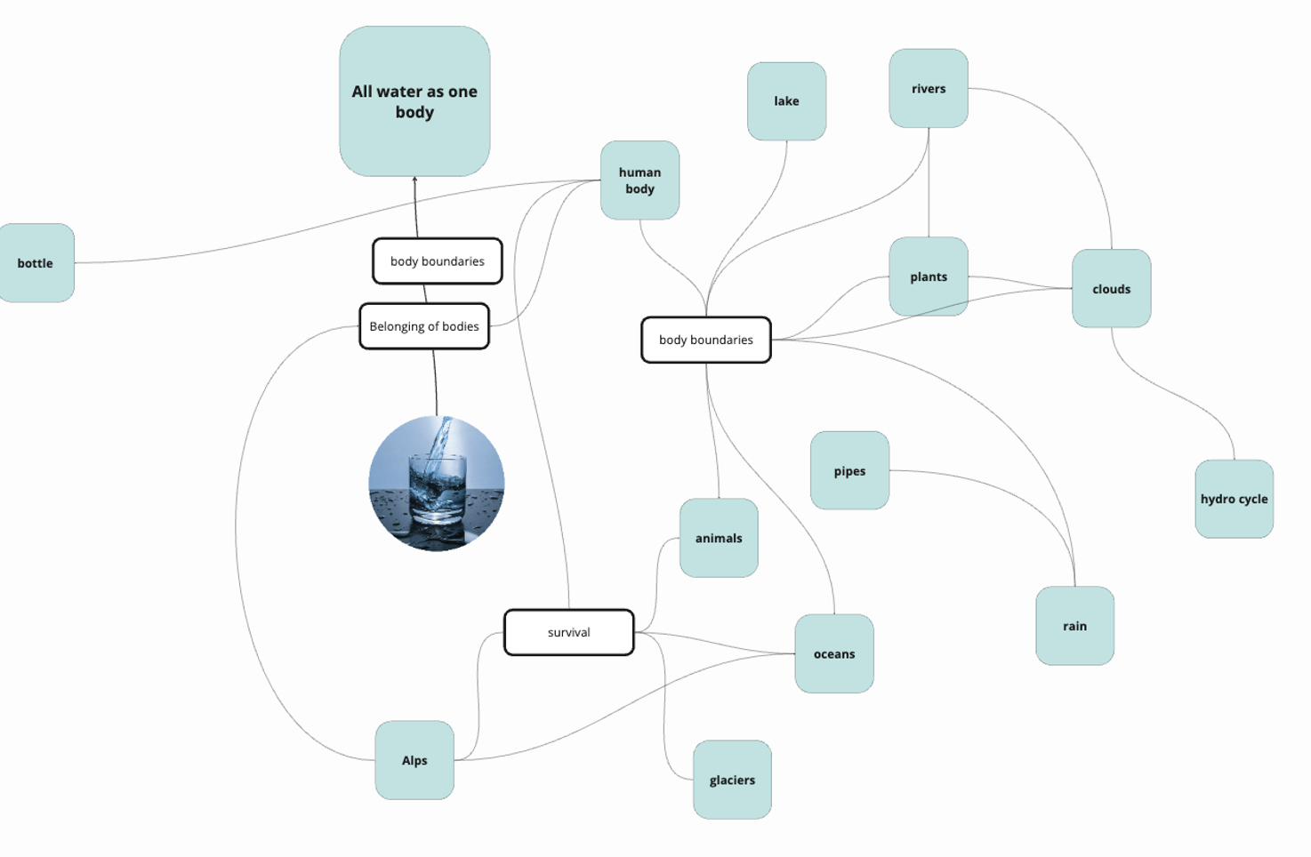
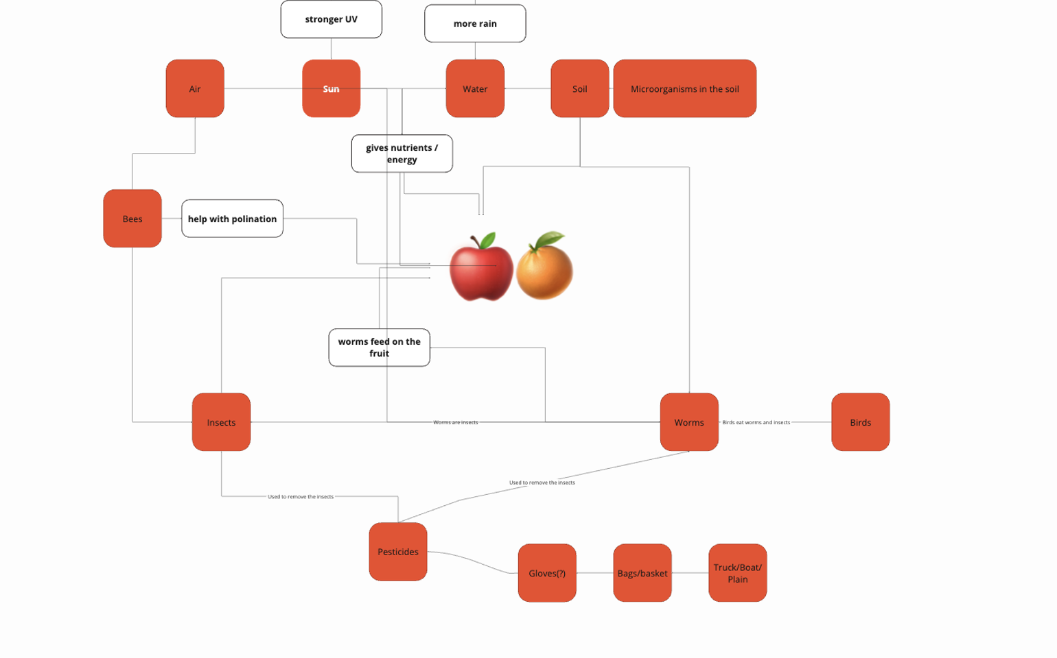
Group exercise: Create an Entanglement map
Step 2 (15 min):
Connect the actors
Define the relations

Slide 13
Mini-exhibition: Wall of Entanglements
Place the doucumentation (worksheet 2) on the exhibition wall
All groups present their entanglement maps
What new insights were gained?
How might these insights influence the design processes?

Slide 14
“We have lost a lot of nature in the past three hundred years – in both senses of the word lost. We have lost nature in the sense that much of nature has been destroyed… But we have also lost nature in another sense. We have misplaced it. We have hidden nature from ourselves.”
Marris, Emma (2011). Rambunctious Garden : Saving Nature in a Post-wild World. Bloomsbury.

Slide 15
Increasing our interaction with nature
There is a strong correlation between interaction with nature, the attachment people feel towards nature, and their motivation to preserve and protect it (Shuttler et al., 2018).
Interaction with nature is on a decline globally, and as a result, we are less aware and mindful of more-than-humans (Soga & Gaston, 2016).
More-than-humans can be found all around us if we learn to notice (the art of noticing) and pay attention to our surroundings.
In doing so, we develop a sensitivity towards more-than-human perspectives in the context of design, hoping that this will find its way into our future work (Metcalfe, 2024).

Slide 16
Next steps
We do not need to step into a forest to experience nature and the more-than-human world. Just by stepping out of the classroom and running this exercise, we create opportunities for ourselves to notice more than– humans, which helps us to relate to and appreciate the presence of nature around us.
– How can methods such as noticing and mapping more-than
human entanglements influence our approach to design in the long run?

Slide 17
References
Haraway, Donna (2016). Staying with the trouble: Making kin in the chthulucene. Duke University Press.
Metcalfe, Daniel (2024). Stepping out of the classroom and into the worlds of other species. In Poikolainen Rosén, Anton; Salovaara, Antti; Botero, Andrea; Juul Søndergaard, Marie Louise (Eds.) More-Than-Human-Design in Practice. Routledge.
Marris, Emma (2011). Rambunctious Garden : Saving Nature in a Post-wild World. Bloomsbury.
Poikolainen , Anton (2025). A more-than-human-design lexicon. In Poikolainen Rosén, Anton; Salovaara, Antti; Botero, Andrea; Juul Søndergaard, Marie Louise (Eds.) More-Than-Human-Design in Practice. Routledge.
Schuttler, Stephanie G; Sorensen, Amanda E.; Jordan, Rebecca C.; Cooper, Caren; Shwartz, Assaf (2018). Bridging the nature gap: can citizen science reverse the extinction of experience? Front Ecol Environ, 16(7), 1540–9295.
https://doi.org/10.1002/fee.1826
Soga, Masashi; Gaston, Kevin J. (2016). Extinction of experience: the loss of human–nature interactions. Front Ecol Environ, 14(2): 94–101.
Tsing, Anna L. (2015). The Mushroom at the End of the World: On the Possibility of Life in Capitalist Ruins. Princeton University Press.

Slide 18
This teaching activity was developed as part of the MOVA project co-funded by the European Union. https://mova.uni.mau.se/
Disclaimer: Funded by the European Union. Views and opinions expressed are however those of the author(s) only and do not necessarily reflect those of the European Union or the European Education and Culture Executive Agency (EACEA). Neither the European Union nor EACEA can be held responsible for them.

