Slide 1


More-than-human personas

Slide 2
Summary
In this teaching activity, students learn how to identify, create, and employ more-than-human personas in technology design. More-than-human personas can help ensuring that the needs of both human and non-human actors are considered when making design decisions, and when designers do not have direct access to the stakeholders.
Learning outcomes
After the teaching activity students should be able to:
Identify more-than-human primary and secondary actors in various contexts and situations.
Create more-than-human personas based on primary and secondary data.
Employ more-than-human personas in technology design.

Slide 3
Key readings
Tomitsch, Martin; Fredericks, Joel; Vo, Dan; Frawley, Jessica; and Foth, Marcus (2021). Non-human Personas. Including Nature in the Participatory Design of Smart Cities. Interaction Design and Architecture(s). 102-130. 10.55612/s-5002-050-006.

Slide 4
Content
What is a persona
What is a more-than-human persona
Why more-than-human personas
How to develop more-than-human personas
References

Slide 5
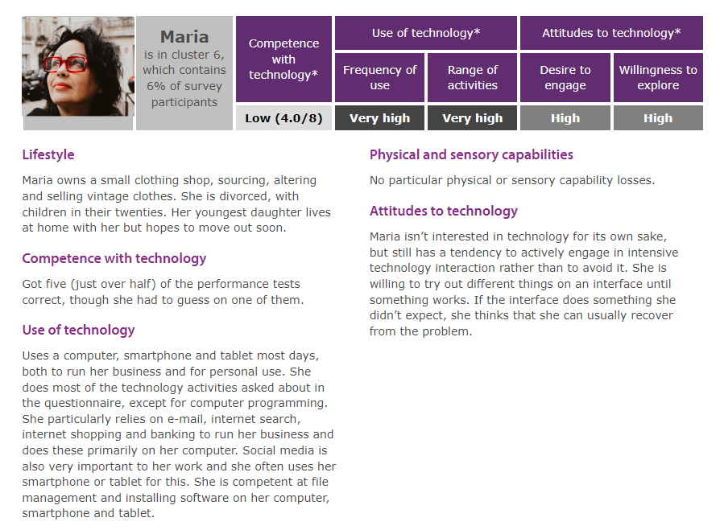
What is a persona?
Personas are user models that are represented as specific, individual human beings, synthesized from observations and data of real people.
A persona is not a person.
You do not look at the entire person but use the area of focus or domain you are working within as a lens to highlight the relevant attitudes, and the specific context associated with the area of work.
Available at: https://www.inclusivedesigntoolkit.com/digitalpersonas/#Maria
(Nielsen, 2013)

Slide 6
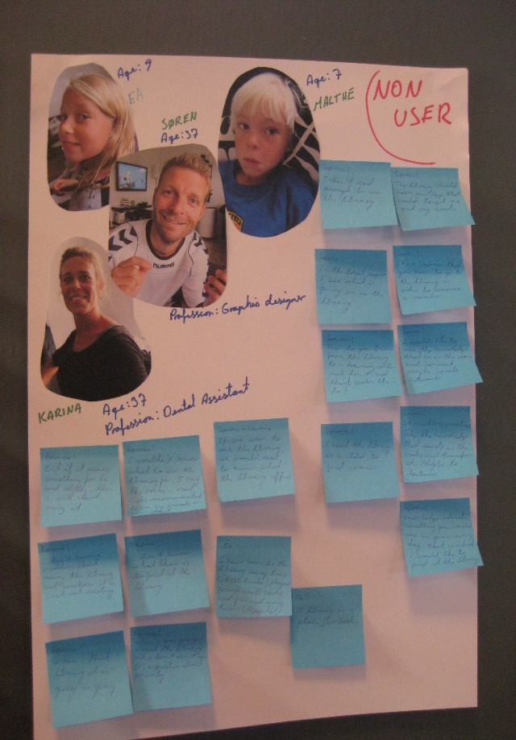
What is a persona?
The notion of personas was first introduced by Cooper (2004) as hypothetical archetypes
Developed as a method for IT system development, product design, marketing, planning of communication, and service design.
Personas are an effective way to make sense of and synthesise research data, to communicate user needs within the design team, and to keep the perspective of users and other important stakeholders at the forefront throughout the design process.
Sample personas: https://www.inclusivedesigntoolkit.com/digitalpersonas/
Personas representing non-users of public libraries.
(Photo by Eva Eriksson)

Slide 7
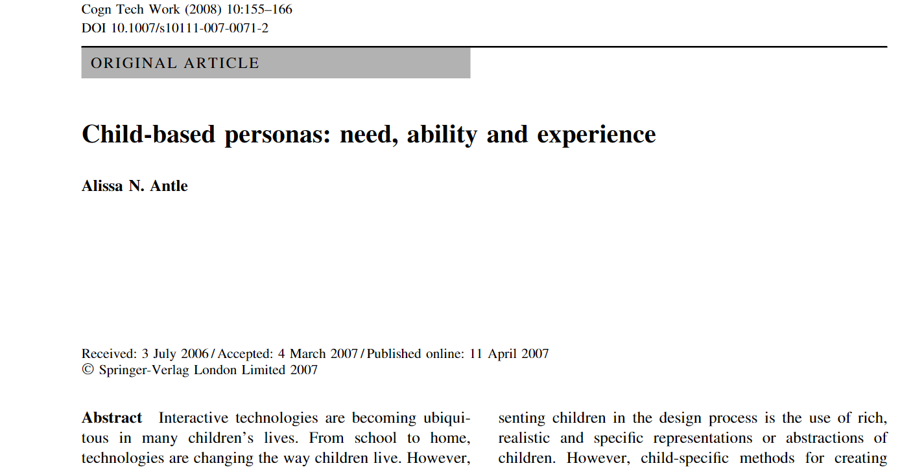
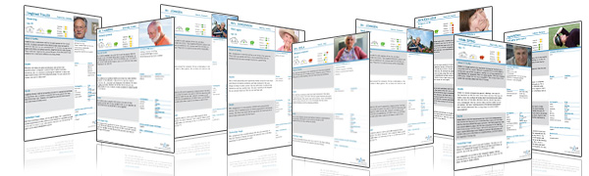
What is a persona?
Elderly Personas
Based on quantitative data from roughly 12,500 older individuals living in different European countries
30 basic personas representing Europeans aged 60 and older coming from three different regions (northern, central, southern) still living at home.
http://elderlypersonas.cure.at
Child Personas
The child-personas technique provides a way to use theoretical information to create child-user archetypes. (Antle, 2008)

Slide 8
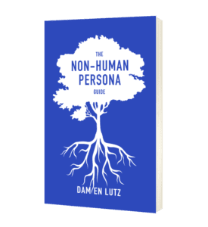
What is a more-than-human persona?
Various types, e.g., animal, environments, species persona, things, technologies
Non-human and non-user personas represent the animals, environments, and ‘invisible’ humans (factory workers, miners, farmers, and communities, etc.) impacted by our product lifecycle so that we may design to protect and respect them.
https://lifecentred.design/non-human-personas/non-human-and-non-user-personas/

Slide 9
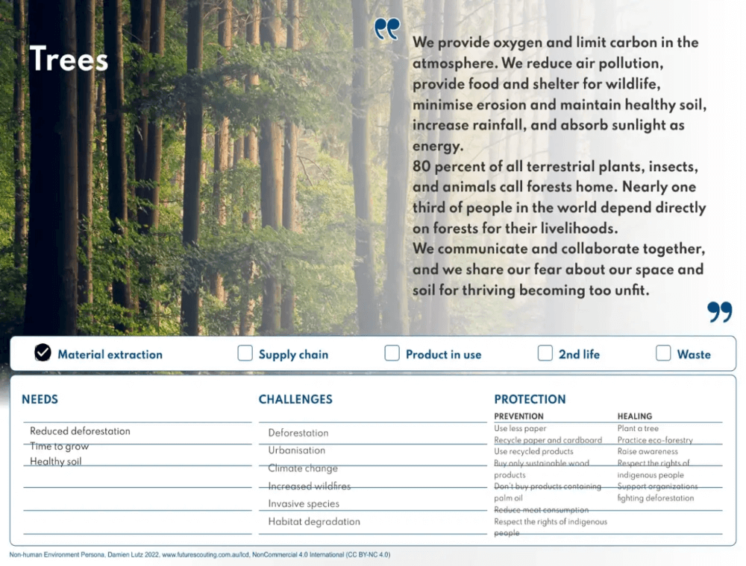
What is a more-than-human persona?
Like personas, non-human personas are based on research data
Collected from secondary and/or primary sources (e.g., contextual observations or interviews with experts).
Just like conventional personas, non-human personas represent the character, attributes and needs of others within all stages of the design process.
They expose and challenge assumptions and provide a means for the design team to represent or speak on behalf of another species or biosystem.
Evaluating designs from alternate perspectives may reveal both symbiosis and conflict (e.g. prey/predator, farmer/farmed).
Even if conflict is not resolvable, these insights can feed into each stage of the design process and ideally lead to a more environmentally considerate solution.
(Tomitsch, 2022)
https://lifecentred.design/non-human-personas/non-human-and-non-user-personas/

Slide 10
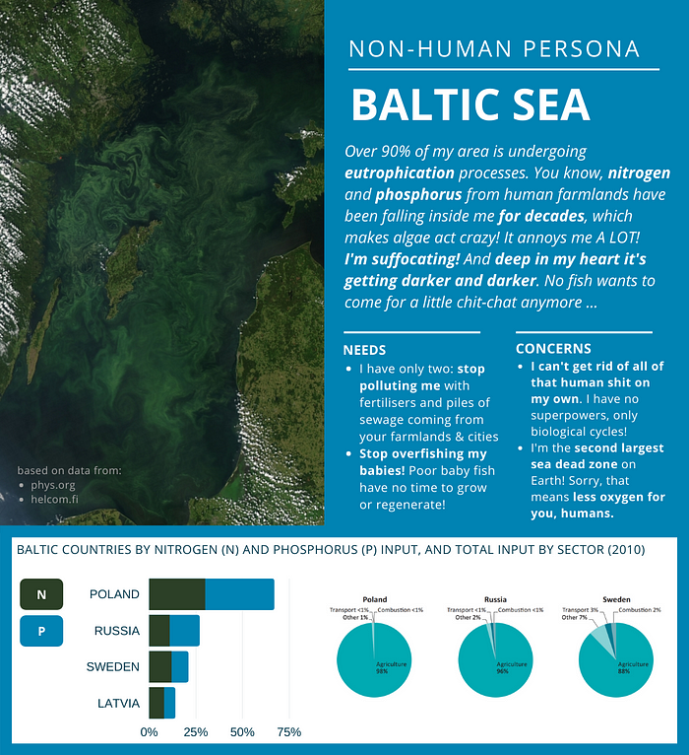
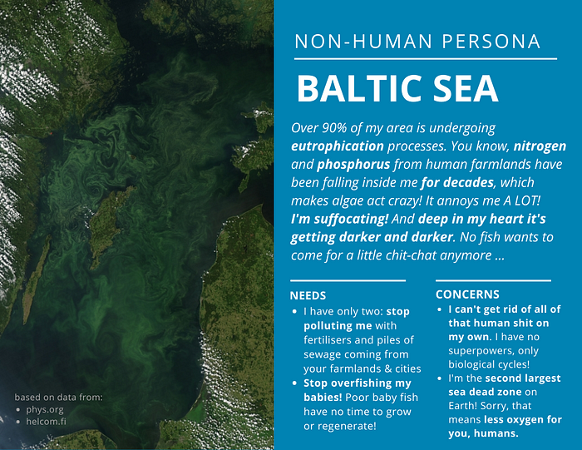
Example non-human persona created from data
Available at: Sznel M.(2020)

Slide 11
Why more-than-human personas?
Designers are increasingly asked to integrate nature, biodiversity and other non-human considerations within design.
Enable designers to expand user-centred design for a more nuanced understanding of both human and non-human needs
Leading towards a more inclusive design practice.
Balance social-ecological factors in design.
Alternative ways of seeing the world.
Give a voice to non-human actors.
Possibility to decenter human comfort and convenience over broader ethical and environmental concerns
(Hernandez-Santin et al, 2023)

Slide 12
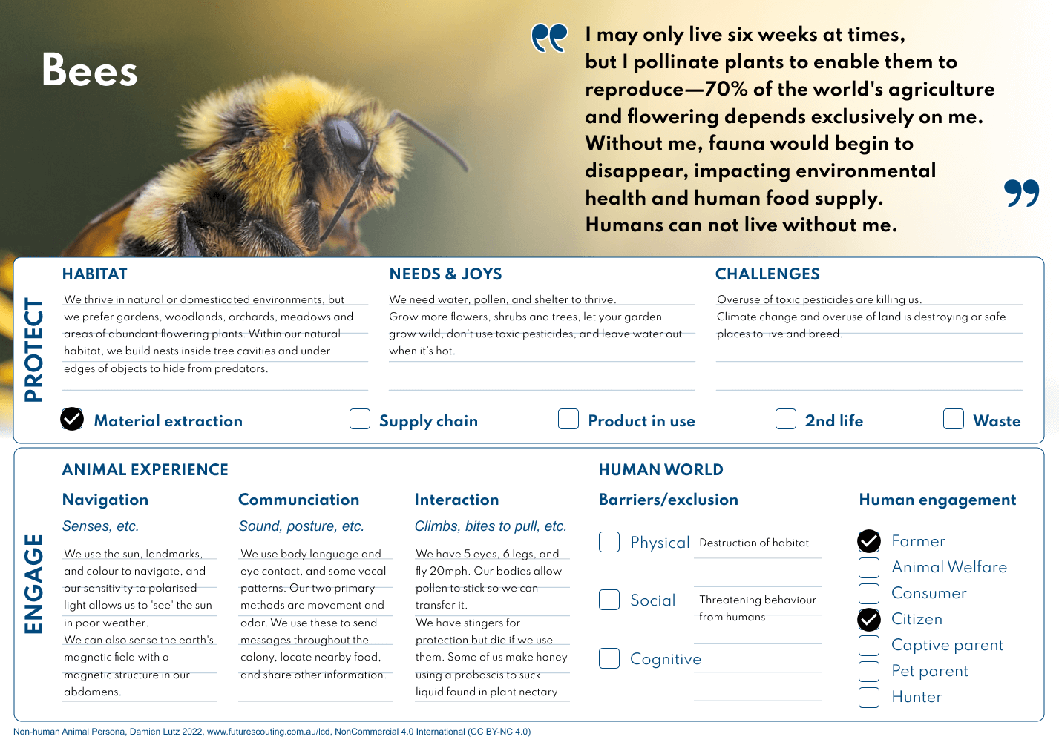
Why more-than-human personas?
'Invisible' stakeholders can have a big impact.
Over the past few years, a tiny virus was the 'most important non-human stakeholder of every business and public service around the world' (Sznel, 2020).
The COVID-19 virus has influenced how we design interactions, services and systems—for example, avoiding touch-based input controls in public interfaces, prioritising an online delivery first approach for providers of goods and enabling employees to work from home. (Tomitsch, 2022)
https://lifecentred.design/non-human-personas/non-human-and-non-user-personas/

Slide 13
How to develop more-than-human personas
Contextual investigations
Collect primary and secondary data about people, things, animals, species
Ethnography & Desk research
Identify stakeholders
Create MTH personas
Employ MTH personas in design
Inform and evaluate design scenarios and concepts
Analyze data
Iterate
Make a stakeholder analysis
Create MTH personas
Identify primary and secondary stakeholders
Synthesize insights

Slide 14
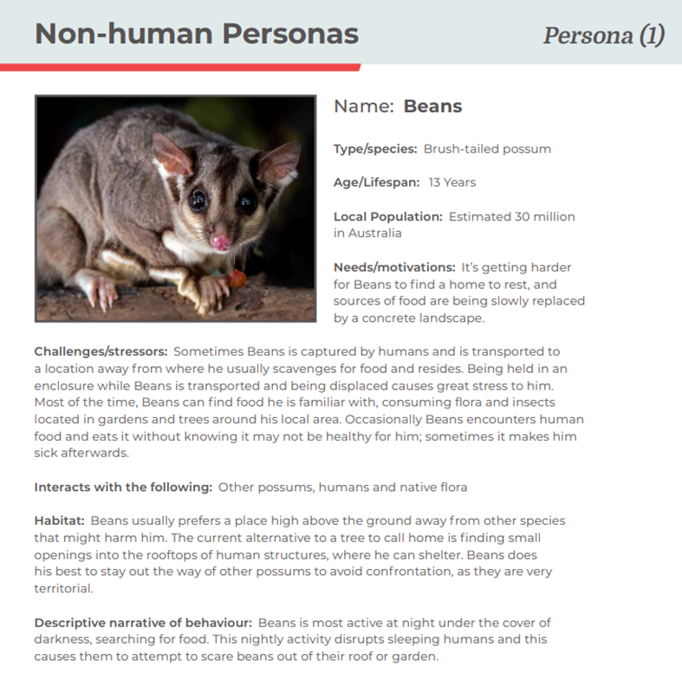
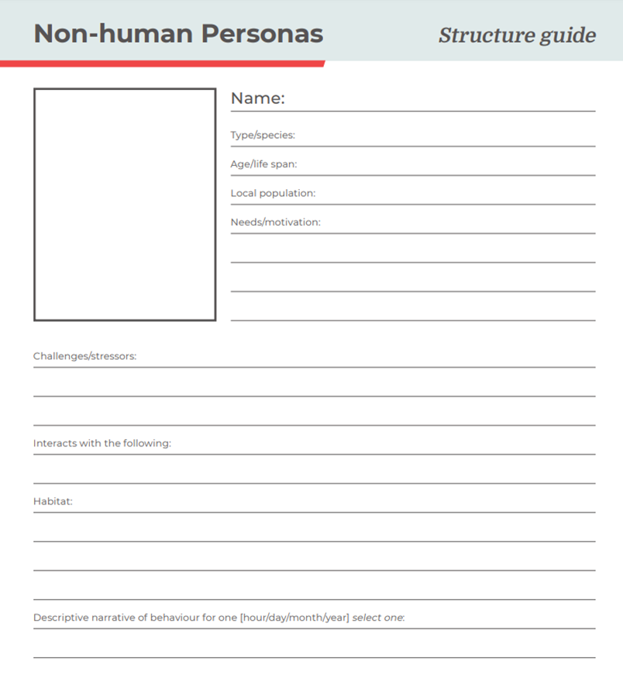
Example of template for non-human persona https://miro.com/app/board/o9J_l2wNzU8=/
Available at: http://designthinkmakebreakrepeat.com/uploads/templates/Non-human%20Personas_Structure%20guide.pdf

Slide 15
Assignment
Create a more-than-human persona
Based on collected primary and secondary stakeholder data, create a more-than-human persona.
More-than-human personas can help ensuring that the needs of both human and non-human stakeholders are considered when making design decisions, enable designers to expand human-centred design for a more nuanced understanding, leading towards a more inclusive design practice, and help when designers do not have direct access to the stakeholders.​

Slide 16
References
Sznel, Monika (2020). The time for Environment-Centered Design has come, Medium, available at: https://uxdesign.cc/the-time-for-environment-centered-design-has-come-770123c8cc61
Sznel Monika (2020b): Your next persona will be non-human — tools for environment-centered designers, https://uxdesign.cc/your-next-persona-will-be-non-human-tools-forenvironment-centered-designers-c7ff96dc2b17, (2020)
Tomitsch, Martin (2022). The case for using non-human personas in design. Why it is time to move beyond just designing for humans. Medium. Available at: https://uxdesign.cc/the-case-for-using-non-human-personas-in-design-7f3343ae2994
Cooper Alan (2004). Inmates Are Running the Asylum, The: Why High Tech Products Drive Us Crazy and How to Restore the Sanity. Sams Publishing.
Hernandez-Santin C., Amati M.; Bekessy, S.; & Desha C. (2023). Integrating biodiversity as a non-human stakeholder within urban development. Landscape and Urban Planning, 232, 104678. ISSN: 01692046, https://doi.org/10.1016/j.landurbplan.2022.104678
Nielsen, L. (2013): Personas. In: "The Encyclopedia of Human-Computer Interaction, 2nd Ed.". The Interaction Design Foundation. Available at: http://www.interaction-design.org/encyclopedia/personas.htm
Tomitsch, Martin; Fredericks, Joel; Vo, Dan; Frawley, Jessica; & Foth, Marcus. (2021). Non-human Personas. Including Nature in the Participatory Design of Smart Cities. Interaction Design and Architecture(s). 102-130. 10.55612/s-5002-050-006.

Slide 17
This teaching activity was developed as part of the MOVA project co-funded by the European Union. https://mova.uni.mau.se/
Disclaimer: Funded by the European Union. Views and opinions expressed are however those of the author(s) only and do not necessarily reflect those of the European Union or the European Education and Culture Executive Agency (EACEA). Neither the European Union nor EACEA can be held responsible for them.

