Slide 1
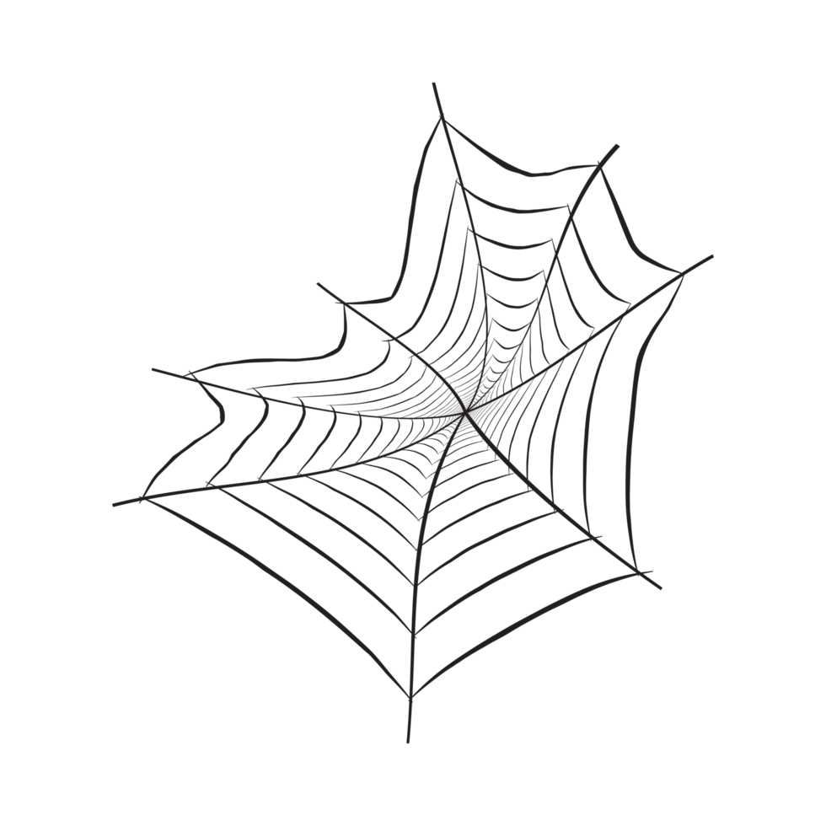


Experiencing Ecosystems and Entanglement

Slide 2
Summary
After this teaching activity, students should be able to grasp the complex topics of Ecosystems and Entanglement within more-than-human-centred design. First, they will visit a specific context to inspire the identification of more-than-human actors. Thereafter, they will explore the interrelations between all actors and visualize the dynamic ecosystem web in an embodied experience using yarn to connect the relationships between actors. Then, students will consider, express and experience a given design case’s positive and negative impact on the ecosystem and its actors. This exercise concludes with a reflection on the dynamic and interconnected nature of the more-than-human ecosystem and your own positionality in more-than-human-centred design.
Learning outcomes
After the teaching activity students should be able to:
Identify the impact of a design on actors in an ecosystem
Describe the connection between the interconnected and dynamic nature of the more-than-human ecosystem and the concept of entanglement.
Construct a dynamic web of the ecosystem, identifying relationships
Reflect on their role and responsibilities as designers within the more-than-human world

Slide 3
Outline/Content
Ecosystems and entanglement
Making an ecosystem web

Slide 4
Key readings/materials
Timothy Morton. (2010). The Ecological Thought. Harvard University Press.
Video material:
https://youtu.be/v6ubvEJ3KGM?si=5PZgt-GKOzaBeg3p
crash course ecosystem ecology (10 minutes)
The books by Anne Sverdrup Thygeson (a biologist specialising in insects and a writer) are filled with illustrative examples of how species are entangled and how humans greatly depend on them.
https://youtu.be/VgyMbS6qs0M?si=e7UXoGieftTndsZH (video of her reading a segment from the book on nature’s shoulders)
Ted talk about book Extraordinary insects:
https://youtu.be/FR1eoOy1tSM?si=TzN4TIOn9NBiO9_n

Slide 5
Human-centred design
focuses on creating products and systems tailored to meet the needs, preferences, and limitations of human users

Slide 6
More-than-human-centred design
expands the scope beyond human users to consider the interactions and well-being of all entities involved, including animals, plants, ecosystems, and technological systems

Slide 7
What are ecosystems and how do they work (entanglement)?
Notes:
https://youtu.be/XVD5izWXmKo?si=j5OC7OG8ce4JvoRn
Short & explains interdependence well
https://youtu.be/v6ubvEJ3KGM?si=qOQNAryUz6x8jwLP
Crash course (10 minutes), explains possible relations, textual, explains endlessness well, more academic level. Talks about toxins and polution.

Slide 8
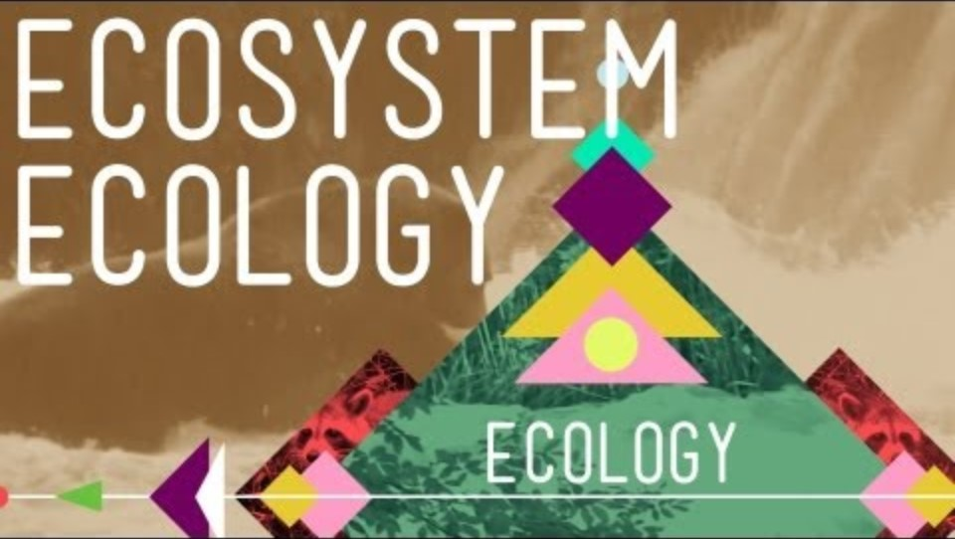
Notes:
https://youtu.be/XVD5izWXmKo?si=j5OC7OG8ce4JvoRn
Short & explains interdependence well
https://youtu.be/v6ubvEJ3KGM?si=qOQNAryUz6x8jwLP
Crash course (10 minutes), explains possible relations, textual, explains endlessness well, more academic level. Talks about toxins and polution.

Slide 9

Today
Introduction and defining actors
3,5 h
In-class topic & case introduction
On-site exploration and actor defining
Activity overview
Embodied web
Reflection

Slide 10
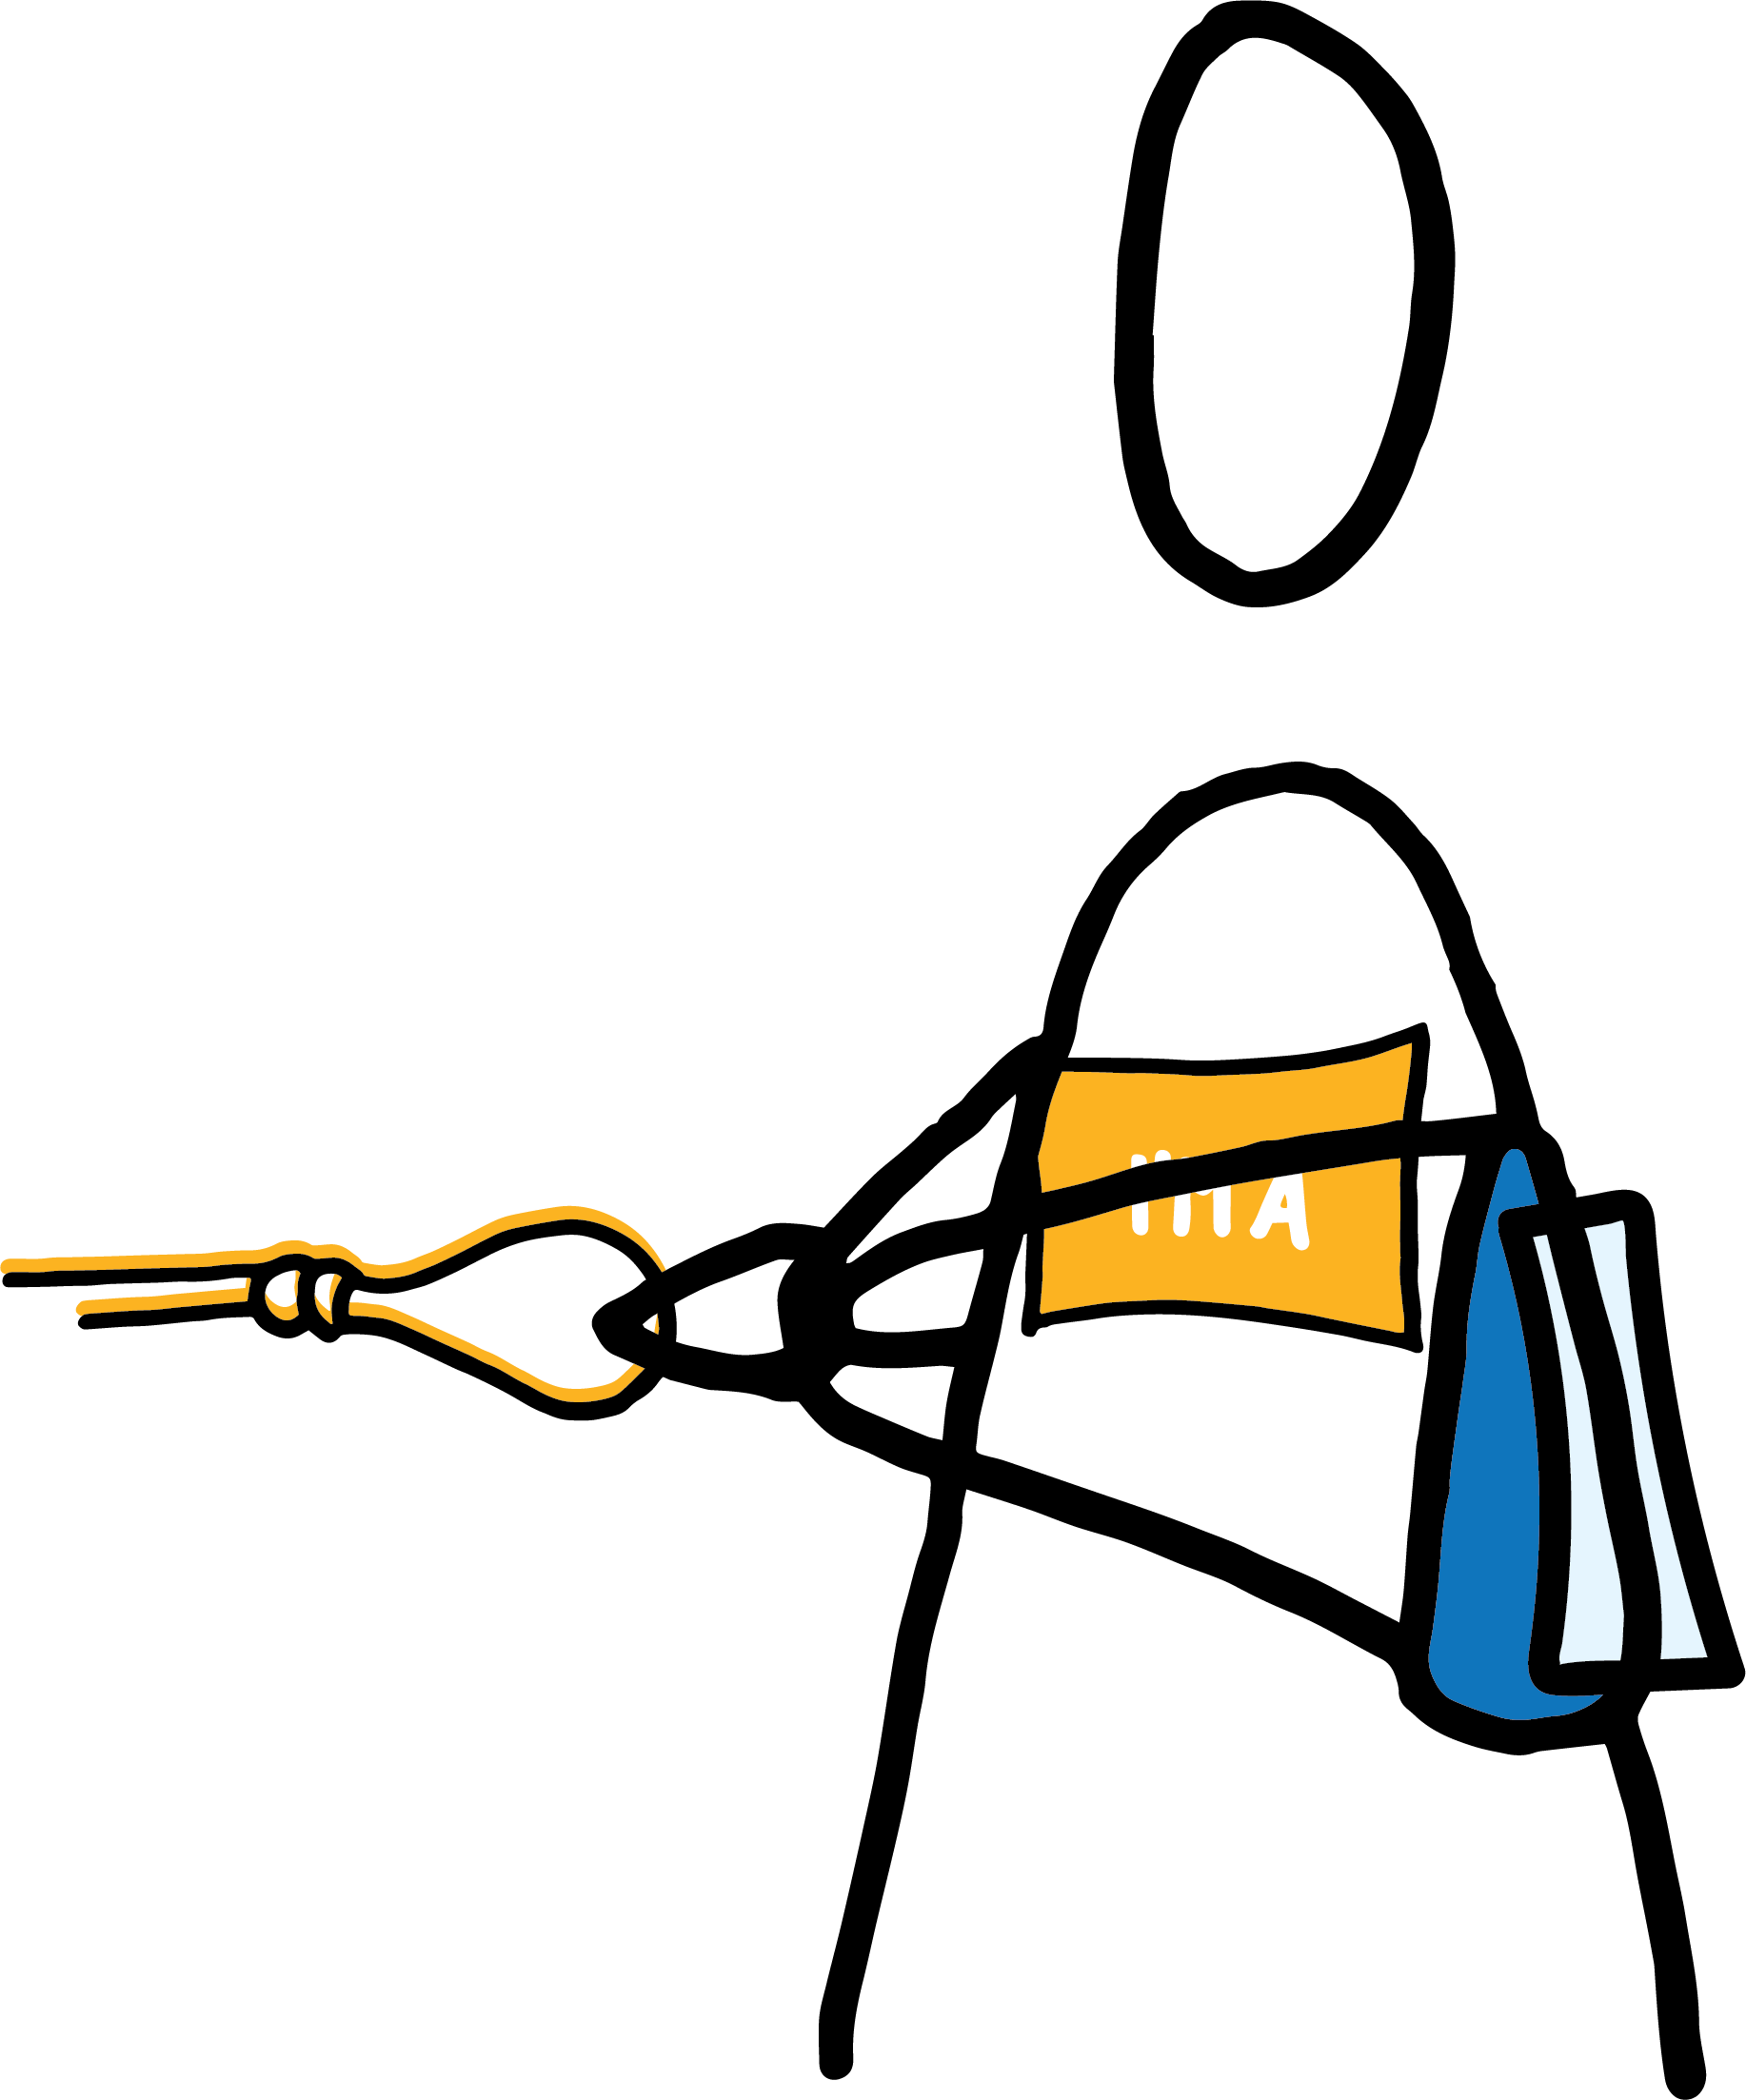
Exploring the context
Defining actors on-site

Slide 11
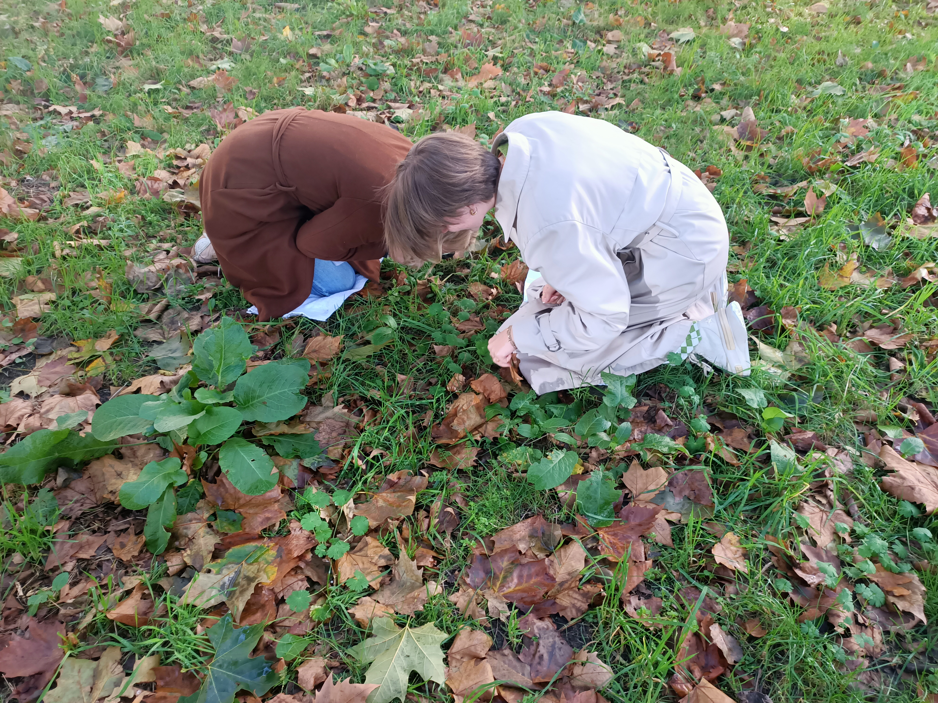
Exploring the context
Defining actors on-site

Slide 12
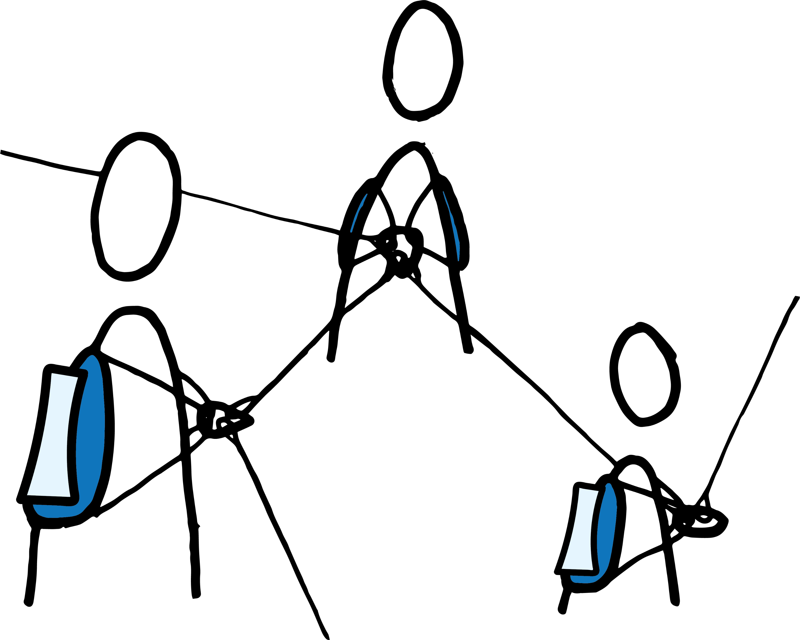









Making
the web
I'M A
Soil
habitat
nutrients
food
Defining actors
relationships
I'M A
Worm
I'M A
Oak tree
fertilisation

Slide 13
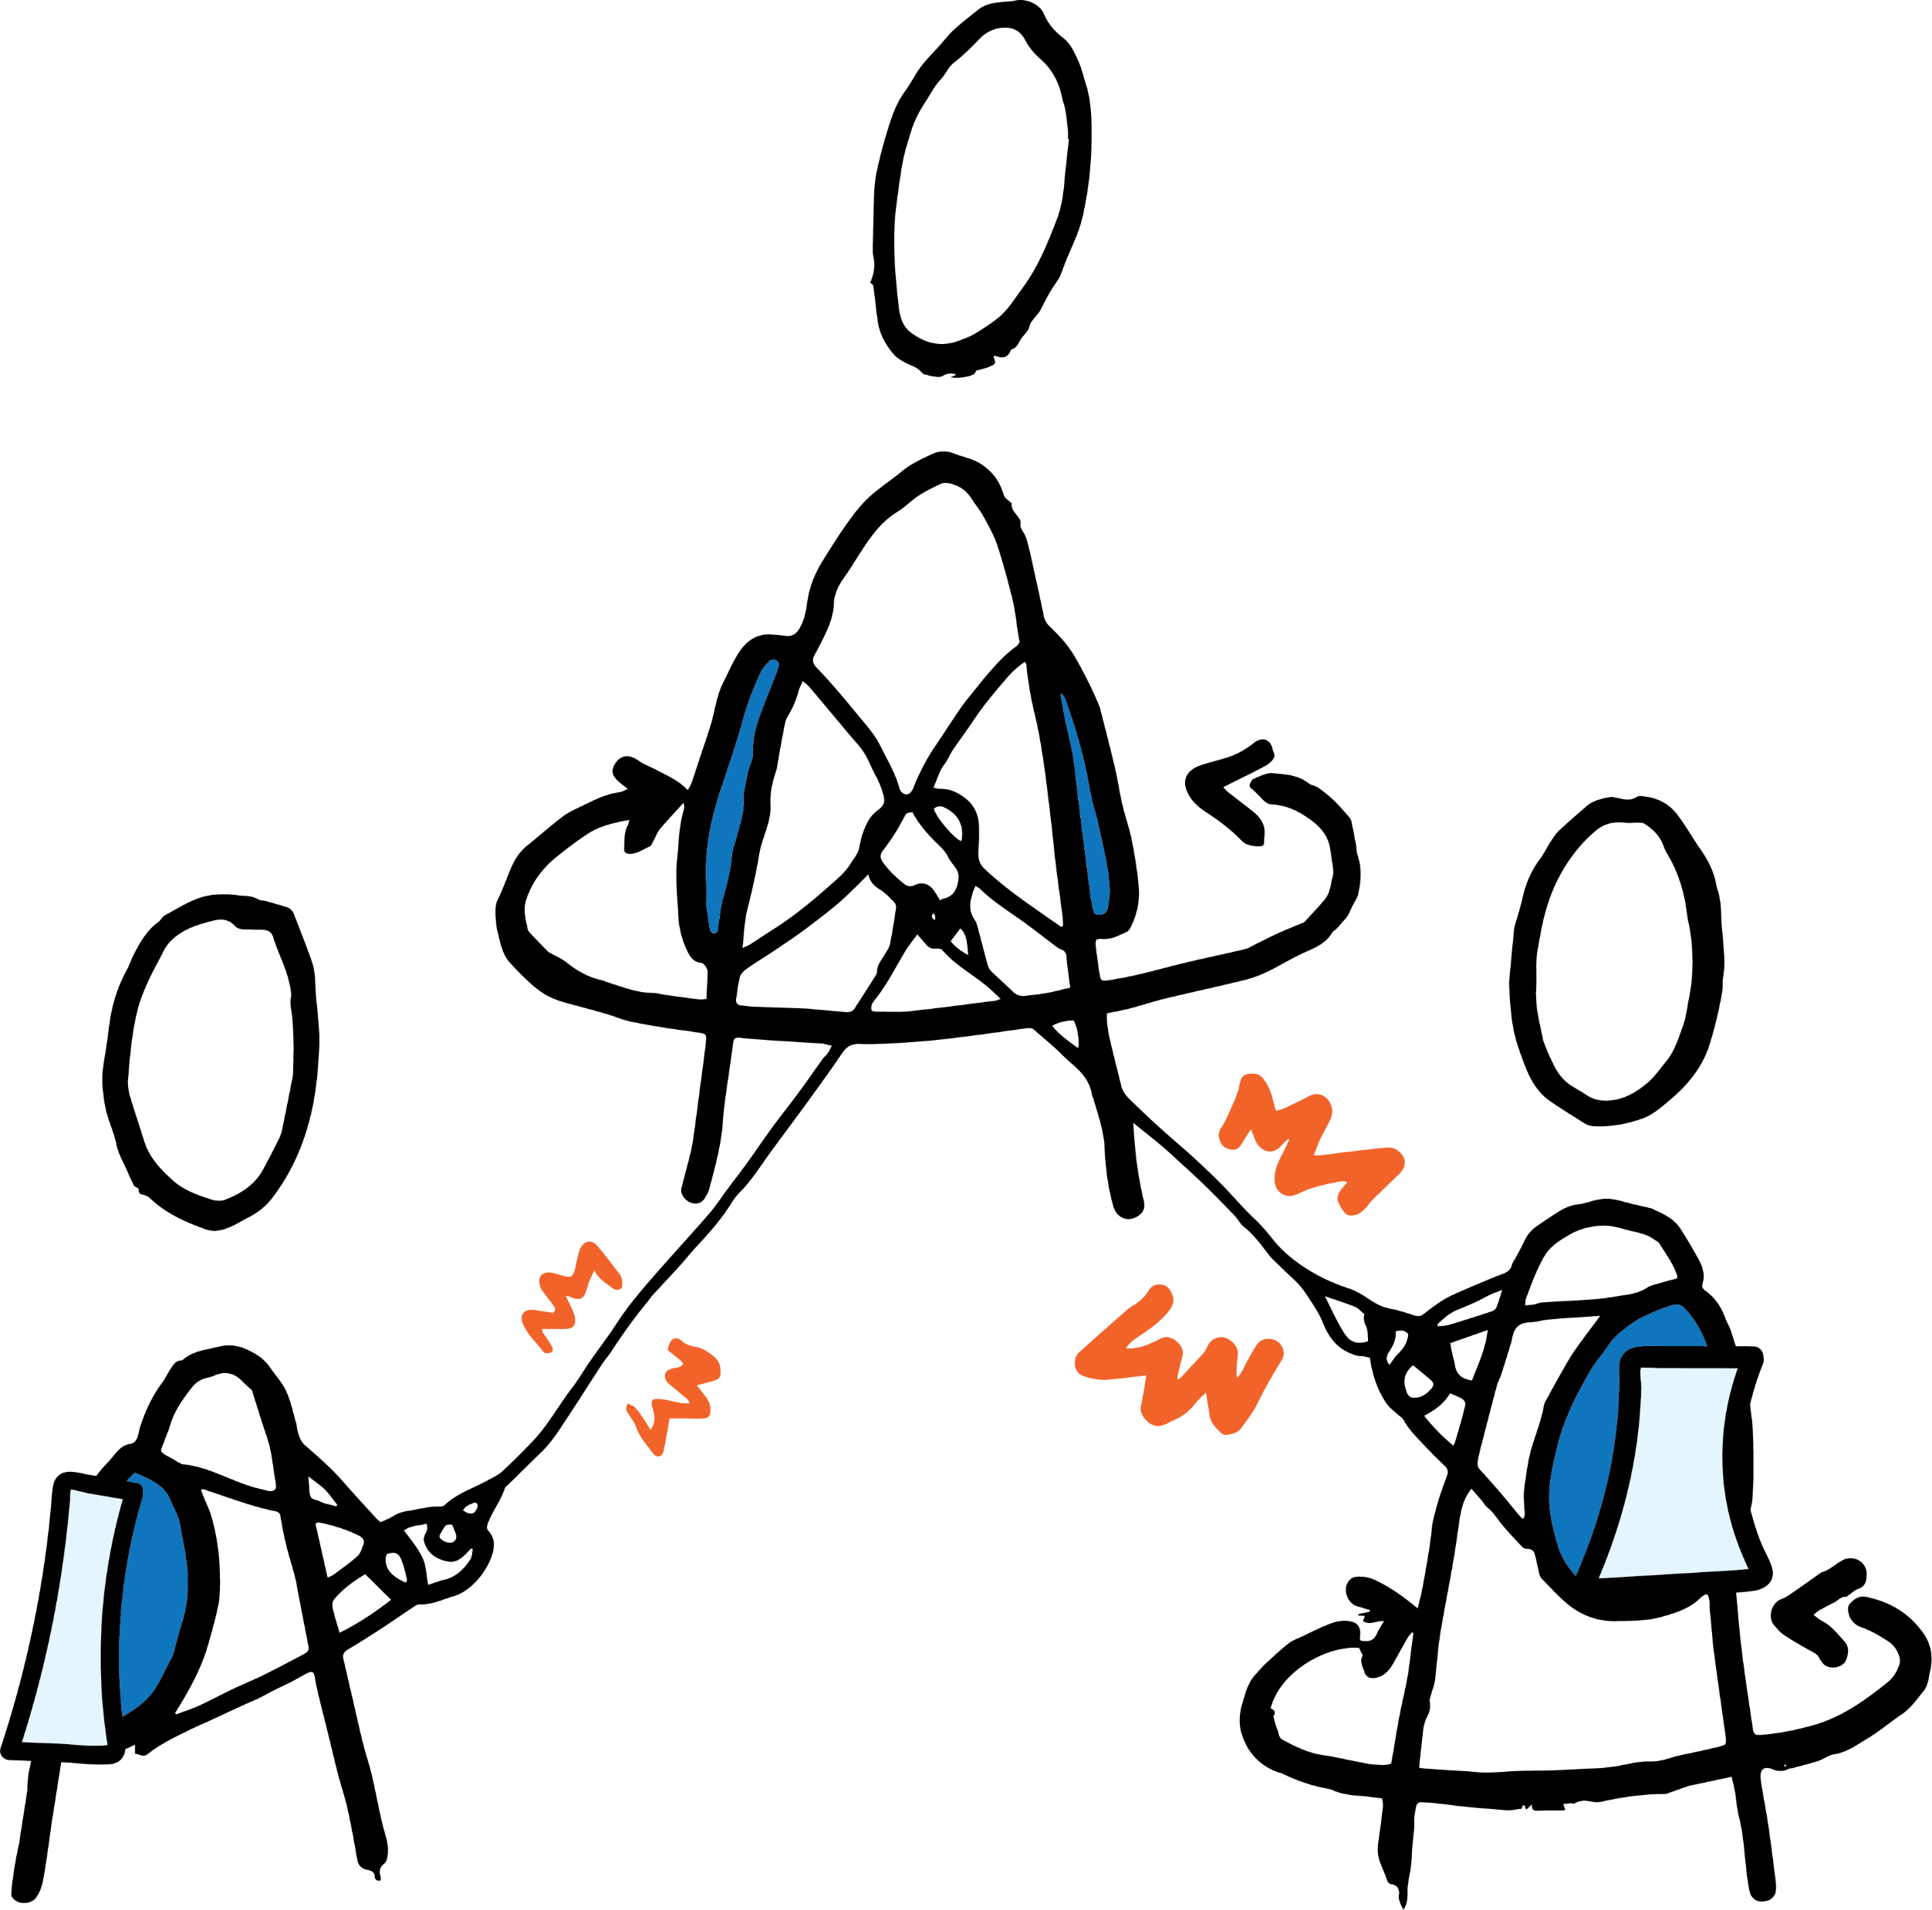
Express how you are affected as an actor!
Making
the web
Intuitive impact experience by twisting back and forth

Slide 14
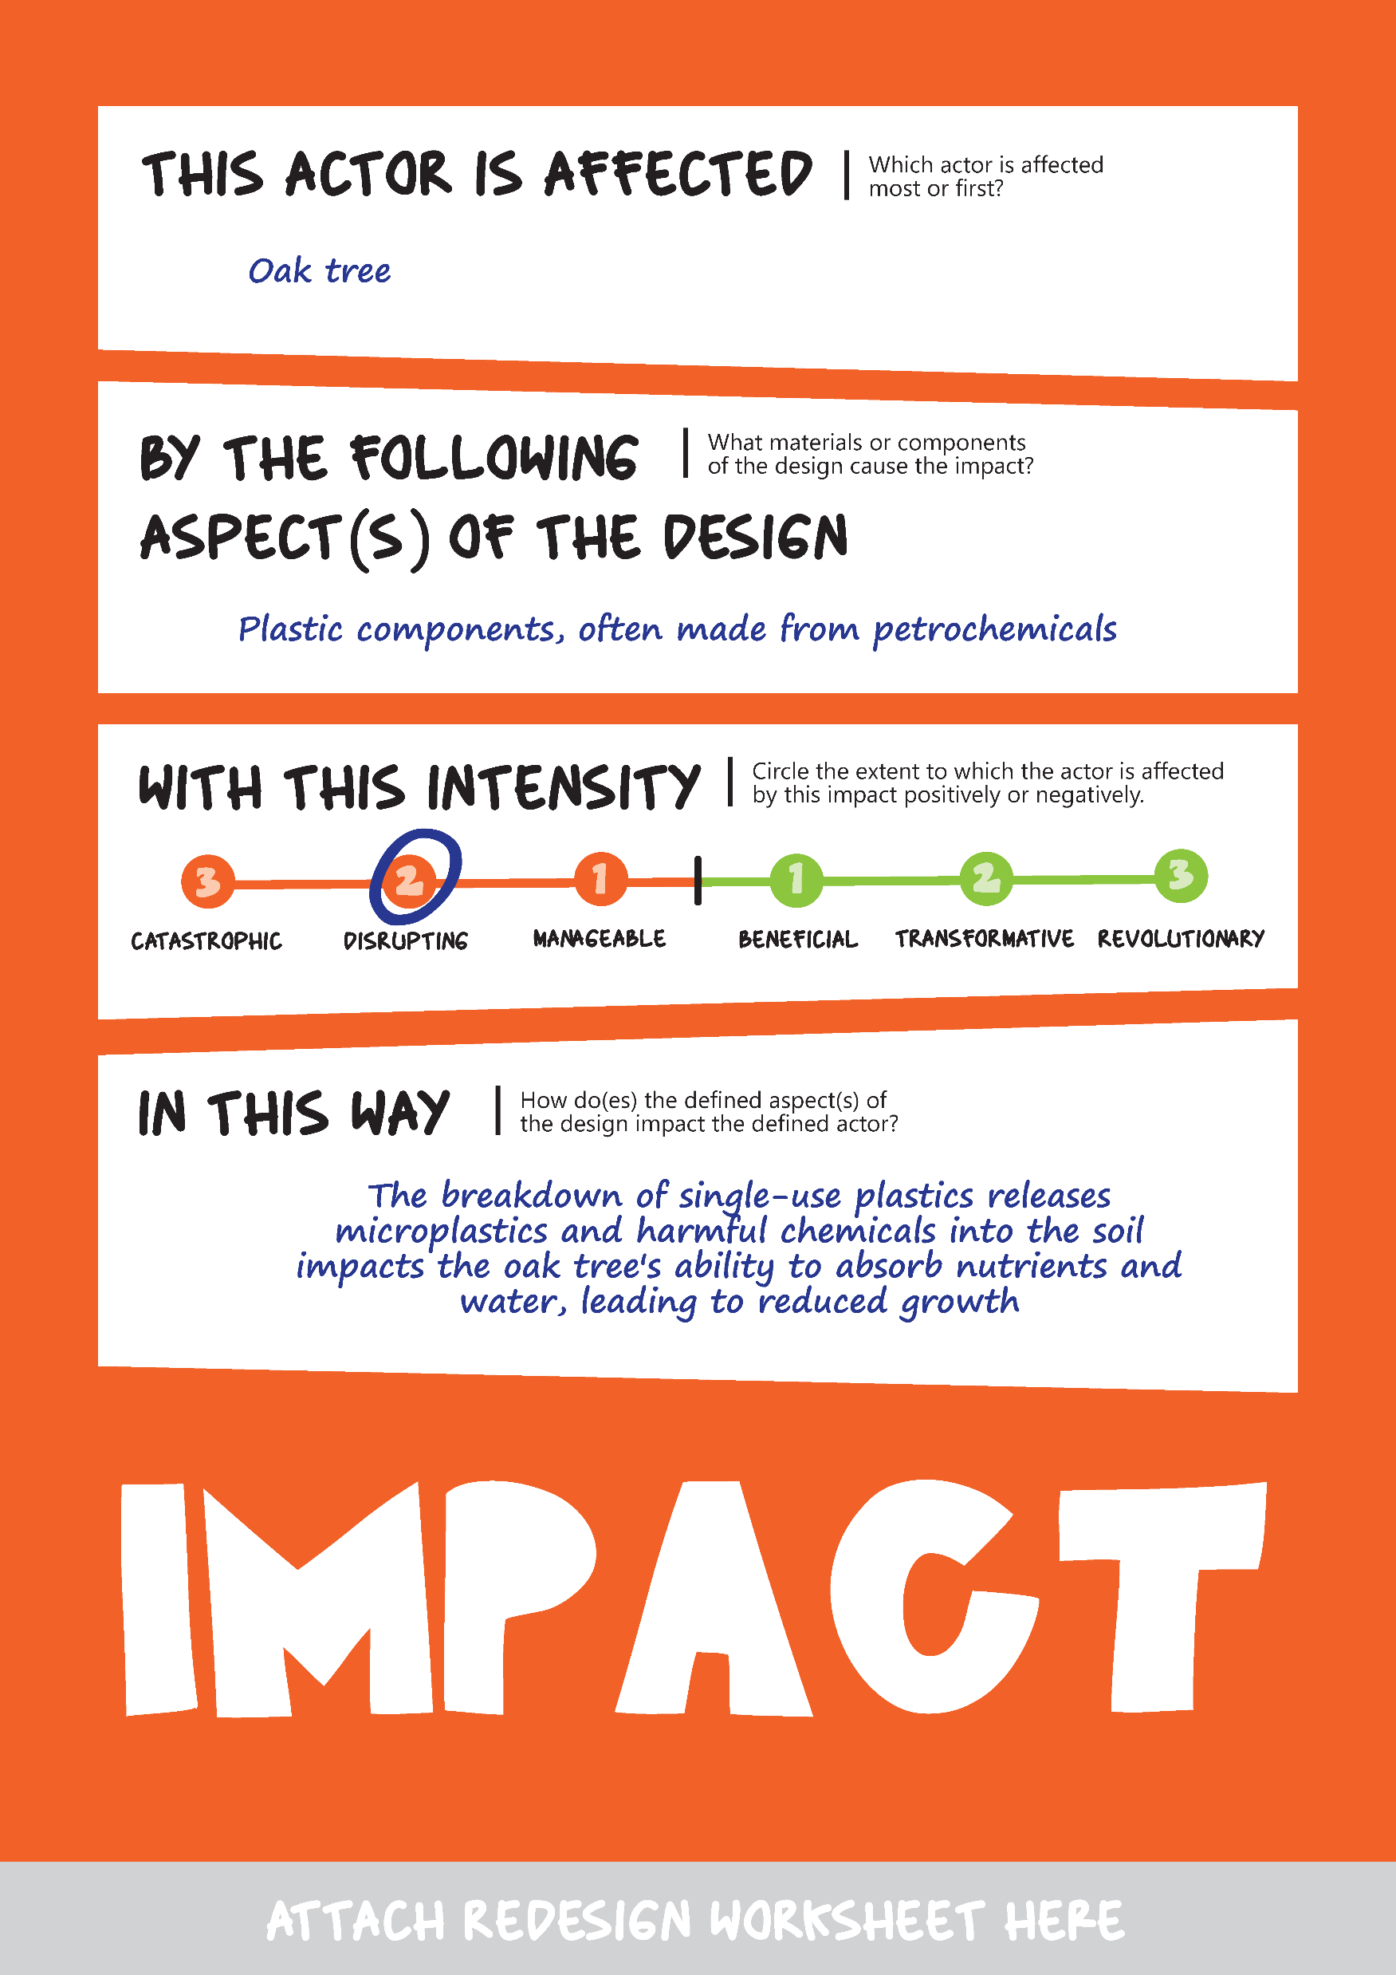
Defining Impact
Defining impact caused by the design

Slide 15
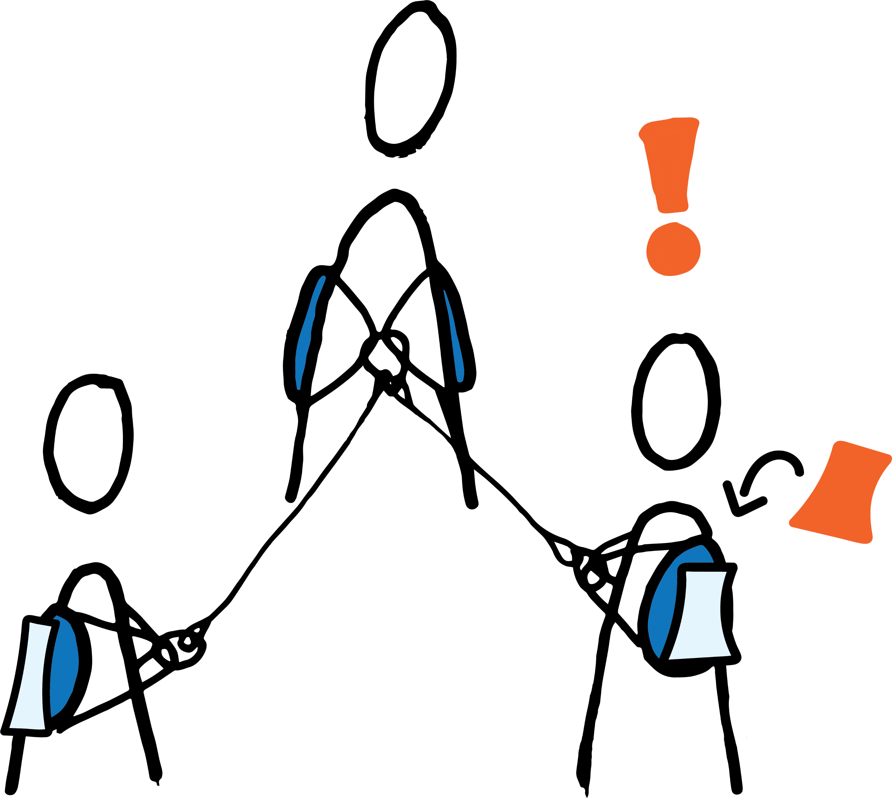
Who is affected most?
Making
the web
Distributing impact weights

Slide 16
What will you learn?
Notes:
https://youtu.be/XVD5izWXmKo?si=j5OC7OG8ce4JvoRn
Short & explains interdependence well
https://youtu.be/v6ubvEJ3KGM?si=qOQNAryUz6x8jwLP
Crash course (10 minutes), explains possible relations, textual, explains endlessness well, more academic level. Talks about toxins and polution.

Slide 17
You will be able to...
Identify the impact of a design on actors in an ecosystem
Describe the relation between the interconnected and dynamic nature of the more-than-human ecosystem and the concept of entanglement.
Construct a dynamic web of the ecosystem, identifying relationships
Reflect on your role and responsibilities as designers within the more-than-human world

Slide 18
Cases
Street lantern
Drone
Public outdoor fitness park
Bus stop shelter
What product will we be experiencing together?
Foldable umbrella
Pen

Slide 19
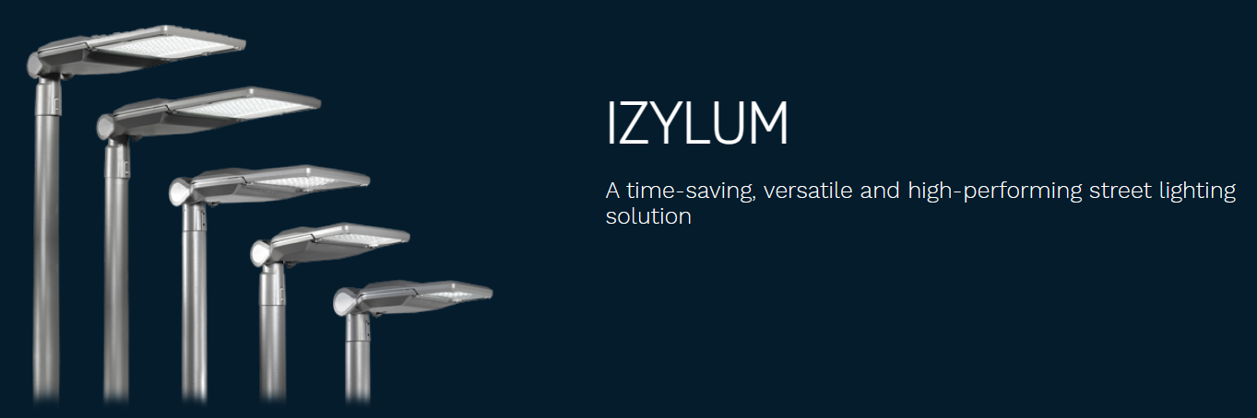
Street lantern
Street
lantern
Link to product

Slide 20
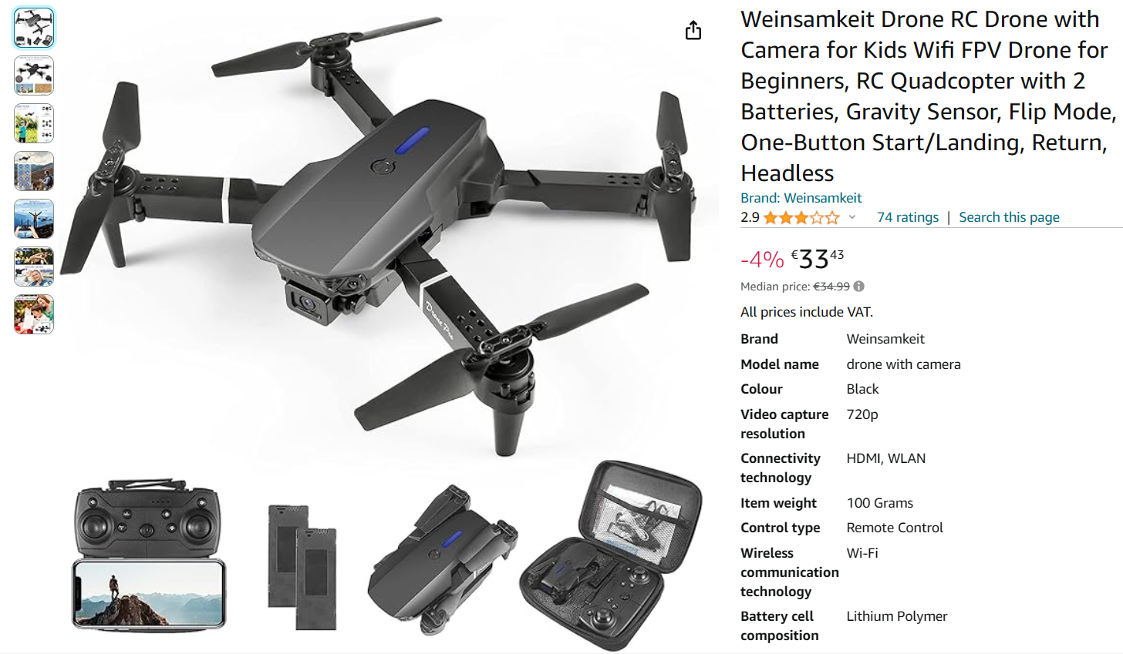
Link to product
Drone
Drone

Slide 21
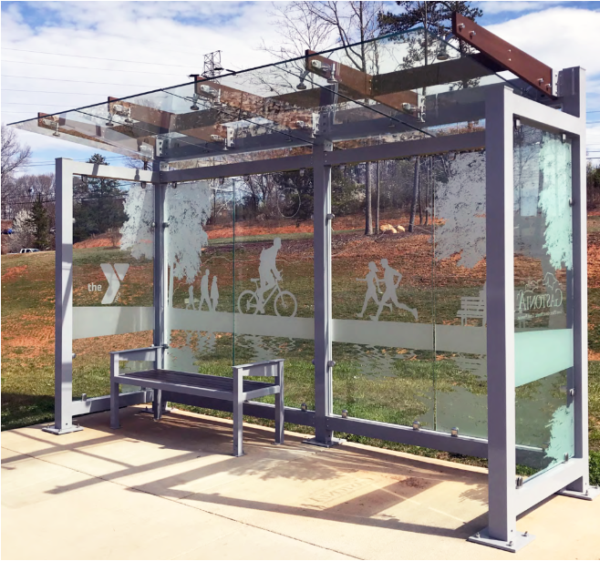
Bus stop
shelter
Bus stop
shelter
Link to product

Slide 22
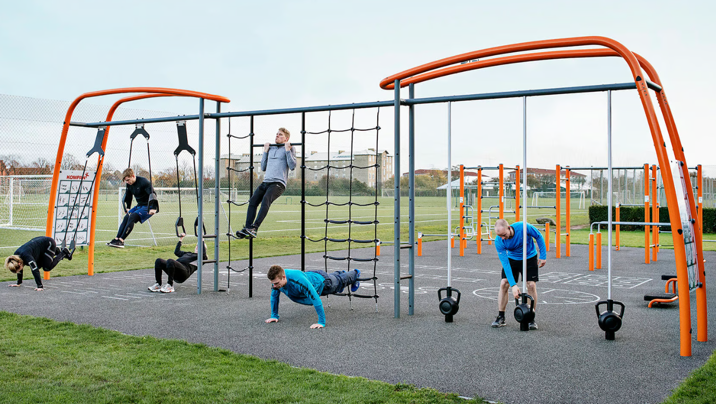
Public outdoor fitness park
Public
outdoor fitness park
Link to product

Slide 23
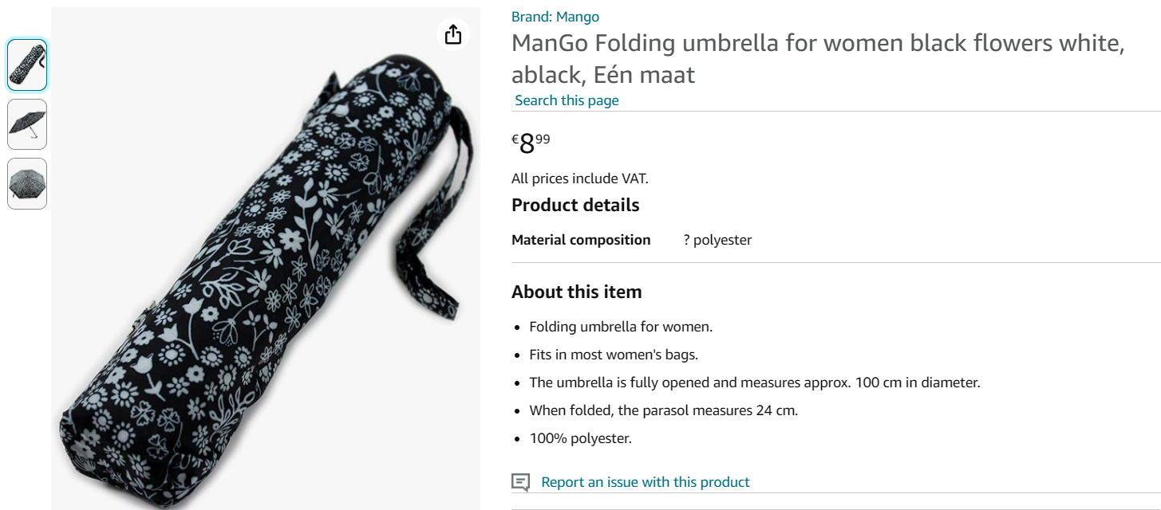
Foldable umbrella
Foldable
umbrella
Link to product

Slide 24
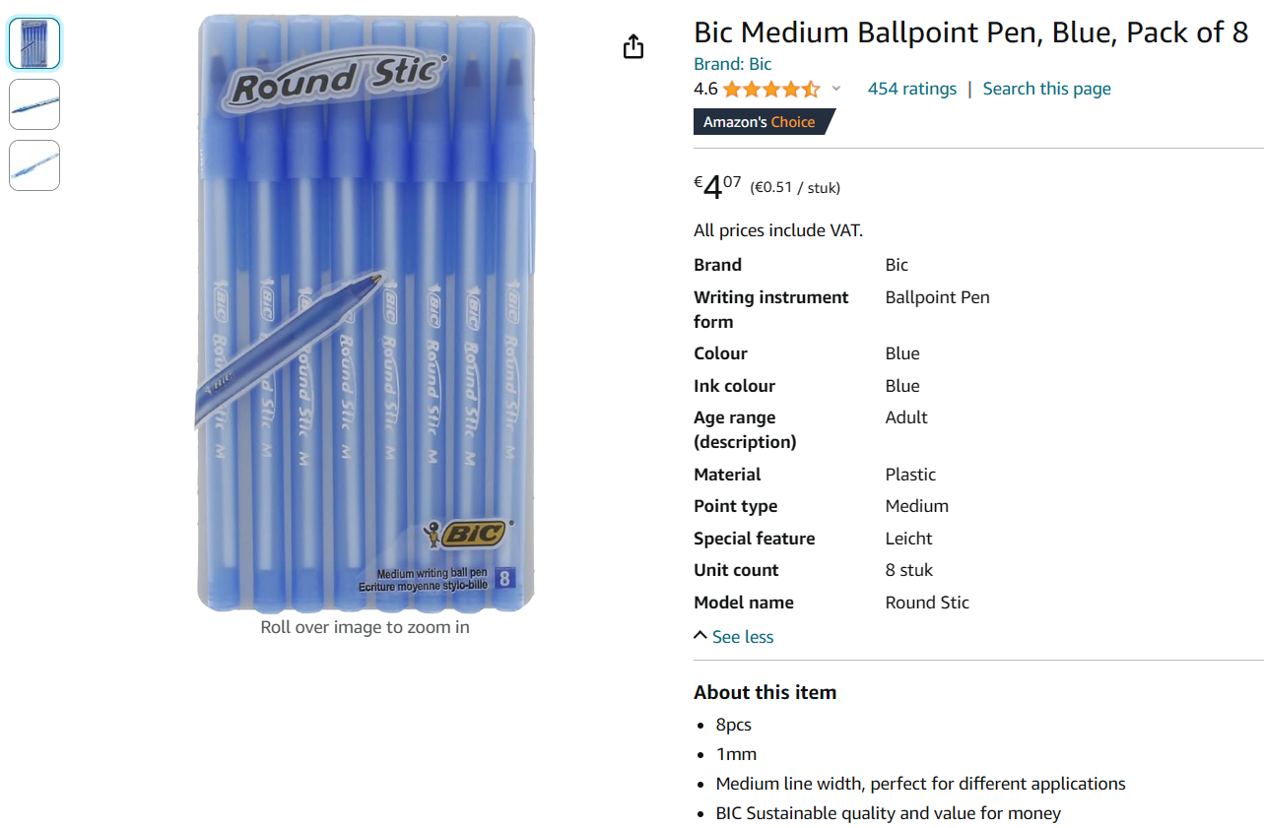
Pens
Link to product
Pens

Slide 25
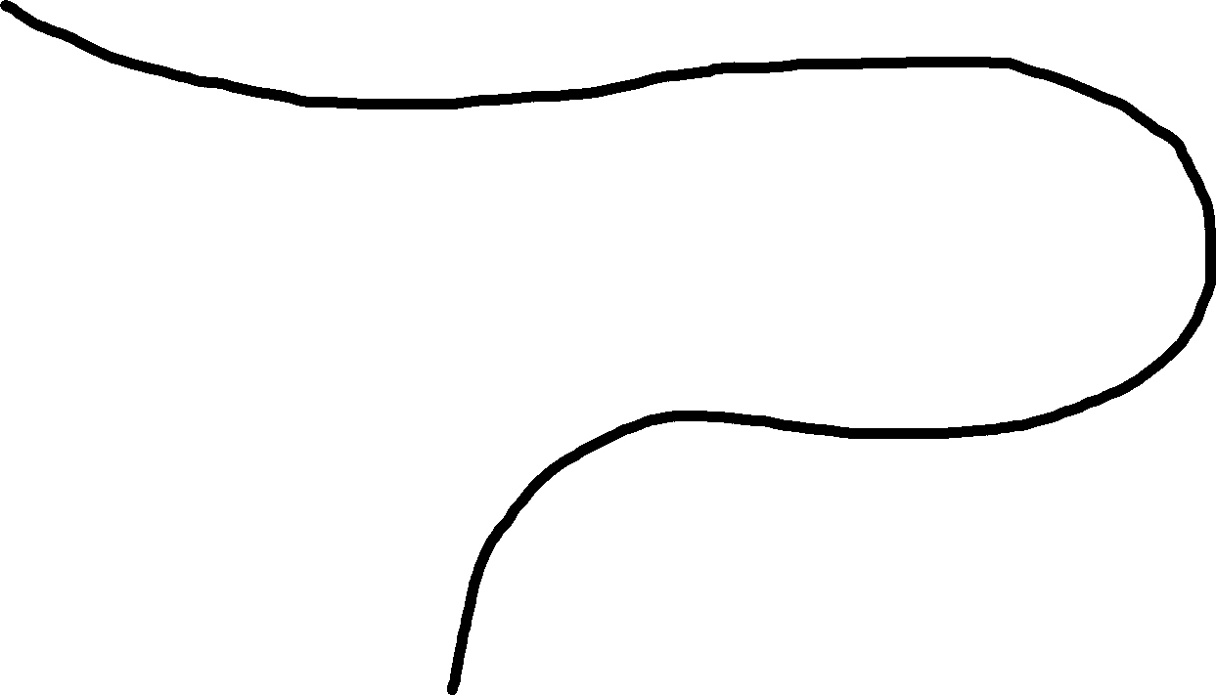
2
3
1
Look individually for actors in the ecosystem.
Make sure you represent both abiotic (e.g., sun) and biotic factors. The latter should consist of different trophic structure layers: primary producers (plants), consumers (e.g., animals, bacteria), detrivores (e.g., worms), and decomposers (fungi)
Create a list of all actors in the ecosystem that are impacted during all lifecycle phases.
Go to an ecosystem that represents the product's lifecycle phase (production/use/after use)
5
4
Part 1
Today
Assign 1 actor to each remaining student
Select a group of 3 students that will lead the next activity.

Slide 26
7
8
6
Make relations between actors with yarn strings and discuss relations
Think about habitat, nutrients, fertilization and food etc.
Consider case impact during the entire product lifespan through intuitive impact expression
Prepare materials
Spread out with a 1m distance
10
9
Part 2
Today
Distribute Impact weights
Define impact through worksheets
11
Reflection

Slide 27
Let's reflect!
What did you learn?
What will be your takeaways to take to future design projects?

Slide 28
Interconnectedness & dynamic nature of MTH ecosystem
Careful considerations in MTH design (approaches)
Complexity, interconnectedness, harmony vs friction, continuous context involvement, endlessness
Positionality as a designer in a MTH context
Situatedness, exploration, material choice, HCD vs MTHCD, seasonality
Your relation, human perspective,
representability, collective effort non-human agency

Slide 29
This teaching activity was developed as part of the MOVA project co-funded by the European Union. https://mova.uni.mau.se/
Disclaimer: Funded by the European Union. Views and opinions expressed are however those of the author(s) only and do not necessarily reflect those of the European Union or the European Education and Culture Executive Agency (EACEA). Neither the European Union nor EACEA can be held responsible for them.

