Slide 1


Ecological Probes for experiencing nature

Slide 2
Summary
An introduction to creating ecological probes and using them to explore a natural environment in a sensory and intuitive manner. This creates a starting point to find tangible ways to involve the more-than-human world in your design.
Learning outcomes
Make (pre-designed) ecological probes to explore a natural environment’s qualities.
Reflect on the experience of exploring the natural context through probes and make sense of it.
Consider and reflect on the impact of your actions on non-humans in the environment.
Imagine new or improved ecological probes suitable for your project.

Slide 3
Outline/Content
Why work with ecological probes?
What are ecological probes?
Make your own ecological probes
Explore your environment with the ecological probes
Analyse your findings and reflect on the use of the probes

Slide 4
Key readings
Rosén, A. P., Normark, M., & Wiberg, M. (2022, October). Noticing the environment–A design ethnography of urban farming. In Nordic Human-Computer Interaction Conference (pp. 1-13).

Slide 5
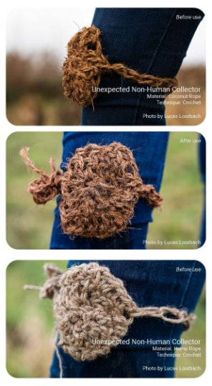
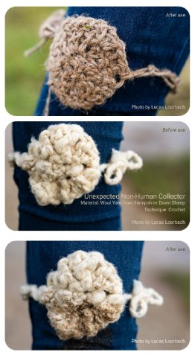
Why ecological probes?
To aid more-than-human-centred design
They raise awareness of non-humans involved
Notes:
Explain what more-than-human design is.
Ecological probes allow for noticing non-humans in an engaging way. This helps to create awareness of non-human entities that live in a certain environment, which can be useful when designing for that environment. Awareness of the non-humans can be a first step towards involving and considering them in your process.

Slide 6
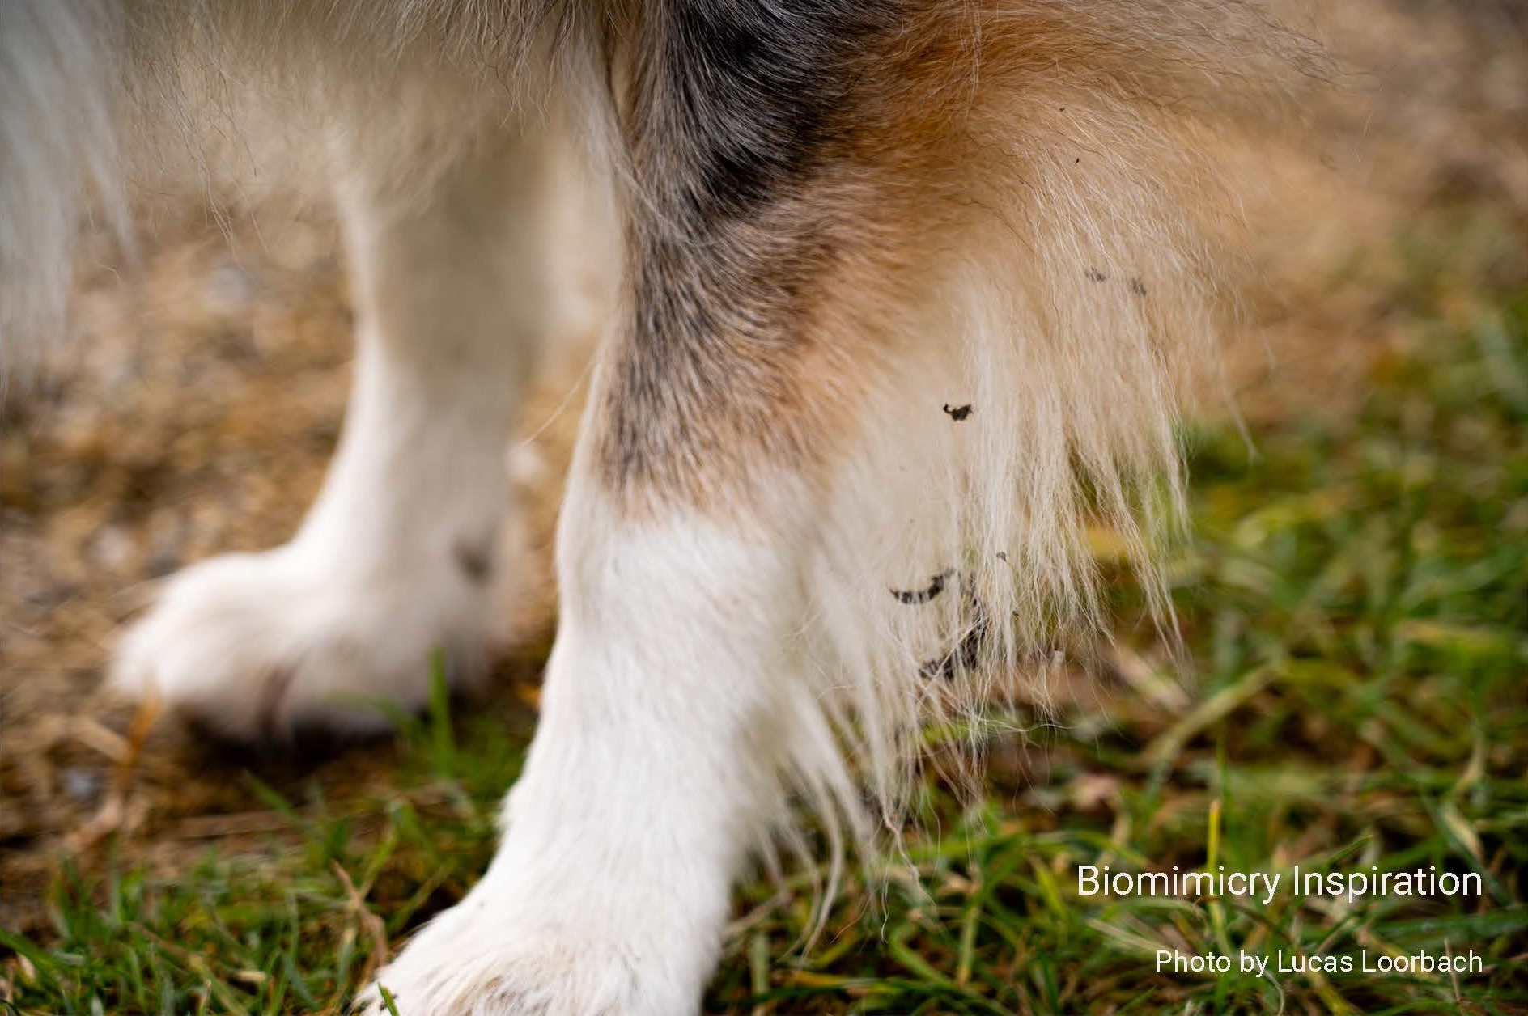
What are ecological probes?
They originated from a student project about creating appreciation for non-humans/nature by letting people notice them.
Based on biomimicry: How seeds stick to fur as inspiration for collecting non-human material unintentionally.
Purpose:
Collect & displace non-human material
Increase understanding of a natural environment
Input for reflection

Slide 7
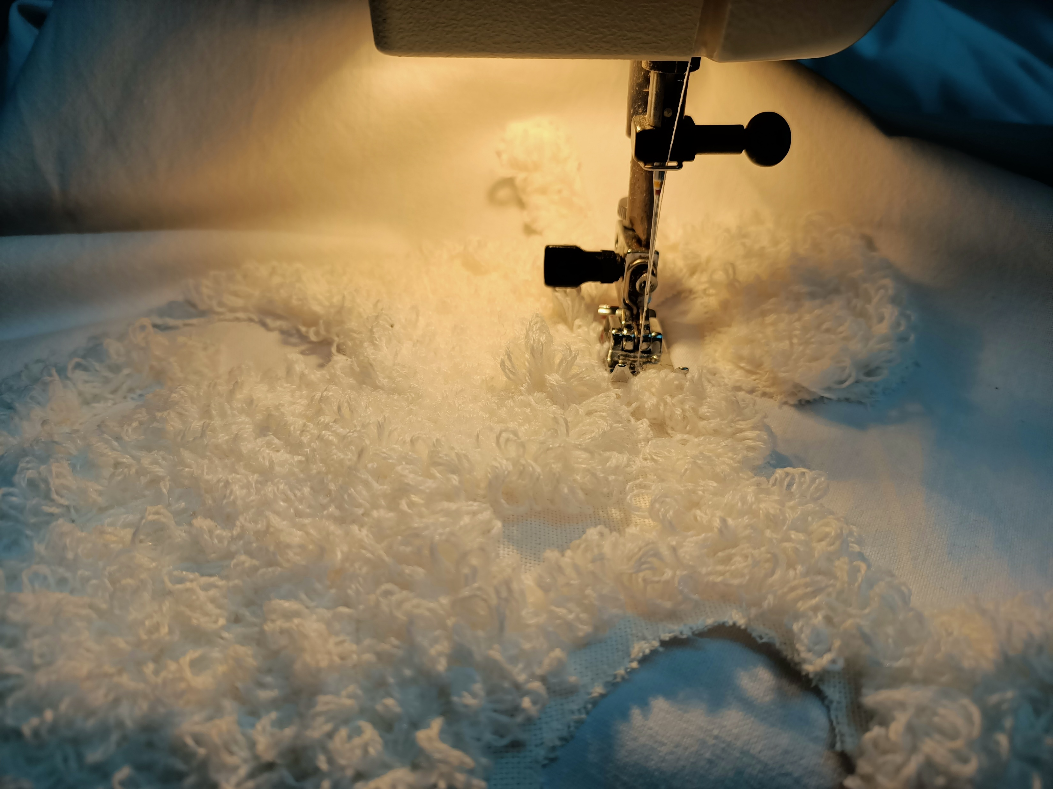
MAKING: Homework
(make groups?)
Make probes by following the DIY worksheet
Help each other when unfamiliar with techniques

Slide 8
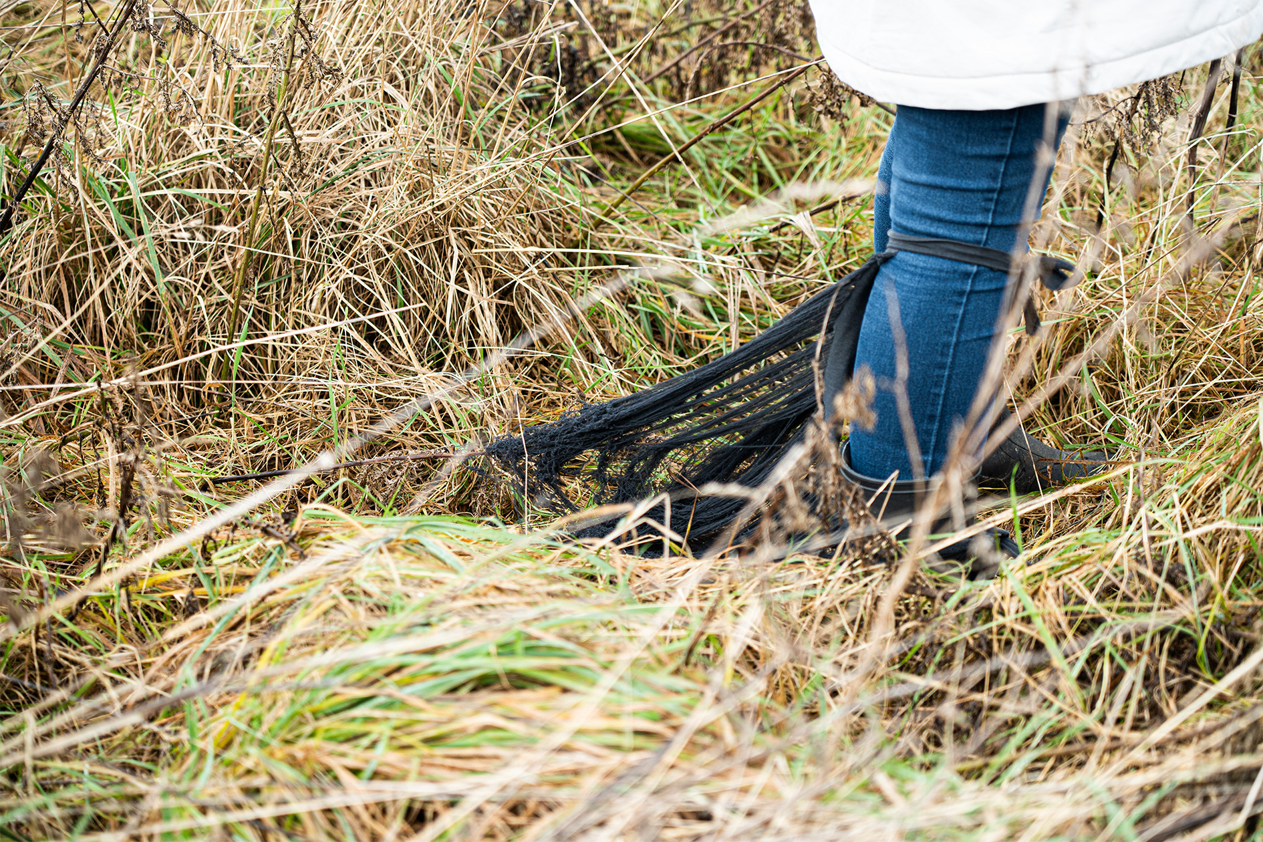
EXPLORING
Where to explore:
Outside, natural environment, context of a current project?
Things to try:
Go beyond a paved path, try different terrains
Consider the impact of the season
What to avoid:
Disturbing the environment
Remove living organisms carefully from your probe in the location they got attached to it (take a picture of them).
Do not leave trash and use natural materials for making your probe.
Do not go off the path when that is indicated (otherwise you disturb the ecosystem.
Document!

Slide 9
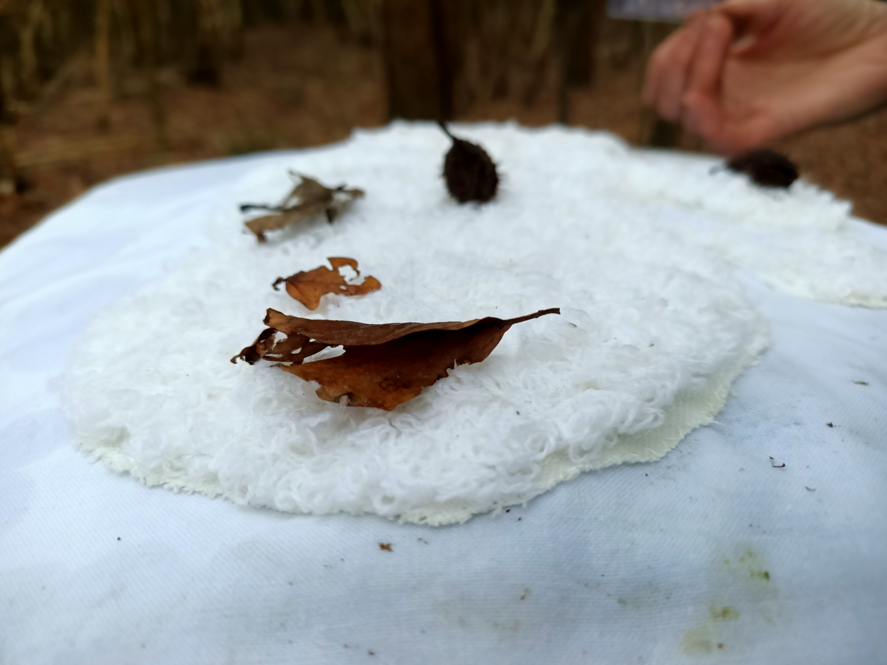
HOMEWORK: Analyse your exploration & Reflect
Use your pictures as a starting point to annotate your initial observations
Consider what these observations can say about the environment
Consider how you impacted the environment
What does it mean for your role as designer?

Slide 10
Reflection
Compare findings in small groups
Reflect on the following:
What is an insight that you got due to the use of the ecological probe?
How did the probe influence how you perceived the environment?
What did you learn about the more-than-humans you encountered?
How will you use your insights and learning in future design activities?
How would you change the probe to improve the exploration or to explore something else?

Slide 11
This teaching activity was developed as part of the MOVA project co-funded by the European Union. https://mova.uni.mau.se/
Disclaimer: Funded by the European Union. Views and opinions expressed are however those of the author(s) only and do not necessarily reflect those of the European Union or the European Education and Culture Executive Agency (EACEA). Neither the European Union nor EACEA can be held responsible for them.

