Slide 1


Constructing design requirements based on more-than-human values and needs

Slide 2
Summary
In this teaching activity, students will learn how to analyse more-than-human values/needs (identified in previous teaching activities). Based on this, they will construct specific design requirements that guide a design process forward. In doing so, the judgments and design decisions involved will be explained in an explicit, debatable, and transparent way.
Learning outcomes
After the teaching activity students should be able to:
analyse the identified values and needs of more-than-human actors and construct specific design requirements,
explain the involved judgments and design decisions in an explicit, debatable, and transparent way.

Slide 3
Content
Value/need hierarchy
Design objectives
Design requirements
Design decisions

Slide 4
Key readings
Van de Poel, Ibo (2013). Translating Values into Design Requirements. In: Michelfelder D., McCarthy N., Goldberg D. (Eds.) Philosophy and Engineering: Reflections on Practice, Principles and Process. Philosophy of Engineering and Technology. Dordrecht.

Slide 5
Constructing design requirements
Analyze the identified values and needs of more-than-human actors and construct specific design requirements.
Explain the involved judgments and design decisions in an explicit, debatable, and transparent way.
Notes:
As words describing values and needs are often perceived as too general, it can sometimes be hard for a designer to make them concrete and incorporate them into design work.
How can we go from general words to specific design requirements?
In this teaching activity, you will learn to construct design requirements based on more-than-human values and needs.
You will be introduce to a method for analysing the identified stakeholders values and needs and construct specific design requirements, which play an important role in guiding a design process.
The exercise is an adaptation of a method originally developed by Ibo Van de Pol who is professor in ethics and technology, and is head of Values, Technology & Innovation på Delft University of Technology (NL).

Slide 6
Value/need hierarchy
More-than-human actor:
Value/need
Design objectives
Design requirements
Value hierarchy worksheet developed by: van de Poel Ibo (2013). Translating Values into Design Requirements. In: Michelfelder D., McCarthy N., Goldberg D. (Eds.) Philosophy and Engineering: Reflections on Practice, Principles and Process. Philosophy of Engineering and Technology. Dordrecht: Springer.
Notes:
The method consist of you formulating a value/need hierarchy of three levels:
1) the stakeholder value/need (previously identified),
2) the design objectives, and (the goals that the design aims to reach),
3) the specific design requirements (a statement about an intended product that specifies what it is expected to do or how it will perform).
By constructing a value/need hierarchy, the identified values/needs are systematically translated into design requirements, and the value judgments and design decisions involved become explicit and transparent.
Value judgment is defined here as the designer’s opinion about whether something is good or bad, right or wrong.
Making these judgments explicit allows for critical reflection upon the translations made, that is, how a particular value has been translated into design requirements.
A values hierarchy makes the design choices, and especially the implied value judgments, more transparent to other stakeholders, which is important because design usually impacts on others besides the
designers.
This enables the debate among the stakeholders involved.
A value/need hierarchy may be helpful in pinpointing exactly where there is disagreement about the specification of values in design.
TEMPLATE
This is a template that you should use to develop this three layered value/need hierarchy through a systematic translation of a value/need into more specific design requirements.
Hands-on, workable design requirements.
The upper layer of the value hierarchy consists of a value/need, followed by an intermediate layer of design objectives, and then a thirds layer of design requirements at the bottom.
The upper level, that is, the value/need, is one of the core values or needs of your stakeholder, that you have previously identified.

Slide 7
Value/need hierarchy
More-than-human actor:
STEP 1: Select an identified value/need of the more-than-human stakeholder
Value/need
STEP 2: Analyse the value/need and construct one or more design objectives
Design objectives
Design requirements
Notes:
STEP 1: Seiect one value/needs as identified as important to the stakeholder.
STEP 2: Analyse the value/need and construct one or more design objectives.
In this case, design objectives refer to attributes or capabilities that the product, system or service should possess.
Such objectives may include striving to e.g. “maximize safety” or “minimize costs” without a specific target.

Slide 8
Value/need hierarchy
More-than-human actor:
STEP 1: Select an identified value/need of the more-than-human stakeholder
Value/need
STEP 2: Analyse the value/need and construct one or more design objectives
Design objectives
STEP 3: Construct specific design requirements
Design requirements
A design requirement is a statement about an intended product that specifies what it is expected to do or how it will perform.
Notes:
STEP 3: Construct specific design requirements.
The third step is to turn the design objectives into more specific targets, here referred to as specific design requirements.
What are the actions or means to achieve these objectives?

Slide 9
Value/need hierarchy
More-than-human actor: Monarch butterfly
Value/need
Liveable habitat
Shelter
Food
Water
Sunlight
Design objectives
Resting spots (flat stones, tree braches
Protection from harsh winds
Resting spots (flat stones, tree braches
Incubators min 10x10x10 cm
Design requirements
Notes:
Let’s start with an example with a human stakeholder.
You are working on a project where you design living spaces for elderly.
The value “elderly autonomy” is identified as important to the stakeholders.
What are the goals and aims that you should strive for? How can these be formulated as design objectives and design requirements?

Slide 10
Value/need hierarchy
More-than-human actor: Monarch butterfly
Value/need
Liveable habitat
Shelter
Food
Water
Sunlight
Design objectives
Space for 10 milkweed vines
Space for 10 marigolds
Space for 10 bee balms
Design requirements
Notes:
Let’s start with an example with a human stakeholder.
You are working on a project where you design living spaces for elderly.
The value “elderly autonomy” is identified as important to the stakeholders.
What are the goals and aims that you should strive for? How can these be formulated as design objectives and design requirements?

Slide 11
Value/need hierarchy
More-than-human actor: Monarch butterfly
Value/need
Liveable habitat
Shelter
Food
Water
Sunlight
Design objectives
Shallow Water Dishes
Puddling Stations
Design requirements
Notes:
Let’s start with an example with a human stakeholder.
You are working on a project where you design living spaces for elderly.
The value “elderly autonomy” is identified as important to the stakeholders.
What are the goals and aims that you should strive for? How can these be formulated as design objectives and design requirements?

Slide 12
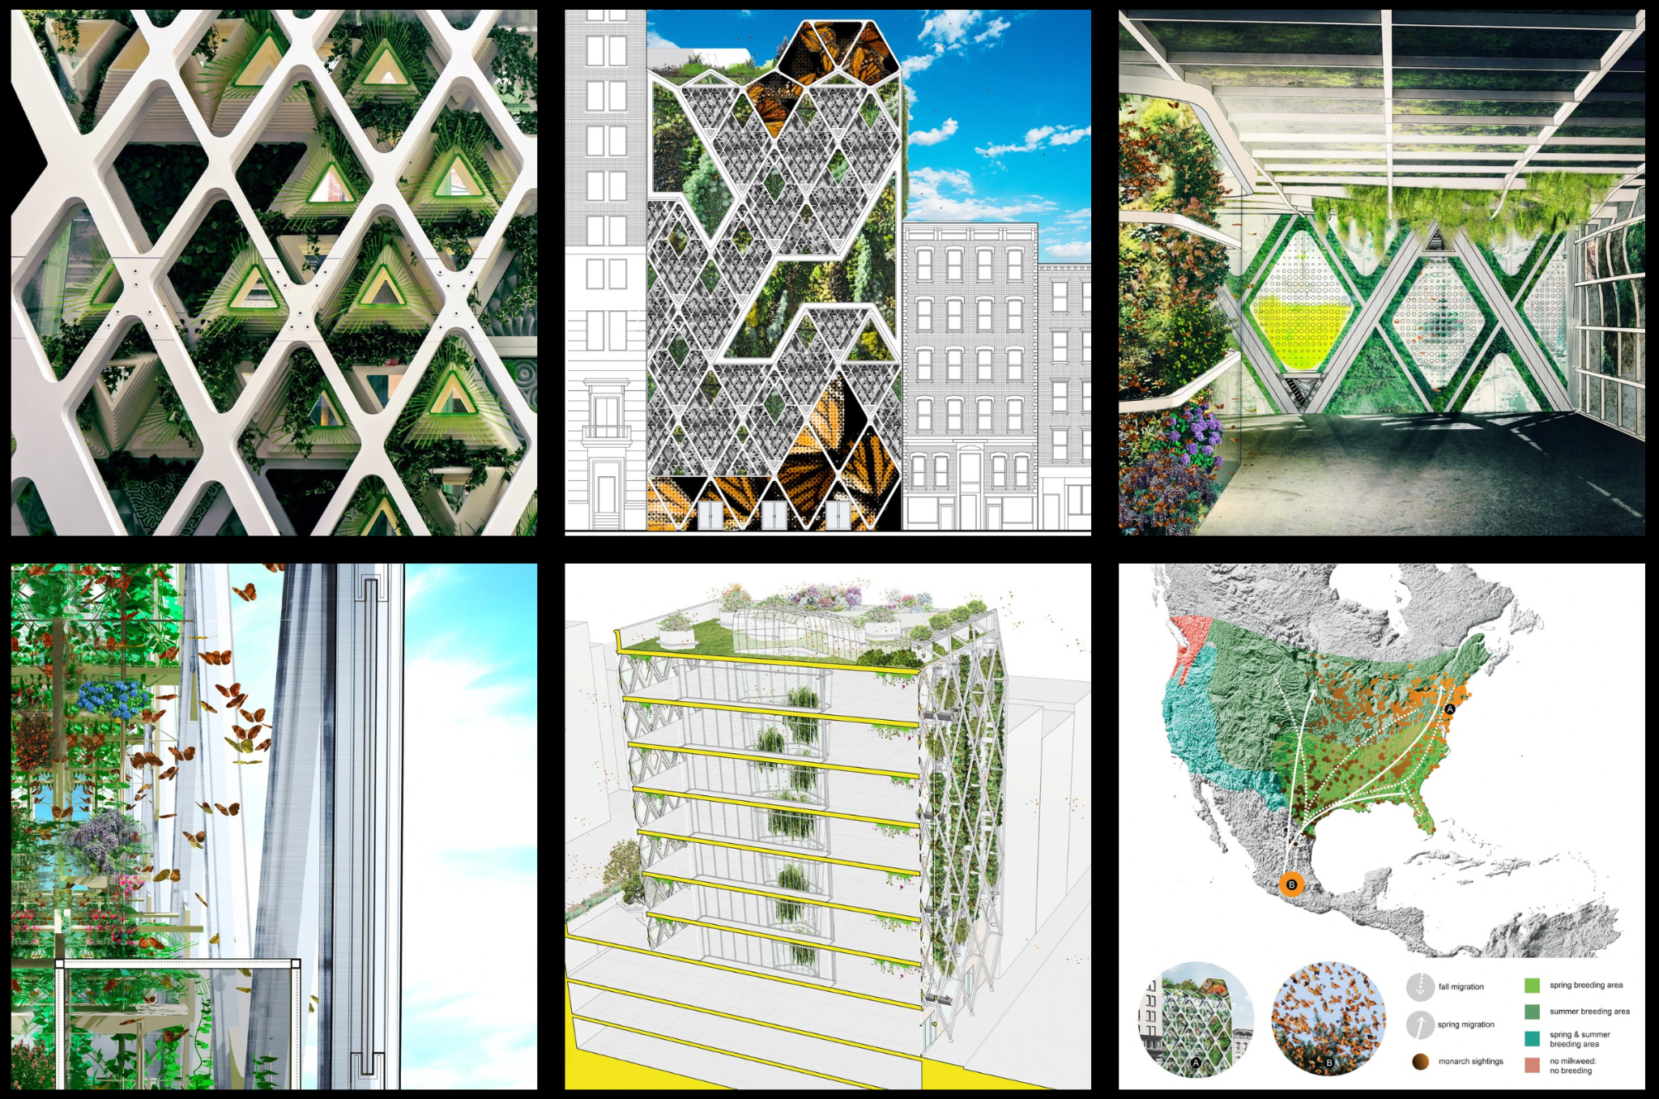
The Monarch Sanctuary (NYC), https://www.terreform.org/monarch-sanctuary

Slide 13
Value/need hierarchy
More-than-human actor: Egg-laying hens
Value/need
Animal welfare
Enough living space
Presence of laying nests
Litter
Perches
Design objectives
At least 450 cm2 floor area per hen
10 cm feeding trough per hen
40 cm height over at least 65 % of the area
Floor-slope of maximally 14 %
Design requirements
Example take from: van de Poel Ibo (2013). Translating Values into Design Requirements. In: Michelfelder D., McCarthy N., Goldberg D. (Eds.) Philosophy and Engineering: Reflections on Practice, Principles and Process. Philosophy of Engineering and Technology. Dordrecht: Springer.
Notes:
Let’s start with an example with a human stakeholder.
You are working on a project where you design living spaces for elderly.
The value “elderly autonomy” is identified as important to the stakeholders.
What are the goals and aims that you should strive for? How can these be formulated as design objectives and design requirements?

Slide 14
Value/need hierarchy
More-than-human actor:
Value/need
Design objectives
Design requirements
Value hierarchy worksheet developed by: van de Poel Ibo (2013). Translating Values into Design Requirements. In: Michelfelder D., McCarthy N., Goldberg D. (Eds.) Philosophy and Engineering: Reflections on Practice, Principles and Process. Philosophy of Engineering and Technology. Dordrecht: Springer.
Notes:
Create one or more value/needs hierarchies based on the values/needs identified in the more-than-human stakeholder analysis that you bring with you to this activity, or a design case provided by the teacher.
When you are done, present your value/need hierarchies and design requirements in class, and explicitly describe your value judgments and how they relate to stakeholders.

Slide 15
Assignment
Select one or more of the identified values/needs of a more-than-human actor that affect or are affected by your design (maybe from a stakeholder analysis that you have conducted in a previous teaching activity).
Develop a value/need hierarchy and construct design requirements based on more-than-human values and needs.
Use the worksheet: value-need_hierachy_worksheet.ppt
Meet back in the classroom in 1 h.

Slide 16
This teaching activity was developed as part of the MOVA project co-funded by the European Union. https://mova.uni.mau.se/
Disclaimer: Funded by the European Union. Views and opinions expressed are however those of the author(s) only and do not necessarily reflect those of the European Union or the European Education and Culture Executive Agency (EACEA). Neither the European Union nor EACEA can be held responsible for them.

