Slide 1
Introduction to more-than-human perspectives in technology design

Slide 2
Summary
An introduction to more-than-human perspectives in design, why it is important to work with these perspectives, and the key theory and terminology behind more-than-human perspectives in design.
Learning outcomes
Recognize themes and background theories related to more-than-human perspectives in technology design.
Describe core concepts associated with more-than-human perspectives in technology design.
Locate additional background theories related to some of the themes introduced.

Slide 3
Outline/Content
Responsibility in relation to the SDGs
What is more-than-human and some critical questions
Why work with more-than-human perspectives in design?
Theoretical groundings and central themes and methods

Slide 4
Key readings
Eriksson, Eva; Nilsson, Elisabet M.; Yoo, Daisy; and Bekker, Tilde (2024). More-than-Human Perspectives in Human-Computer Interaction Research: A Scoping Review. In Proceedings of the 13th Nordic Conference on Human-Computer Interaction (NordiCHI ’24). Association for Computing Machinery, New York, NY, USA, Article 72, 1–18. https://doi.org/10.1145/3679318.3685408

Slide 5
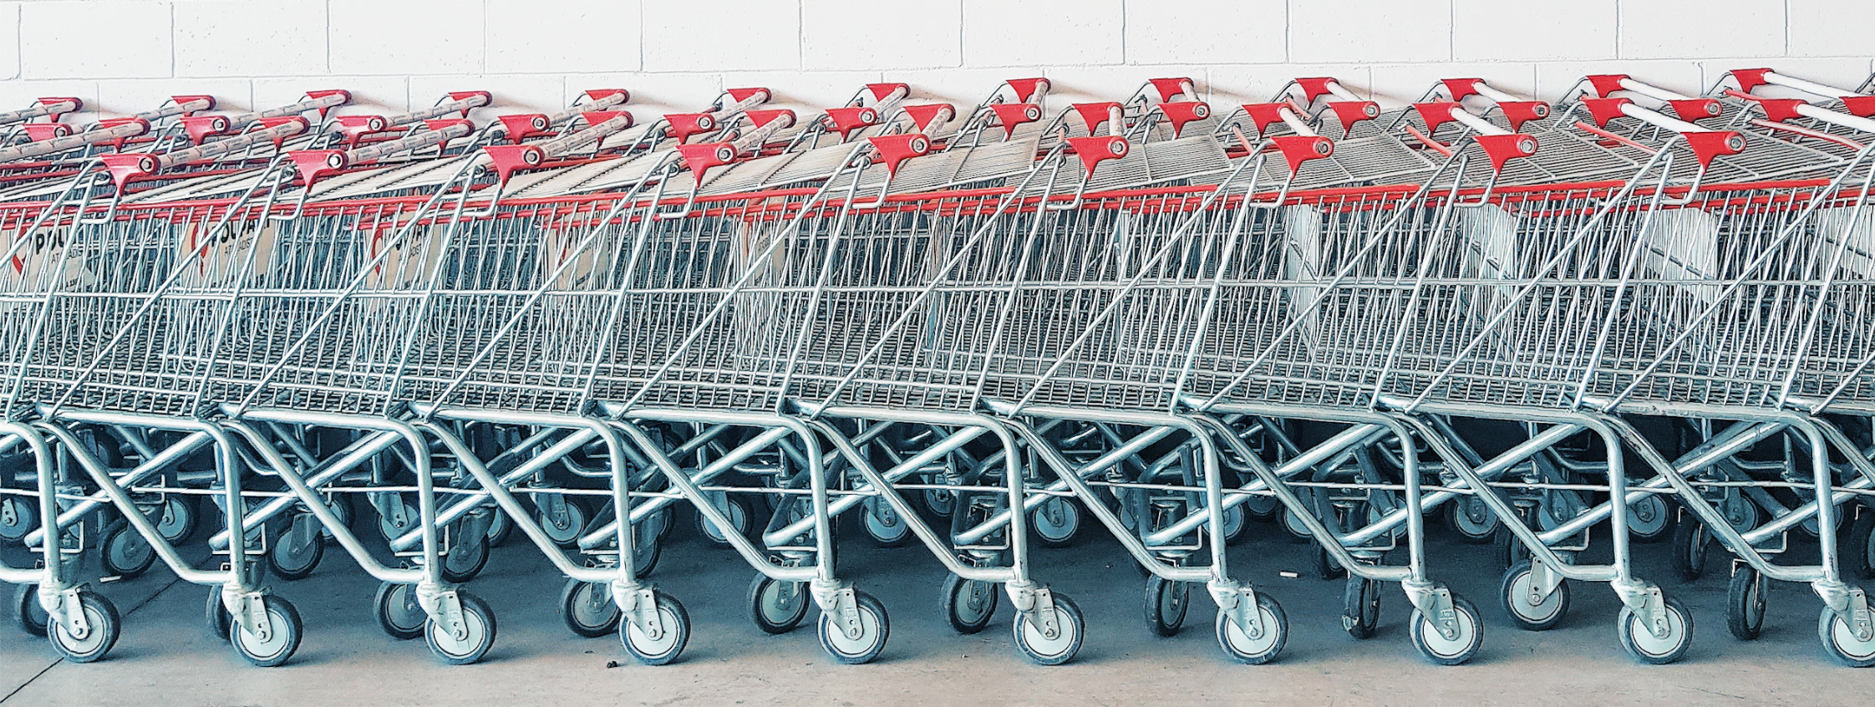
Your responsibility as a designer
Since the UN sustainability development goals (SDGs) consider the planet as well as people and profit, designers should make efforts towards including more-than-human perspectives in design. It matters what we design and how these designs shape our behaviors in relation to living sustainably on the planet. Designing with more-than-human perspectives in design go beyond the kind of human-centeredness that has been governing design so far.
Photo by: https://unsplash.com/photos/gray-and-red-metal-shopping-cart-lot-beside-wall-EDztlsQAEIY

Slide 6
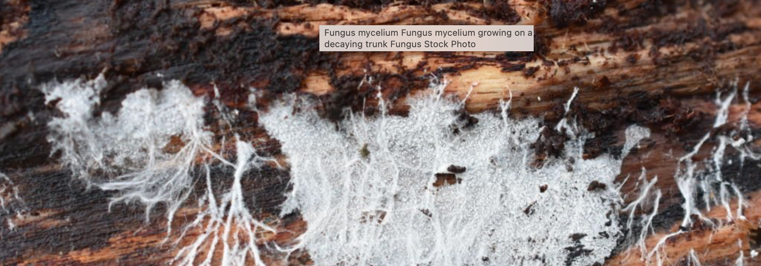
What is the more-than-human?
More-than-humans or the more-than-human is not well defined. It can be anything from other species to oceans, mountains, rivers, and fungi. However, it can also be robots and artificial intelligence – even spirits (understood from Indigenous Knowledge perspectives).
Photo by: Hhelene. https://www.istockphoto.com/photo/fungus-mycelium-gm1406195519-457835918

Slide 7
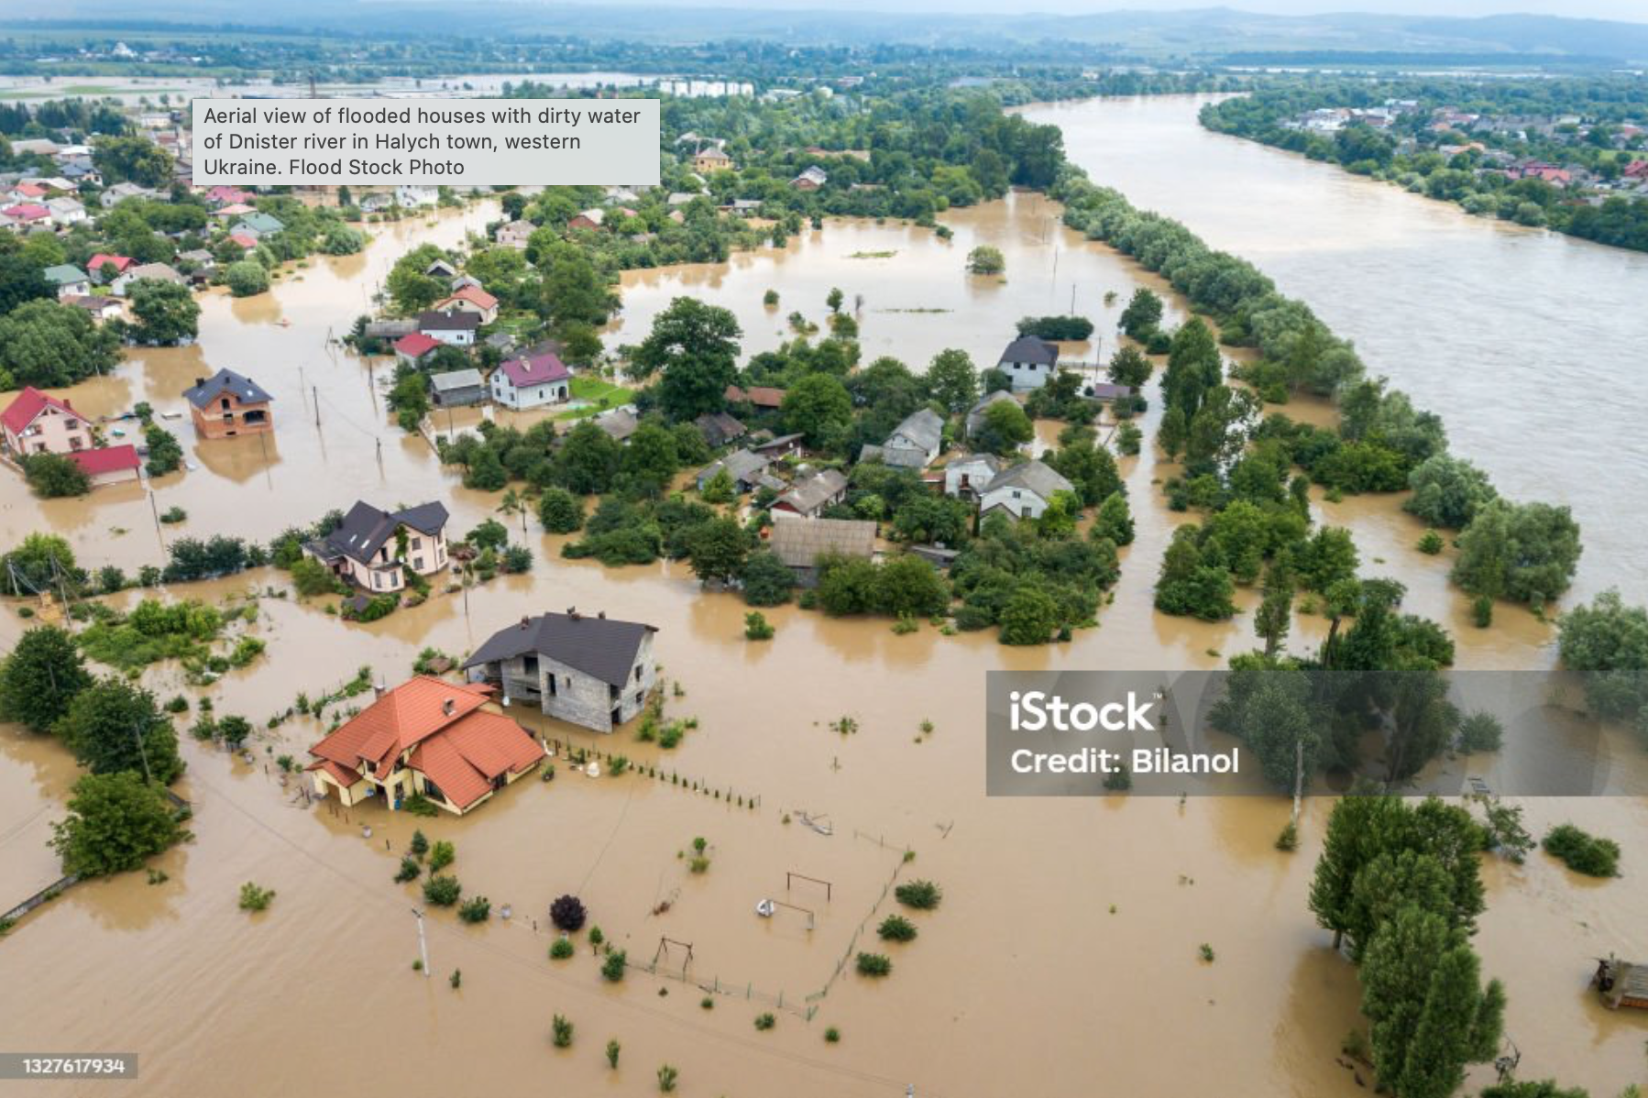
How can students in technology design educations work with more-than-human perspectives?
How might we apply a new repertoire of design methods in a time where multiple societal systems and structures will undergo radical changes because of the consequences of climate change?
Photo by: Bilanol. https://www.istockphoto.com/photo/aerial-view-of-flooded-houses-with-dirty-water-of-dnister-river-in-halych-town-gm1327617934-411923683

Slide 8
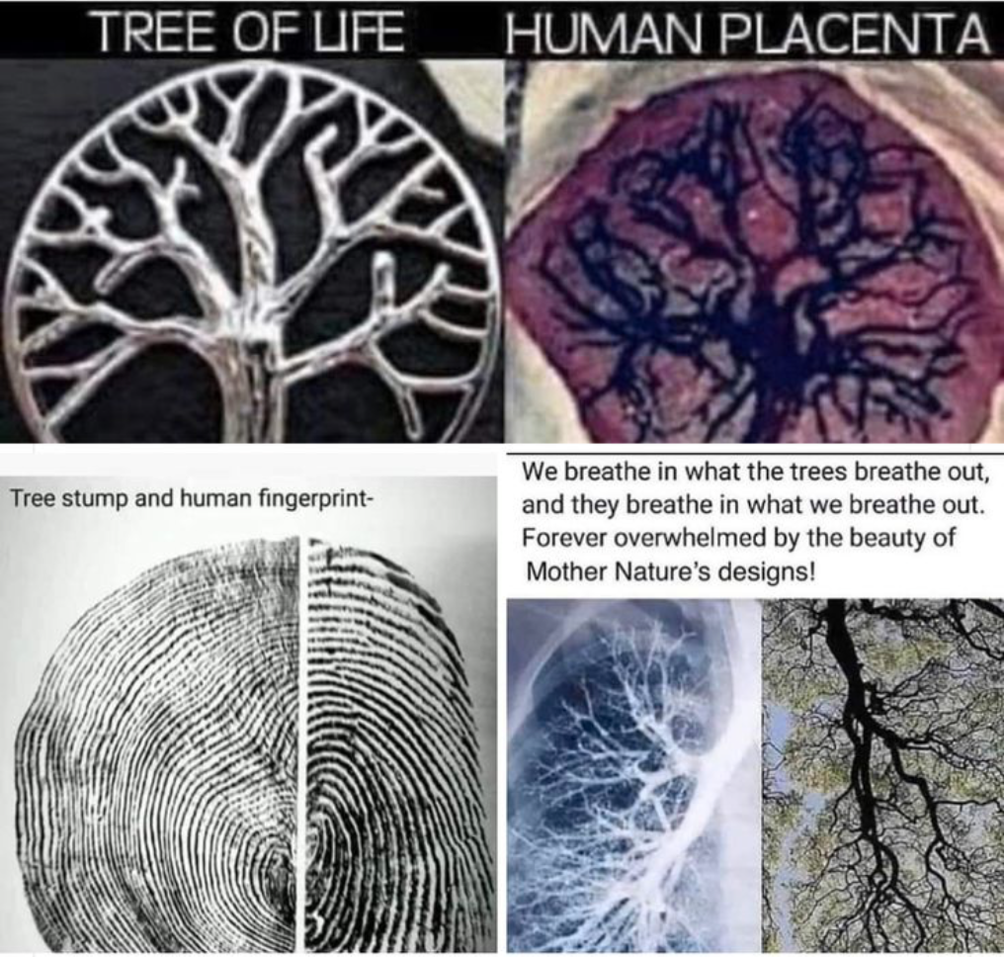
Photo by: Deirdre Dagostino. https://www.pinterest.com/pin/knowledge-is-power--355995545546763386/

Slide 9
Employing multiple kinds of knowledge - going beyond modern world-view & value systems
According to Arturo Escobar 2018, p. 95, the bifurcation of the following is a problem:
“Human and non-human, live (life/organic) and inert (matter/ inorganic), reason and emotion, ideas, and feelings, the real and its representations, the secular and the sacred or spiritual, what is alive and what is dead, the individual and the collective, science (rationality, universality) and non-science (belief, faith, irrationality, culturally specific knowledge), facts and values, form and content, developed and underdeveloped.”
Escobar, Arturo. 2018. Designs for the pluriverse – radical interdependence, autonomy, and the making of worlds. Duke University Press.

Slide 10
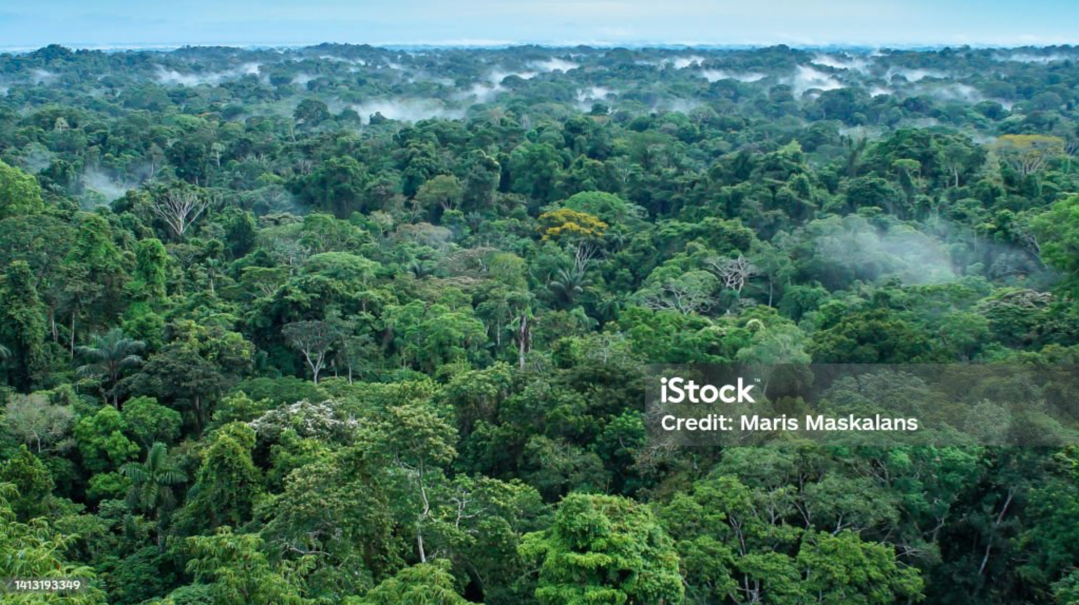
The issue of identifying more-than-human values …
How might we listen to the more-than-human and define what more-than-human perspectives and values are?
Photo by: Maris Maskalans. https://www.istockphoto.com/photo/beautiful-landscape-of-the-amazon-rainforest-yasuni-national-park-ecuador-gm1413193349-462350551

Slide 11
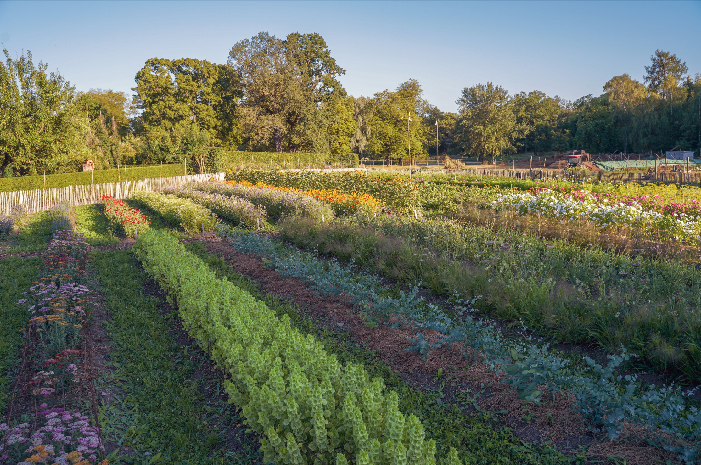
The issue of cultural appropriation
If Indigenous peoples have knowledge about living with ecological more-than-humans through traditional ecological knowledge (TEK),
How might we learn from each other across cultures in respectful ways?
This is an image of a permaculture garden. This way of growing food comes from indigenous farming practices.
Photo by: Wikimedia Commons. https://commons.wikimedia.org/wiki/File:Permaculture_DSC00722.jpg

Slide 12
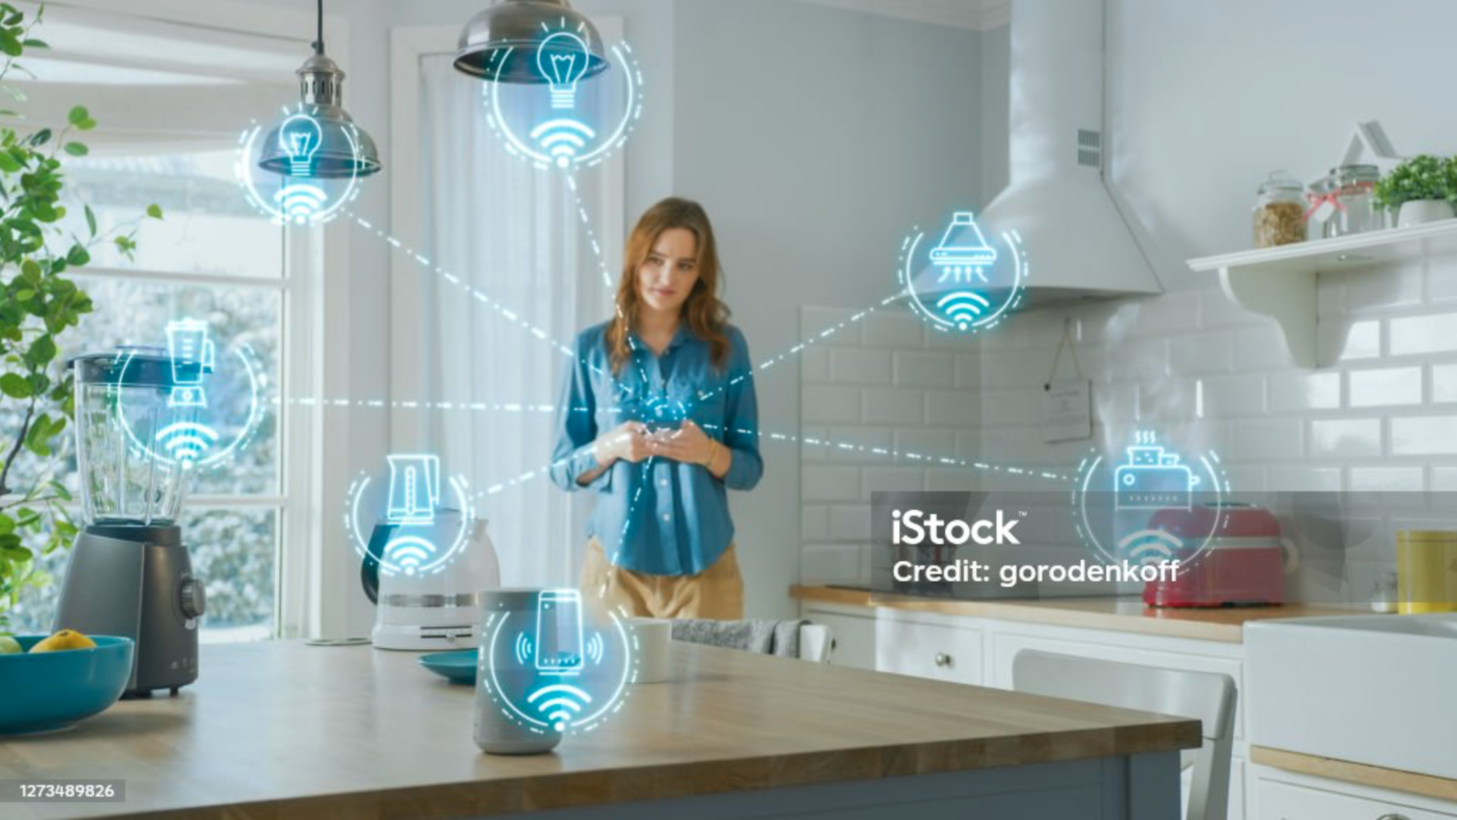
Criticism of technology designs for individual users
How might we design for/with collectives of humans and non-humans who live in networks with each other in web-of-life?
Photo by: gorodenkoff. https://www.istockphoto.com/photo/internet-of-things-concept-young-woman-using-smartphone-in-kitchen-she-controls-her-gm1273489826-375346539

Slide 13
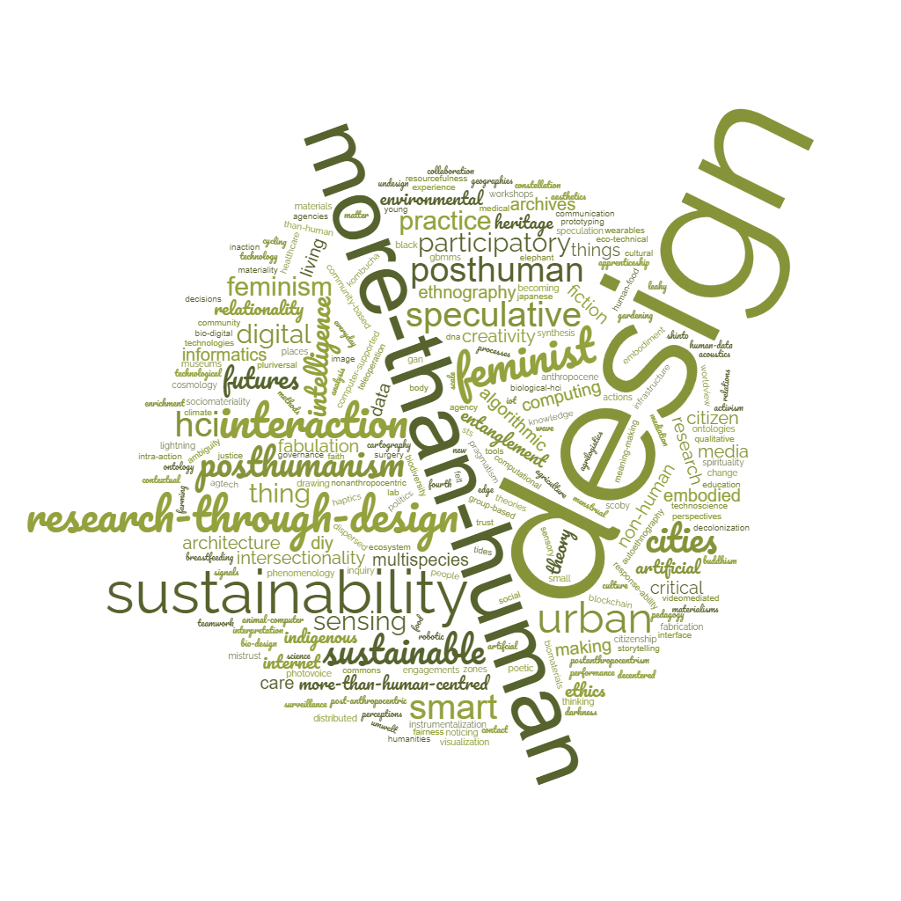
Themes
Some common themes inside
more-than-human perspectives
in design.
Photo by: the teachers who created the Open Educational Resource

Slide 14
Why work with more-than-human perspectives in HCI?

Slide 15
Why work with more-than-human perspectives in HCI?
Sustainability: majority of scholars working with MTH in HCI argue that they do it because they want to contribute to a more equal and just world for all life on the planet without putting unnecessary strain on the Earth’s supporting eco-systems.

Slide 16
Why work with more-than-human perspectives in HCI?
Sustainability: majority of scholars working with MTH in HCI argue that they do it because they want to contribute to a more equal and just world for all life on the planet without putting unnecessary strain on the Earth’s supporting eco-systems.
The time of the Anthropocene: there is an increased interest in technologies that strengthen relations with the environment. How might new technologies give a different understanding of and relationship with more-than-human worlds? What if we put the soil at the center of attention? Or water?

Slide 17
Why work with more-than-human perspectives in HCI?
Sustainability: majority of scholars working with MTH in HCI argue that they do it because they want to contribute to a more equal and just world for all life on the planet without putting unnecessary strain on the Earth’s supporting eco-systems.
The time of the Anthropocene: there is an increased interest in technologies that strengthen relations with the environment. How might new technologies give a different understanding of and relationship with more-than-human worlds? What if we put the soil at the center of attention? Or water?
IoT-AI: could they be less focused on human needs, but rather through a re-focus of data interactions put emphasis on how humans interact with their urban and natural environments – ecological actants (flora, fauna, climate)?

Slide 18
Why work with more-than-human perspectives in HCI?
Sustainability: majority of scholars working with MTH in HCI argue that they do it because they want to contribute to a more equal and just world for all life on the planet without putting unnecessary strain on the Earth’s supporting eco-systems.
The time of the Anthropocene: there is an increased interest in technologies that strengthen relations with the environment. How might new technologies give a different understanding of and relationship with more-than-human worlds? What if we put the soil at the center of attention? Or water?
IoT-AI: could they be less focused on human needs, but rather through a re-focus of data interactions put emphasis on how humans interact with their urban and natural environments – ecological actants (flora, fauna, climate)?
Representation: how might more-than-human stakeholders be represented through data in technologies and through designs that we interact with at a daily basis? What if designs were animal centered instead if human centered?

Slide 19
Even more reasons to work with more-than-human perspectives in HCI

Slide 20
Even more reasons to work with more-than-human perspectives in HCI
Technology: how might we explore technologies themselves as a more-than-human things? Investigations of data-driven patterns to understand complex relations and entanglements between humans and more-than-human things in the design of IoT ecosystems. This to get a better idea of:
How might we develop meaningful, ethical, socially and environmentally sustainable technologies? (Considering AI, machine learning, robotics and automation).

Slide 21
Even more reasons to work with more-than-human perspectives in HCI
Technology: how might we explore technologies themselves as a more-than-human things? Investigations of data-driven patterns to understand complex relations and entanglements between humans and more-than-human things in the design of IoT ecosystems. This to get a better idea of:
How might we develop meaningful, ethical, socially and environmentally sustainable technologies? (Considering AI, machine learning, robotics and automation).
Body: becoming more aware of the co-constructive role of non-human aspects in human and more-than human lives. By focusing on the sensing body and how we feel, we might develop subjective accounts of what it means to be entangled in different ways. Understanding what technologies can sense and make sense of. Finding new ways of conceptualizing bodies as performative, sensing, datafied, intersectional and more-than-human entities.

Slide 22
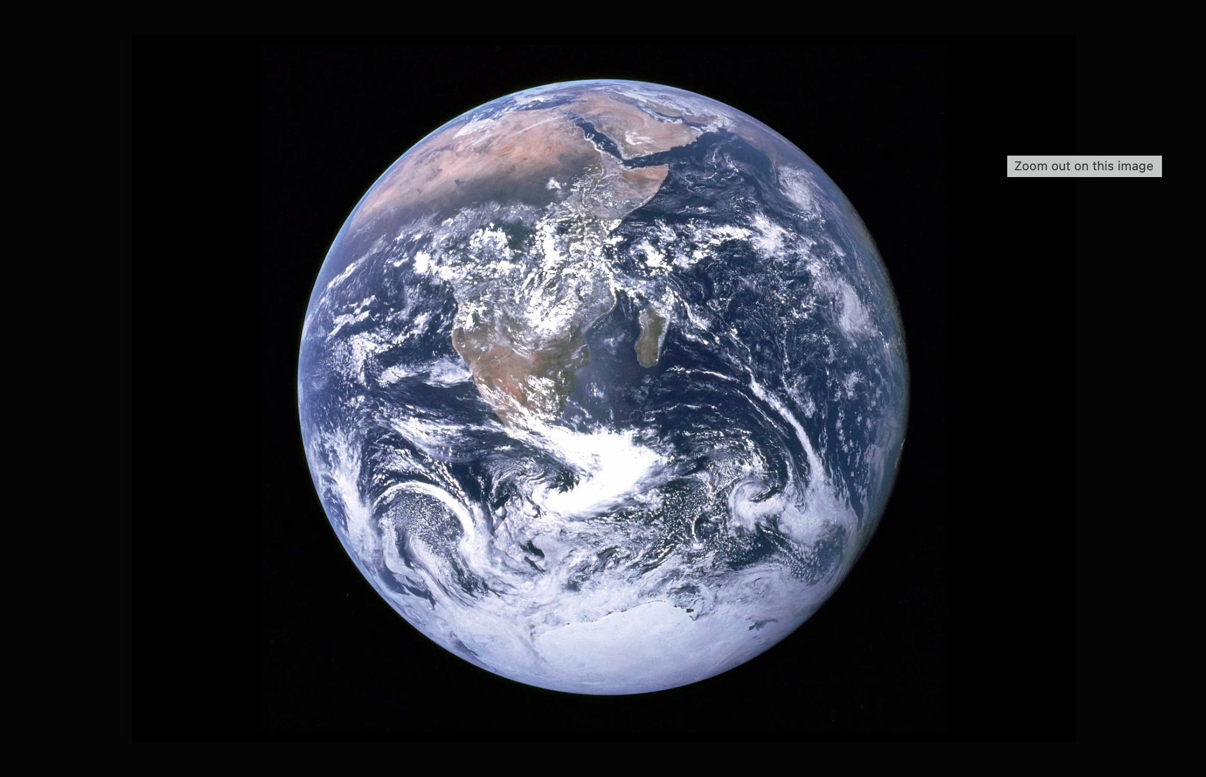
Theoretical groundings working with
more-than-human perspectives
How might we approach and engage with more-than-human stakeholders including technologies in the time of the Anthropocene?
Photo by: Nasa. https://unsplash.com/photos/earth-with-clouds-above-the-african-continent-vhSz50AaFAs

Slide 23
Feminism
Rejection that science is value free, commitment to empirical accounts of human experience, commitment to gender, drawing on knowledge of pragmatism, decolonization, posthuman feminism, and Indigenous Knowledge.
Themes and methods: human-nature interactions mediated by technologies, co-designing with more-than-humans, care narratives: caring for ecological or technological existences, making-as-knowing approaches, awareness towards tensions in representation, legitimization, unseen labor, material narratives.

Slide 24
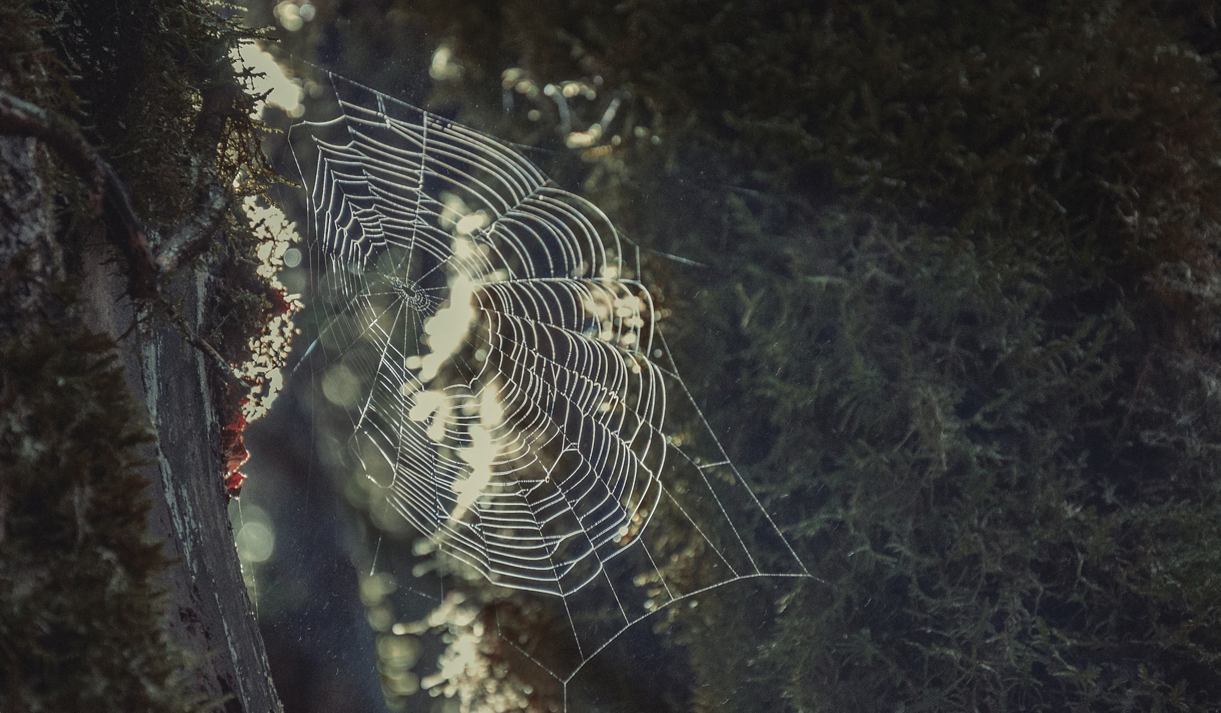
Understanding different kinds of human/more-than-human entanglements
How might we become aware of and get a sense of the more-than-human stakeholders that we are surrounded by?
And how might we understand the ways in which we are entangled with more-than-human stakeholders in the eco- or technology systems that we are part of?
Photo by: Ola Noland. https://unsplash.com/photos/a-spider-web-hanging-from-the-side-of-a-tree-pCyNx4gjkmE

Slide 25
(Post)phenomenology
Different waves of HCI:
user to body: emphasizing the corporeal situatedness of the ’user’
body to bodies (UbiComp): reaching a plural form of bodies
bodies to more-than-human bodies: complexifying composition of ’bodies’ so that they already comprise more-than-human elements.
Themes and methods: (auto-)ethnography. Designers sensitize themselves to bodily experiences to feel, sense and empathize with the more-than-humans they interact with. In this way designers might relate to the inner state of the more-than-human who they interact with. The aim is to uncover entanglements of humans and more-than-humans.

Slide 26
When integrating
new technologies
in ecological
environments
How might organic and technological
non-human life play a role in
entanglements with humans
and ecological environments?
What are the benefits and
consequences?
Photo by: Nils Jacobi.
https://www.istockphoto.com/photo/cat-gps-tracker-gm1201055972-344274266

Slide 27
New materialism
New materialism: New-materialist philosophy covers organic non-human life, geological foundations of living matter, and technological mediation.
Themes and methods: surveillance technologies and how they are designed to have a reductive and exclusionary vision of othering with consequences of for example racism. How communities negotiate interconnected and intersectional forms of safety. Critical perspectives on how we use non-human-life in ways that influence human lives and more-than-human lives.

Slide 28
Donna Haraway’s concept
“nature-cultures”
How might we create living habits that acknowledge our entanglements with ecological environments?
Photo by: Spencer Watson. https://unsplash.com/photos/aerial-photography-of-beach-shore-during-daytime-ioy3bN5Irew

Slide 29
Environmental humanism
Addressing the human exceptionalism narrative which originates from the Western dualist philosophical tradition. Cartesian dualism such as fact/fiction, culture/nature, human/nonhuman, body/soul makes it challenging to consider entanglements between human and non-human worlds. For example: consider Donna Haraway’s concept of ”nature-cultures”.
Themes and methods: speculative design, more-than-human world-making practices, speculative fabulations drawing on environmental humanities and their ludic, aesthetic/artful approaches.
Speculative fabulations are introduced in participatory design processes through embodied and material storytelling that probes more-than-human imaginaries. Imagine how post-anthropocentric cities will be like with entanglements of humans and more-than-humans and future multispecies cohabitations.

Slide 30
Linking human and non-human worlds
How might we establish
connection with non-human
worlds that influence
how we live?
And where humans are not
the center of attention?
Photo by: Nicholas Rhodes. https://unsplash.com/photos/woman-in-black-jacket-standing-on-brown-tree-log-in-forest-during-daytime-uGYRKtUT8uc

Slide 31
Posthumanism
Overcoming problematic narratives of human privilege and exceptionalism, posthumanism explores post-human and more-than-human designs and considers the entanglements between human and non-human worlds. This is related to feminism approaches and environmental humanism.
Themes and methods: posthumanism design and research regarding representationalism, legitimization, unseen labor, dualistic material narratives, pluriversal design agendas. Methods evolve around uncovering the grand narratives where humanism is in the center of attention.

Slide 32
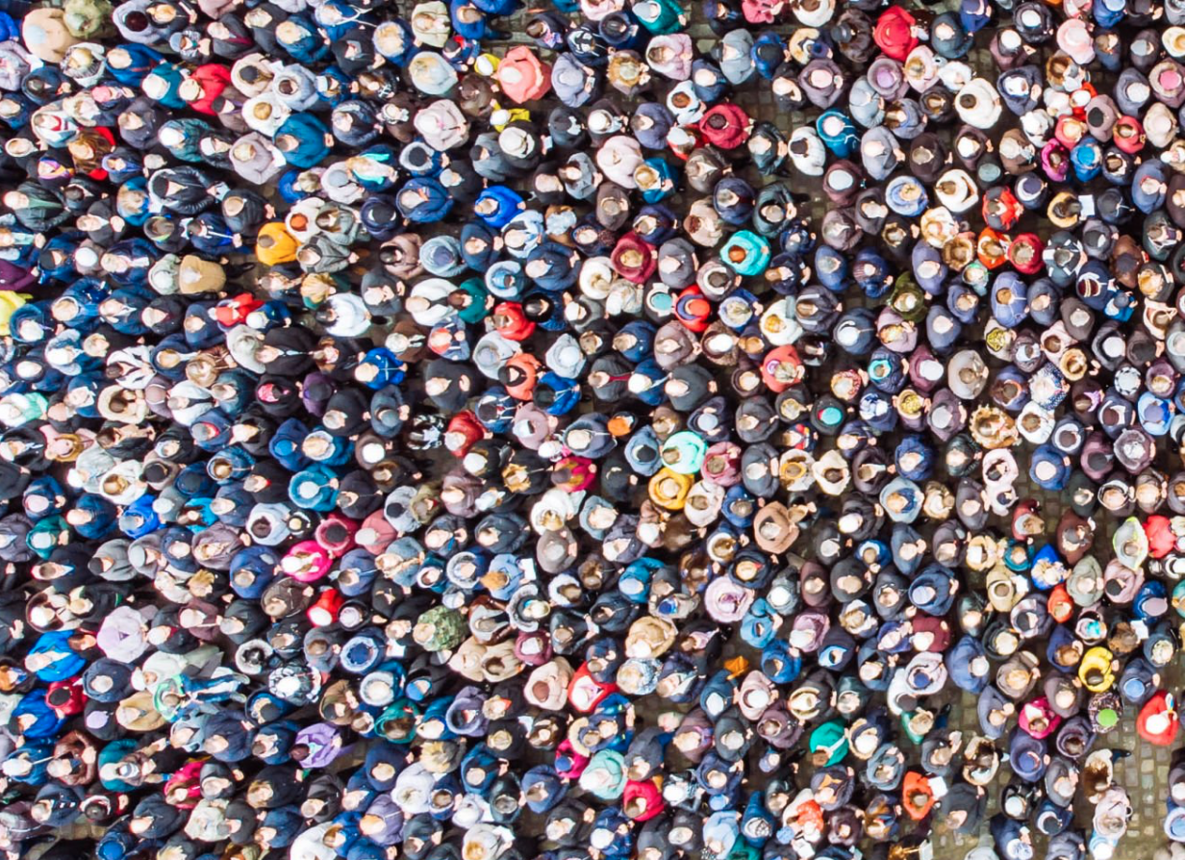
What happens when decentering the
human viewpoint?
How might we conceive of humans and ‘the human’ from other points of view?
Photo by: Vera Petrunina. https://www.istockphoto.com/photo/above-view-on-crowd-big-amount-of-people-gm1058709228-282956762

Slide 33
Object-oriented ontologies
Object-oriented ontologies (OOO): everything should be considered an object. This leads to decentering the human viewpoint. Argument: human minds and bodies are not the only actants (playing a role) worth considering. OOO offers a flat ontology perspective where all human and nonhuman actants – people, objects, and the natural world – are given equal consideration within the design assemblage (situation where several actants play a role).
Themes and methods: critique of actants that operate within independent perspectives, even though they are interrelated. Imagining more-than-human sustainable futures that go beyond considering only humans. Considerations include both the technological and the ecological (flora, fauna, climate). Mapping more-than-human stakeholders and how they are entangled.

Slide 34
References
Eriksson, Eva; Nilsson, Elisabet M.; Yoo, Daisy; and Bekker, Tilde (2024). More-than-Human Perspectives in Human-Computer Interaction Research: A Scoping Review. In Proceedings of the 13th Nordic Conference on Human-Computer Interaction (NordiCHI ’24). Association for Computing Machinery, New York, NY, USA, Article 72, 1–18. https://doi.org/10.1145/3679318.3685408

Slide 35
This teaching activity was developed as part of the MOVA project co-funded by the European Union. https://mova.uni.mau.se/
Disclaimer: Funded by the European Union. Views and opinions expressed are however those of the author(s) only and do not necessarily reflect those of the European Union or the European Education and Culture Executive Agency (EACEA). Neither the European Union nor EACEA can be held responsible for them.

